Slide 1
Quote of the month:
We own retention…
“The retention mission of the commissioner corps is best achieved by providing an adequate number of trained unit commissioners who provide a link to district committee resources in support of a quality unit program.”
Tico Perez
Notes:
It is a lot easier to improve and keep a unit than it is to start a new one.
You can make the difference by supporting unit growth in the Journey to Excellence criteria, linking district committee resources to meet the unique needs of each unit you serve, visiting those units and logging the visits with UVTS, and supporting on-time charter renewal.

Slide 2
COMMISSIONER Training Updates

Slide 3
October 12, 2013 Indiana, PA
SAVE THE DATE!

Slide 4
3-Year Plan
• Fall 2013 District Leadership Conference Run by LHC Commissioners
Spring 2014 Combine DLC with UofS Cabinet & TDC joint ownership
Spring 2015 Run by Area 4 leadership

Slide 5
BASIC TRAINING
• February 23, 2013 – Area 1 8:30 AM @ Lebanon Presby Church
• April 20, 2013 – Area 3
• June 15, 2013 – Area 6

Slide 6
2013-2014 TRAINING PLAN
• Assignments
Roundtable Commissioner Basic
New Unit Commissioner Basic
Other Needs?
Notes:
Roundtable/Forum guides being updated
Title change approved by Exec Board (ACC & ADC & staff to be Asst RT)
Program issues that require additional review by Volunteer & Youth Development teams
Committee meets again in February
Rollout – May 2013

Slide 7
PTC (Philmont Training Center) Week 3: June 23-29

Slide 8
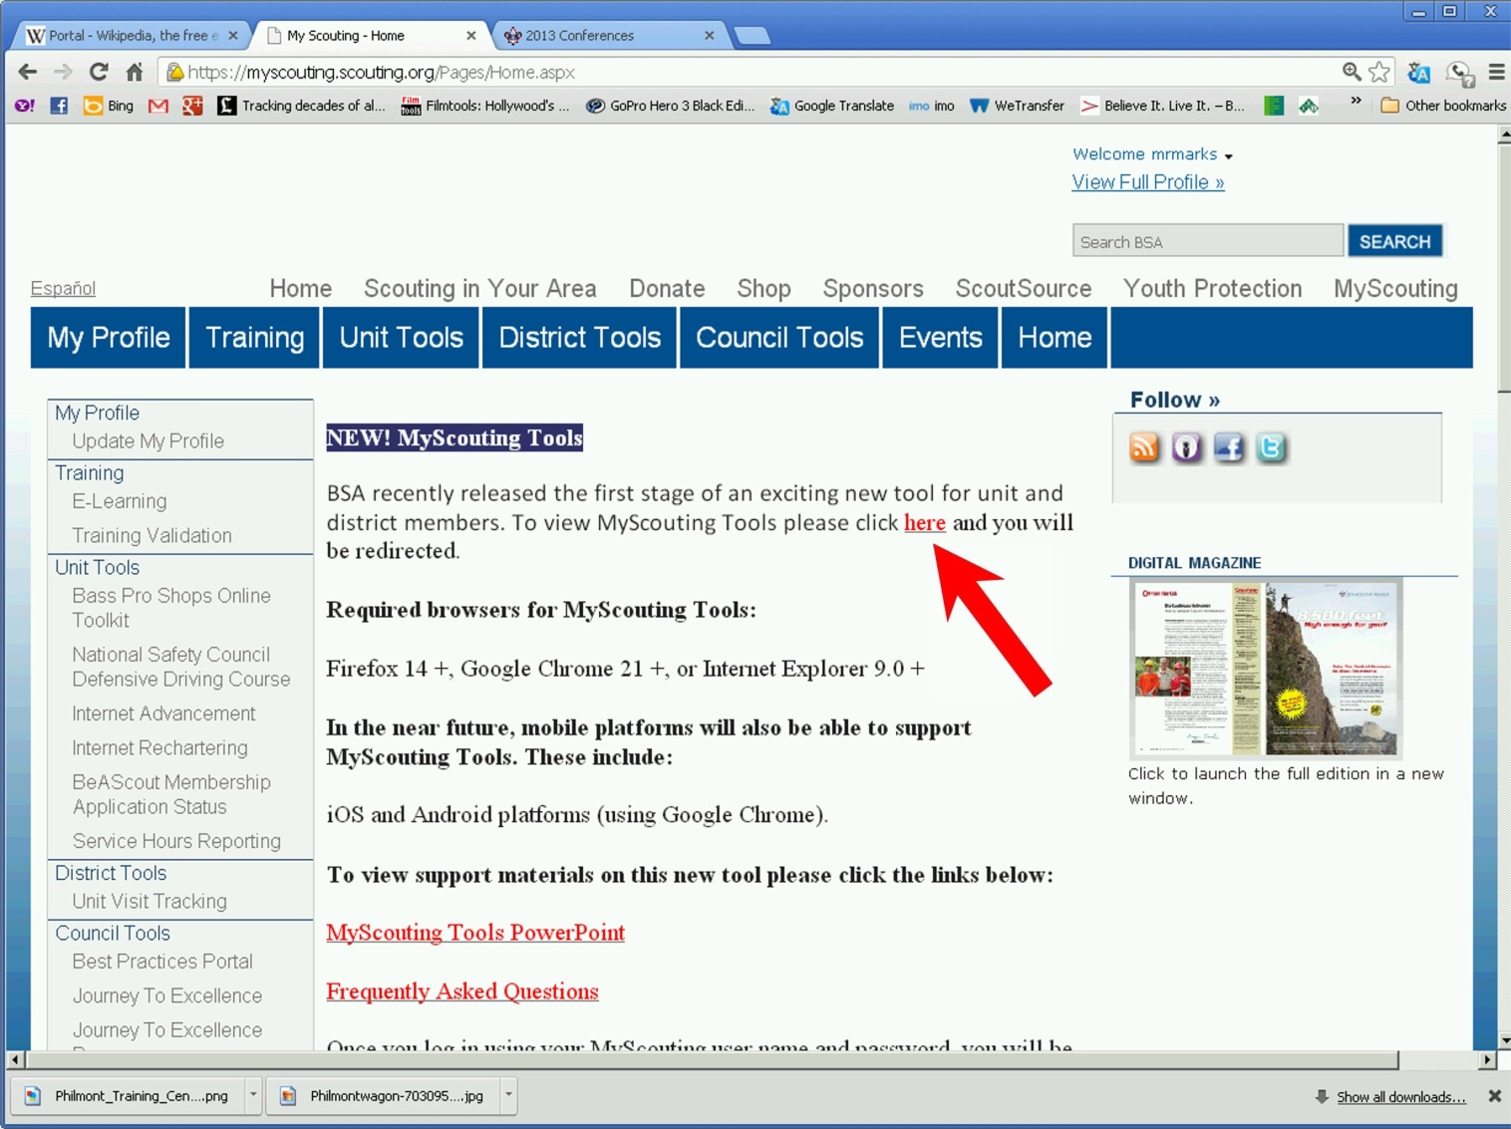
MyScouting UPDATE
8

Slide 9
MyScouting UPDATE
9

Slide 10
Webelos-To-Scout
Did anyone use the resources?!
Or talk to their Boy Scout Units?
What were the results?

Slide 11
COMMISSIONER CABINET
Monthly Training

Slide 12
Steve Deemer District Commissioner
VOICE OF THE SCOUT
Fall Update

Slide 13
Voice of the Scout
What it is NOT!
Just another survey
A way for people to complain
Something to be ignored
Going away…
Notes:
JTE & VOS is not going away!
BSA has a lot invested in this process.
It makes sense. It can (will) drive change!

Slide 14
Voice of the Scout
What is it?
Newest (and final) Component of JTE
Stakeholder feedback (Scout, Scout Parent and Volunteer)
Quantitative & Qualitative Data used to affect change!
Notes:
Comprehensive Scout, Parent, Volunteer and Charter Org membership feedback program
System to continuously assess how well we are delivering the Scouting experience over time

Slide 15
Qualitative Data
Verbatim Comment
“We have so much fun. I slept at a
zoo overnight, went camping in a
cabin and now I get to go
camping in a tent. I love earning
belt loops, too. It's fun.” Cub Scout
Notes:
(1 minute): What Information VOS will give
In addition to answering questions by ranking numerically how much you agree with a driver question, the participant will have the opportunity to respond with a verbatim answer. This is an example of what that might look like.

Slide 16
Quantitative Data
If asked, how likely are you to recommend Scouting to a friend?
Unit NPS
District NPS
Notes:
(2 minutes)What Information VOS will give results from numeric questions.
The first question will always be a loyalty question—if asked, how likely are you to recommend Scouting to a friend?

Slide 17
Quantitative Data
Cub Scouting is really fun.
Attending roundtables helps me become a more effective leader.
Scout meetings are a good use of my son’s time
I have the tools & resources to be an effective leader.
Loyalty (NPS)
Driver
Driver
Driver
Driver
Driver
Driver
Driver
Notes:
(2 minutes)
The next series of questions called “drivers” try to determine why a respondent replied as they did.
There are some sample driver questions

Slide 18
Quantitative + Qualitative = Opportunity for Change
Notes:
(1 minute) When the quantitative data and the qualitative data support one another, it indicates that there is an opportunity for change. The JTE scores should also validate that. And that’s where the Unit Commissioner comes in.
Troop – more Older Boy programs
Pack – more outdoor activities

Slide 19
Voice of the Scout
How is the VOS measured?
VOS Uses the Net Promoter Score (NPS) approach as the key metric.
NPS is captured by one question that demonstrates member LOYALTY.
Notes:
Expands upon traditional “satisfaction surveys” approaches
Uses “Net Promoter Score” methodology NPS is a measure of customer loyalty
Note corporations that use the NPS method…

Slide 20
Net Promoter Score: Basic Components
i.e. N=100 10% NPS 30% promoters 20% detractors
(response rate) (30 people chose 9-10) (20 people chose 0-6)
Notes:
(3 minutes): How VOS Works
Key Question – “How likely is it that you would recommend the Boy Scouts to a friend or colleague?”
Responder gives score from 10 (best) to 0
Depending on how they answer, they belong to certain groups –
9-10 – Promoters
7-8 – Passives
0-6 – Detractors
Net Promoter Score - Promoters minus Detractors—the Passives don’t count.
Corrected to represent 100 responses
Top score is 100 – worst is minus 100

Slide 21
Why Using NPS Makes Sense
Proven methodology
Easy to use & understand
Easy to communicate
Action oriented
Simple for respondent
1 Loyalty Question
7 Driver Questions
Open comments
Loyalty (NPS)
Experience
Driver
Experience
Driver
Experience
Driver
Experience
Driver
Experience
Driver
Experience
Driver
Experience
Driver
Notes:
Seven Driver Questions are tailored for each audience (parents, Scout groups, volunteers groups, chartering organizations). Driver questions will give insight on if experiences are positive or negative based on program design or operational delivery. They help answer “why” a person gave a particular NPS rating.
Key Points:
EASY TO MEASURE: By focusing on one question that defines what a loyal customer is, it streamlines the way results are communicated.
EASY TO UNDERSTAND FEEDBACK: Responses are placed into three responder groups that make intuitive sense for management and leaders to address: Promoters, Passives and Detractors.
ACTION-ORIENTED: Seeing metrics and trends within the three responder categories offers a way to see if solutions are impactful, with the intent to move people away from being detractors into being promoters.
CUSTOMER-FOCUSED: Improvement becomes directed to what actually matters to the customer, which keeps attention on the right stuff!

Slide 22
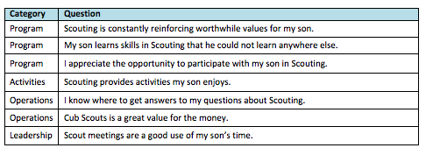
NPS + DRIVERS = Voice of the Scout
Driver questions have been statistically validated so we understand
What drives loyalty for each audience segment.*
Driver Questions Sample
Notes:
Key Points:
Most successful NPS programs today supplement the NPS/Loyalty question with additional “driver” questions.
For Scouting, driver questions have been developed for each of the 7 segment audiences that isolate their unique expectations of Scouting.
These driver questions are aligned with larger strategic themes that exist within the broader Journey to Excellence system (ie questions that address programs, activities, operations and leadership)
All questions have been pre-validated in testing done this past spring and during our VOS pilot survey program early this summer.

Slide 23
Voice of the Scout
Unit Commissioner Role
TODAY:
Encourage unit participation
Remind units to provide e-mail addresses
(NEAR) FUTURE:
Interpret results to Unit Key 3
Coach unit to make changes

Slide 24
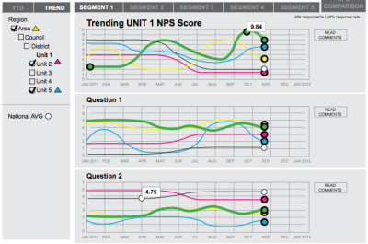
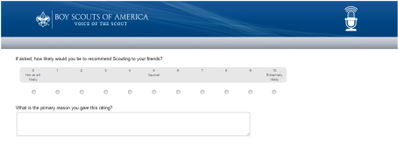
SURVEY
COMMUNICATE
RESPOND
Interpret data
Guide and coach
action
Monitor results
Email invitations sent
To stakeholders at maximum of once every six months.
VOS results sent to UC and Unit Key 3 by email in advance of Unit Key 3 meeting
Report action plan to district and report progress and results through UVTS
Notes:
Commissioner (2 minutes): This is what it will look like for the Unit and the Unit Commissioner. Invitations to participate will be sent twice a year. The anonymous results will be collated and analyzed by national and reach the Unit Commissioner via his/her District Commissioner. The Unit Key 3 will receive theirs through the District Committee. Everyone will receive their copy of the report individually and prior to the Unit Key 3 meeting that the Unit Commissioner will set up. The Unit Commissioner will facilitate the meeting where he/she will interpret the data, guide and coach action to meet customer satisfaction. The Unit Commissioner will then report that plan to his District Commissioner and look for ways to link District Resources to the Unit. He/she will also look for those actions to be implemented when he/she does the regular unit visits. And, of course, it will be reported in UVTS

Slide 25
LHC Net Promoter Scores
As of 12/14/12

Slide 26
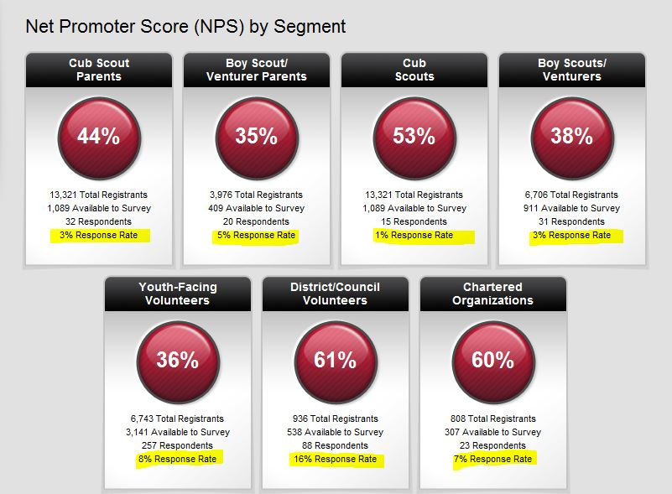
LHC Net Promoter Scores (cont)

Slide 27
Boy Scout/Venturing Youth

Slide 28
Boy Scout/Venturing Youth

Slide 29
Boy Scout/Venturer Parents

Slide 30
Boy Scout/Venturing Parents

