Slide 1
WELCOME Commissioner Role in JTE and Voice of the Scout Originally presented at the 2012 National Annual Meeting

Slide 2
Steps for a Unit Commissioner in Journey to Excellence
National Updates and publishes this year’s standards
Unit uses JTE standards for their annual Action Planning and Program Planning – reminded and supported by UC
Unit reviews performance on JTE monthly/quarterly – supported by UC
UC makes regular contact, records in UVTS for UC benefit
Unit annual JTE performance is assessed at rechartering – supported by UC. Awarded Gold, Silver, Bronze
Unit is presented JTE recognition – by UC
CONTINUOUS IMPROVEMENT is a key part of JTE

Slide 3
Newest Component of JTE: Voice of the Scout
Notes:
Commissioner (2 minutes): Voice of the Scout is the final component of Journey to Excellence. You are all familiar with Journey to Excellence—it has been in place for a year now. Voice of the Scout is the feedback mechanism that will provide guidance to unit leadership as they build a better unit. The Unit Commissioner has a vital role to play in this process.
Voice of the Scout – What is it?
It’s a survey:
It is a Stakeholder (Scout, Scout Parent and Volunteer) assessment survey
It asks Questions to determine stakeholder satisfaction and reveals areas for improvement
It will ask stakeholders to participate twice per year. The requests will come by e-mail to all stakeholders, their response is electronic and anonymous.
Responses are collated and analyzed by National
Presented locally at 3 levels
Unit, District, Council
Response and action at all levels based on VOS information
Optional 2012, Used Nationally 2013

Slide 4
Voice of the Scout – What is it?
Stakeholder (Scout, Scout Parent and Volunteer) assessment survey
Questions to determine stakeholder satisfaction and areas for improvement
Optional 2012, Used Nationally 2013

Slide 5
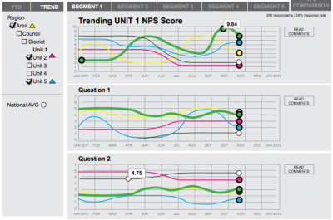
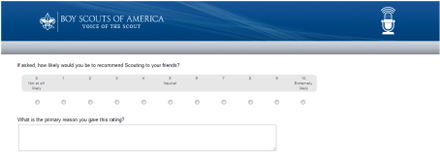
SURVEY
COMMUNICATE
RESPOND
Interpret data
Guide and coach
action
Monitor results
Email invitations sent
To stakeholders at maximum of once every six months.
VOS results sent to UC and Unit Key 3 by email in advance of Unit Key 3 meeting
Report action plan to district and report progress and results through UVTS
Notes:
Commissioner (2 minutes): This is what it will look like for the Unit and the Unit Commissioner. Invitations to participate will be sent twice a year. The anonymous results will be collated and analyzed by national and reach the Unit Commissioner via his/her District Commissioner. The Unit Key 3 will receive theirs through the District Committee. Everyone will receive their copy of the report individually and prior to the Unit Key 3 meeting that the Unit Commissioner will set up. The Unit Commissioner will facilitate the meeting where he/she will interpret the data, guide and coach action to meet customer satisfaction. The Unit Commissioner will then report that plan to his District Commissioner and look for ways to link District Resources to the Unit. He/she will also look for those actions to be implemented when he/she does the regular unit visits. And, of course, it will be reported in UVTS

Slide 6
Key players in Unit VOS
The Unit Key 3
Charter Organization Rep (IH)
Unit Leader
Unit Committee Chair
VOS results are shared in a meeting
with ALL of the Unit Key 3
The Unit Commissioner facilitates this meeting
Notes:
Commissioner (2 minutes): The Unit Key 3 is a relatively new concept. It is included in the New Unit Organization Plan and there is a full description of it in the Unit Performance Guide which is located on the national website. But a quick overview is that its members are the COR (or in the case of a missing COR, the IH), the Unit Leader and the Unit Committee Chair. It functions like any other Scouting Key 3 on behalf of the unit. Occasionally and certainly when reviewing the Voice of the Scout results, the Unit Commissioner will meet with them but is not a member of the Unit Key 3. It is at these two meetings a year—the Action Planning Meeting and the Mid-Charter Review Meeting—where the results of the VOS surveys are dealt with at the unit level.

Slide 7
Net Promoter Score: Basic Components
i.e. N=100 10% NPS 30% promoters 20% detractors
(response rate) (30 people chose 9-10) (20 people chose 0-6)
Notes:
Operations (3 minutes): How VOS Works
Key Question – “How likely is it that you would recommend the Boy Scouts to a friend or colleague?”
Responder gives score from 10 (best) to 0
Depending on how they answer, they belong to certain groups –
9-10 – Promoters
7-8 – Passives
0-6 – Detractors
Net Promoter Score - Promoters minus Detractors—the Passives don’t count.
Corrected to represent 100 responses
Top score is 100 – worst is minus 100

Slide 8
Quantitative Data
Cub Scouting is really fun.
Attending roundtables helps me become a more effective leader.
Scout meetings are a good use of my son’s time
I have the tools & resources to be an effective leader.
Loyalty (NPS)
Driver
Driver
Driver
Driver
Driver
Driver
Driver
If asked, how likely are you to recommend Scouting to a friend?
Unit NPS
District NPS
Notes:
Operations (2 minutes)What Information VOS will give results from numeric questions.
The first question will always be a loyalty question—if asked, how likely are you to recommend Scouting to a friend?
The next series of questions called “drivers” try to determine why a respondent replied as they did.
There are some sample driver questions and the complete set is on Scouting.org

Slide 9
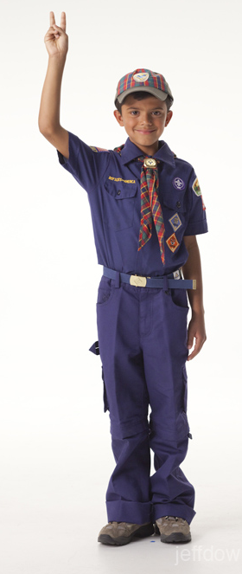
Qualitative Data
Verbatim Comment
“We have so much fun. I slept at a
zoo overnight, went camping in a
cabin and now I get to go
camping in a tent. I love earning
belt loops, too. It's fun.” Cub Scout
Notes:
Operations: (1 minute): What Information VOS will give
In addition to answering questions by ranking numerically how much you agree with a driver question, the participant will have the opportunity to respond with a verbatim answer. This is an example of what that might look like.

Slide 10
Quantitative + Qualitative = Opportunity for Change
Notes:
Commissioer (1 minute) When the quantitative data and the qualitative data support one another, it indicates that there is an opportunity for change. The JTE scores should also validate that. And that’s where the Unit Commissioner comes in.
Troop – more Older Boy programs
Pack – more outdoor activities

Slide 11
Unit Commissioner VOS Role
Promote Participation
Prepare
Interpret VOS Learnings
Coach, Guide
Cheerlead, Monitor, Recognize
Notes:
Commissioner (1 minute): In a nutshell the Unit Commissioner Promotes participation, prepares him/herself for the two meetings, interprets the VOS material with the Unit, Guides and coaches for change and celebrates success.
Good, current e-mails are obtained from parents/youth and unit leaders - UC helps obtain and verify
Stakeholders AUTHORIZE THEIR SPAM FILTER to accept scouting.org e-mails – supported and encouraged by UC
VOS requests sent & surveys are completed - Unit leadership encourages participation – supported by UC
VOS results are shared with Unit Key 3 by District VOS champion - ideally NOT the UC
VOS results are intrepreted by the UC in a meeting with the Unit Key 3.
The UC will coach for change
The UC will link the District/Council/national resources with the unit as needed to assist in effecting change

Slide 12
UC - Meetings with Unit are Key to Success
At least 6 contacts with unit per year
Recharter meeting
Self Assessment & Action Planning Meeting to review VOS findings & JTE status within 45 day
Mid-Charter Review to review VOS findings & JTE progress
Three others
Notes:
Commissioner(3 minutes): The Unit Commissioner should have 6 contacts the unit each year. Three of those visits are meetings with the unit leadership. These meetings are critical to the Success of the unit. They should be no stranger to the Unit commissioner although you may not recognize them by name. The Recharter meeting generally takes place about 2 weeks before rechartering and the activity for that meeting is on-time recharter. The Action Planning Meeting takes place shortly after recharter. During the Centennial Quality Unit days, this was where the unit would set its goal for the coming year. With JTE, we still have that meeting. The unit reviews its JTE successes and plans for actions that will help them improve their JTE scores for the coming year. Now, with Voice of the Scout, that data will also be a part of that meeting and help determine specific goals. The third meeting takes place 6 months before recharter. For lack of a better term, we are calling that meeting the Mid-Charter Review. At this meeting the unit leadership reviews the progress made so far and makes adjustments to insure the desired JTE status by recharter. Now VoS will also be a part of that meeting. Both the Action Planning Meeting and the Mid-Charter Review are very similar in nature and the UC has a critical role to play.

Slide 13
Unit Commissioner Role
JTE
Educate units regarding the JTE criteria yearly
Meet (and exceed) JTE commissioner visit requirements
Voice of the Scout
Encourage unit participation
Interpret results to Unit Key 3
Notes:
Commissioner: The commissioners role in the logistical part of this is minor. He/she makes sure the unit leadership is aware and understands the JTE criteria. And the unit commissioner should certainly meet—and exceed the visitation requirement. Last year there were only 8 councils that were “gold” in unit visitation. SURELY that will change.
With Voice of the Scout, the unit commissioner is again the promoter. While VoS is not mandatory in 2012, it will be in 2013. Unit leadership will need help in understanding why this is important. They’ll need reminding of the need for email addresses and there is a particular way that those need to be gathered in regards to youth 14 and over. The critical importance of adding email info during recharter. Out of 100.000 units in spring survey, less than 20 had 5 or more responses so we MUST get more parents and scouts completing surveys to get valid information at the unit level.
VoS will come out twice each year—in the fall and in the spring.
“Manners” will encourage participation: thank to those who participated; “we’ll be having a meeting”; “You said you wanted x, so we’re making a change”

Slide 14
JTE On-Line Resources
Council JTE Scoreboard
Automatically populated
Updated 3 times per month
Available through “MyScouting” account
District JTE Scoreboard
Will be available as part of major BSA IT upgrade
JTE On-line support resources
www.scouting.org/JTE
Worksheets, interactive spreadsheets

Slide 15
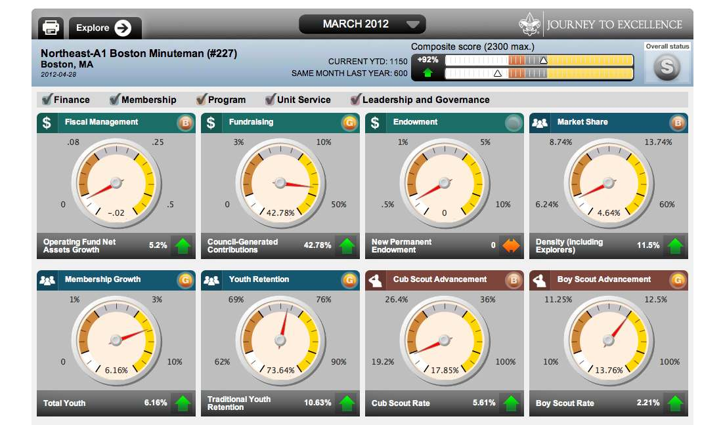
Screenshot of JTE Council Dashboard

Slide 16
VOS On-Line Resources
VOS IS PART OF JOURNEY TO EXCELLENCE
Bonus points for participation in 2012
Participation is expected and metered in 2013
VOS Dashboard displays survey results for Council volunteers and district key 3 members

Slide 17
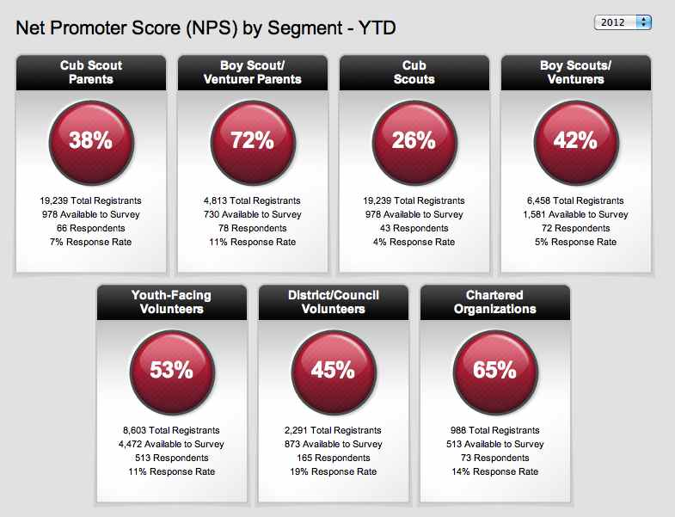
Screenshot of VOS Dashboard

Slide 18
To Improve Unit Programing
“ It takes a entire District to serve a Unit”
Use all the people resources and available tools
Council and District Committees
Commissioner Staff
Both fully staffed
Notes:
Commissioner: The people resource specialists for improving unit programing are the Council and District Committees. They run the operations side of things and they are the subject matter experts on Advancement, Finances, Training, Camping, Activities… etc.
The unit commissioner visit units and assist them in getting the help they need to succeed from the district.
This is what unit service should look like: the unit commissioner is the link. The link goes both ways—information and support such as camping activities go to the unit and requests for assistance go from the unit to the district. As someone from the operations side of things recently said to me, “The commissioners have all the information. They know what is going on at the district and council level and they know what is going on in the units.” It is up to the unit commissioner to be the link, not to be the be all and end all to the unit.

Slide 19
Summary
Everyone has a role to play in the support of our units and our youth
JTE tells us how we’re doing against specific criteria
VOS tells us how our stakeholders think we’re doing
Better units + better program+ happier youth = achieving “the main thing”
It takes an entire district to serve a unit
Notes:
Operations (1 minute): Everyone plays an important role. JtE measures us against a specific criteria. VoS measures what our stakeholders think. When the Commissioner staff and District Committee are both working together, the unit stands a much better chance of receiving the needed support and sets them on the trail to become a high performing unit. It takes an entire District to serve a Unit! And it gives our Scouts and their parents a Scouting experience we can all be proud of
Everyone has a role to play in the support of our units and our youth
It is important to utilize all the tools and resources available
JtE tells how we’re doing against specific criteria
VOS tells how our stakeholders think we’re doing
Consider feedback the doorway to opportunity for change
Better units, better program, happier youth
“ It takes a entire District to serve a Unit”

Slide 20
OUR GOAL????
Better Scouting
Clear Expectations, No Surprises
CONTINUOUS IMPROVEMENT
BSA Mission fulfilled!
Notes:
Operations: (1 minute)

