Slide 2
COMMISSIONER Training Updates

Slide 3
BASIC TRAINING
Commissioner Basic Training & Hosts
• June 16, 2012 – Area 6
• December 15, 2012 – Area 2 & 4
• February 23, 2013 – Area 1
• April 20, 2013 – Area 3
• June 15, 2013 – Area 6

Slide 4
UPCOMING TRAINING

Slide 5
Additional Basic Training
Commissioner College
• October 20, 2012 – Heritage Reservation
• October 19, 2013 – Indiana, PA
Fall Kick-off & Barbecue
• August 18, 2012 – Camp Twin Echo
• August 17, 2013 – Camp Seph Mack
University of Scouting (maybe)
• March 16, 2013

Slide 6
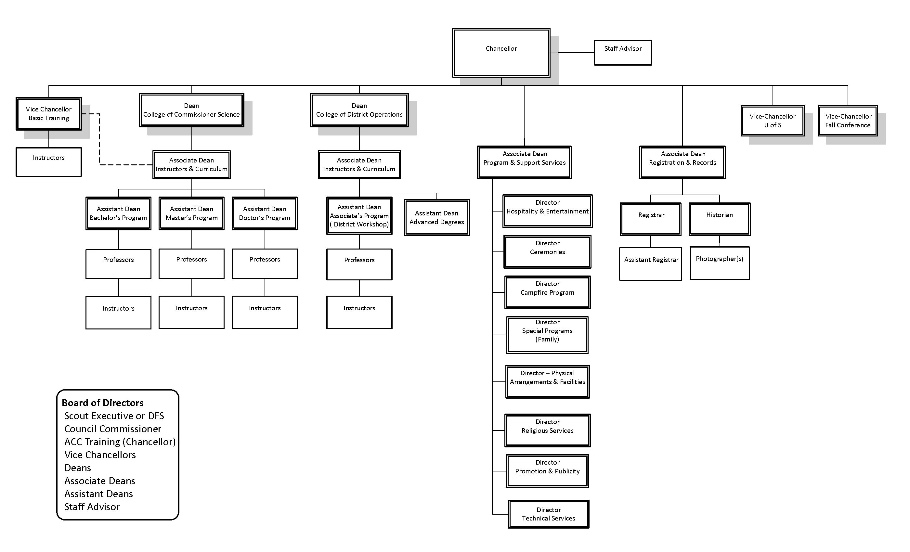
CZAR OF BASIC TRAINING!

Slide 7
ASK THE COMMISH

Slide 8
FALL KICK-OFF & BARBECUE
August 18 @ Camp Twin Echo

Slide 9
COMMISSIONER COLLEGE
History of excellence
Heroic efforts to improve
Flat-line attendance
Recent survey summary
Control our own destiny

Slide 10
COMMISSIONER COLLEGE
3-Year Plan
2012 Heritage Reservation
2013 Indiana, PA
2014 University of Scouting

Slide 11
COMMISSIONER COLLEGE
Rebranding

Slide 12
DISTRICT LEADERSHIP CONFERENCE
Includes College!

Slide 13
DISTRICT LEADERSHIP CONFERENCE
Vision
FUN!
High Quality
New Features
Flexible
Simple
FUN!

Slide 14
DISTRICT LEADERSHIP CONFERENCE
Marketing

Slide 15
DISTRICT LEADERSHIP CONFERENCE
NER Area 4 Invited
http://dlc.scouting.org
http://college.commissioner-bsa.org
http://committee.commissioner-bsa.org
Promotion/Communication

Slide 16
DISTRICT LEADERSHIP CONFERENCE
Features
One day –or– Weekend
Individual –or– Family
One participant fee $45
Reduced staff fee $25
Family Program $10
MONEY BACK GUARANTEE!

Slide 17
DISTRICT LEADERSHIP CONFERENCE
Features
Inclusion of District Committee
District Committee Orientation
Commissioner Basic
AM Classes / PM Classes
Top Dog – keynote speaker
Main meal = Saturday lunch

Slide 18
DISTRICT LEADERSHIP CONFERENCE
Features
Ask the Expert (all day)
Fireside Chats
All day Exploring/Venturing roundtable
All day help with UVTS, Recharter
Possible scholarship?
FUN FUN FUN
Notes:
No handouts

Slide 19
DISTRICT LEADERSHIP CONFERENCE
FYI
Participant registration open NOW
Staff registration open by Friday
Class registration open June 1
Professor / Instructor Workshop
Staff Meeting – September Cabinet
Notes:
No handouts

Slide 20
DISTRICT LEADERSHIP CONFERENCE
Need YOUR help!
Corn Hole Games
Actor
Free stuff
Active participation
Names of New Commissioners
SELL!!

Slide 21
QUESTION ~ COMMENTS

