Slide 1
ORIENTEERING and TRAINING
COMMISSIONERS

Slide 2
Dan Urban Assistant Council Commissioner
What happens…
Before and After Basic Training?!
Notes:
One dramatic development in American Society is the interest in learning as a lifetime activity. Education has become as important an activity for adults as it always has been for children.

Slide 3
Orienteering - Commissioners
First Things First
Plan a journey… you must first plan your trip
So it is with becoming a Unit Commissioner
Where do you start?
What do you do first?
Notes:
When you plan a journey you must first plan your trip.
So it is with becoming a unit Commissioner
Where do you start?
What do you do first?

Slide 4
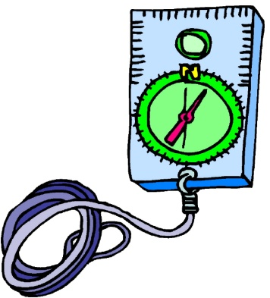
Orienteering - Commissioners
First Things First
In orienteering, the first step is to learn how to read a compass
As Commissioners, you must first learn how to do your job, or what your job encompasses

Slide 5
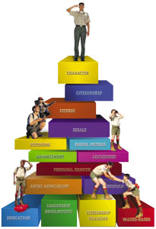
Orienting & Training Commissioners
Commissioner Education
Commissioners are looked to be the “Expert in Scouting”
We advise units, leaders, roundtable participants, everyone!

Slide 6
Orienting & Training Commissioners
Learning is a Continuous Process
Orientation video/Online Fast Start - within 48 hours
Personal Coaching - within 2 hours
Commissioner Basic - within 2 months
Arrowhead Honor - within 1 year
Commissioner’s Key - after 3 years
Continuing Education - every month
Notes:
Commissioners must also view learning as an important part of their Scouting lives. Plan for the ‘New’ Commissioner to participate in the following training opportunities within the period allotted from the time they agree to serve.

Slide 7
Orienting & Training Commissioners
Approaches to Training
Group Training
Most effective
Builds team sprit
Personal Coaching
One-on-one situations
Immediate training
Self-Study
Least Desirable
Includes contact with counselor
Notes:
Group Training. This is the most common and most effective approach. It provides fun and fellowship and builds Scouting spirit. These ingredients are as essential in Scouting training as is the knowledge imparted. Group training builds a team spirit in a group of commissioners dedicated to quality scouting.
Personal Coaching: Personal coaching may be used in a one-on-one situation or with an instructor and a small group of trainees. It is normally used to provide immediate training for new commissioners, as they will not be effective without training. This training method is sufficient to get them started, but they must attend a basic training course when available.
Self Study: The lease desirable method, self-study should be used only when group training is not available and personal coaching is not possible. Self-study consists of reading assignments, etc., but must include contact with an instructor or counselor even if by telephone. No feedback!

Slide 8
Orienting & Training Commissioners
Orientation
Within 48 hours of commitment
Video - “Unit Commissioner’s Orientation Operations: Helping Units Succeed
Coaching/orientation session with ADC or DC
Discuss pages 4 through 9 in Commissioner Field book
Notes:
Be sure the new commissioner views the orientation video within 48 hours of being recruited. Once the video is viewed, the commissioner should meet one-on-one with a ADC or DC to discuss their assignments.
Coaching/orientation session for unit commissioners are usually conducted by DC or ADC, in some cases by the District Executive. Coaching sessions help develop good commissioner communication that extends far beyond training. Personal Coaching is also on the job training. Coaching sessions are short and related to the trainee’s experiences into bite-sized pieces for better digestion. Use pages 4 through 9 of the Commissioner’s field book as part of the first orientation session with new commissioners. Review other sections of the field book in subsequent sessions.

Slide 9
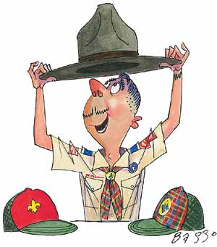
Orienting & Training Commissioners
Orientation Projects
Video - Highlights of District Operations Helping Units Succeed
Fill out Commissioners program Notebook
Study assigned Unit Rosters
Review leaders of assigned units with ADC
Notes:
Each Commissioner should complete all of the orientation projects as a part of their orientation process.

Slide 10
Orienting & Training Commissioners
Orientation Projects
With ADC, visit a unit meeting that is a good example
With ADC, review a basic kit of materials to assist units in succeeding
Complete one additional project assigned by ADC
Notes:
Each Commissioner should complete all of the orientation projects as a part of their orientation process.

Slide 11
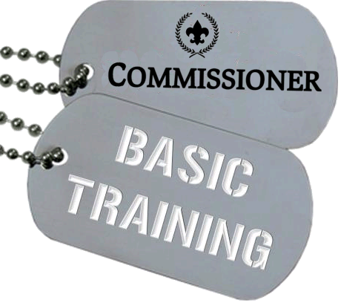
Orienting & Training Commissioners
Commissioner Basic Training
Participate in Commissioner Basic Training
Include unit visit
Discuss with assigned ADC
Commissioner’s Greatest Priority
How to help a Unit
Why Commissioners
Review Commissioners Training Manual
Notes:
The new commissioner should participate in the commissioner basic training within two months of being recruited. This training involves actual visits to Scouting units and includes these sessions: “Units: The Commissioner’s Greatest Priority”, “How to Help a Unit”, and “Why Commissioners?”
After completion of commissioner basic training, the Trained Leader emblem may be worn.
Review the latest edition of the Commissioner Basic found in the Administration of Commissioner Service, No. 34501.
See pages 55 – 96, in Section II.
Discuss and compare the two ways to do basic training
Three separate days with intervening supervised unit visits
One day course with unit visits just before and after the course.
11

Slide 12
Orienting & Training Commissioners
Continuing Education
Monthly
At each District commissioner meeting
5 – 15 minutes in length
Topical (annual commissioner service plan)
Annually
Commissioner Conference (and/or)
College of Commissioner Science
Notes:
Should occur every month at district commissioner staff meetings. Review the list of training topics in the appendix of “Commissioner Administration of Unit Service,” section one of Administration of Commissioner Service..
The district commissioner (and district executive) select a topic each month that best matches the current skill needs of their commissioners. Parts of the training outlines in section one of this manual provide ready-to-go training topics for the district commissioner staff meetings.

Slide 13
Orienting & Training Commissioners
Unit Stops Meeting
Unit with no Leader
No Active Committee
Leader Lacks Training
No New Youth Members
Weak Leadership
Conflict with Community Organization
Lapsed Charter
No Planned Program
No Youth Leaders
Adult Conflicts
No Camping
No Advancement
District Activities
Others !!!
Notes:
Just SHOW the topics – no time for discussion!
- Commissioner helps for Packs, Troops, and Crews, (No. 33618)
- Continuing Education for Commissioners, (Section three of Administration of Commissioner Service)
- Helpful DVDs available include:
Commissioner Annual Orientation DVD, AV-04DVD03
• Commissioner Service and District Operation Support DVD, No. AV-06DVD08, with audiovisuals in support of commissioner service
• Highlights of District Operations for the 21st Century: How Districts Operate DVD, No. AV-06DVD08
• The Unit Commissioner’s Orientation: Helping Units Succeed DVD, No. AV-06DVD08
• Unit Problem-Solving for Commissioners DVD, No. AV-06DVD08
• Meetings of the District, DVD, No. AV-06DVD07

Slide 14
Orienting & Training Commissioners
Commissioner Conference (Barbecue)
Yearly meeting for all Commissioners in LHC
Highlight Council’s plan for Unit Service
Agenda
Advanced Training
Information on latest scouting program
Fellowship
Inspiration
August 10, 2013 @ CSM
Notes:
Should occur every year at the annual council commissioner conference. Agenda includes:
50% of the session for Advanced Training
30% of the session regarding information on the latest changes to the scouting program
10% of the session for fellowship
10% of the session for inspiration.

Slide 15
Orienting & Training Commissioners
Commissioner College (DLC)
District Leadership Conference
We include District Operations
Offers curriculum based programs
Associate
Bachelor
Masters
Doctors
Continuing Education
Notes:
This is how a council implements the annual commissioner college. At the college each participant as the opportunity to earn their next degree in Commissioner Science.
See Section III, Chapter IV; Administration of Commissioner Service

Slide 16
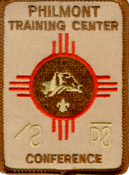
Orienting & Training Commissioners
Philmont
Conferences at National Training Center
Effective Roundtables
How to conduct Commissioner College
The Unit Commissioner
DC and ADC Training
The Council Commissioner
Focusing on the Main Thing
Mountain Top Experience!
This year: June 23 to 29, 2013
Notes:
Discuss Philmont Training Conference. Best opportunity for a family vacation and to gain knowledge about scouting. This knowledge is gained while having fellowship with scouters across the United States. Philmont is located in Cimarron New Mexico at the BSA National High Adventure base.
To attend Philmont you must be a registered scouter and recommended by your District Training Chairman and the Council Executive.
16

Slide 17
Orienting & Training Commissioners
Other Training
Youth Protection
Health & Safety (mostly online)
Leader Specific
Introduction to Outdoor Leader Skills
Supplemental (UofS, Powderhorn, etc.)
21st Century Wood Badge
Notes:
Encourage all Commissioners to become familiar with training courses in all levels of Scouting.

Slide 18
Orienting & Training Commissioners
Other Training
Fellow Commissioners!
Notes:
Encourage all Commissioners to become familiar with training courses in all levels of Scouting.

Slide 19
Orienting & Training Commissioners
Keys to Good Training
Be Prepared
Handle questions well
Don’t apologize
Be familiar with topic
Only professional A/V
Stick to schedule
Involve participants
Establish personal rapport
Don’t appear disorganized
Start off quickly to establish an image
Notes:
Review this list of classroom / presentation keys to good training. Discuss why these are important in making presentations to all audiences not just teaching.

Slide 20
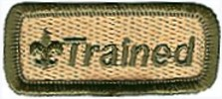
Orienting & Training Commissioners
Training Commissioner’s
Fast Start training within 48 hours
Basic Leader within 2 months
Recognize Accomplishments
Continuously Update Skills
Notes:
Summarize the session.
Commissioner Training is just like all other Scouting Training. You begin:
Fast Start training within 48 hours of signing as a Commissioner
Basic Leader within 2 months
Recognize Commissioner’s for accomplishments
Continuously Update Skills

Slide 21
Orienting & Training Commissioners
Commissioner Websites
National BSA: Scouting.org/Commissioners Click on “Commissioner Training” on left hand side

Slide 22
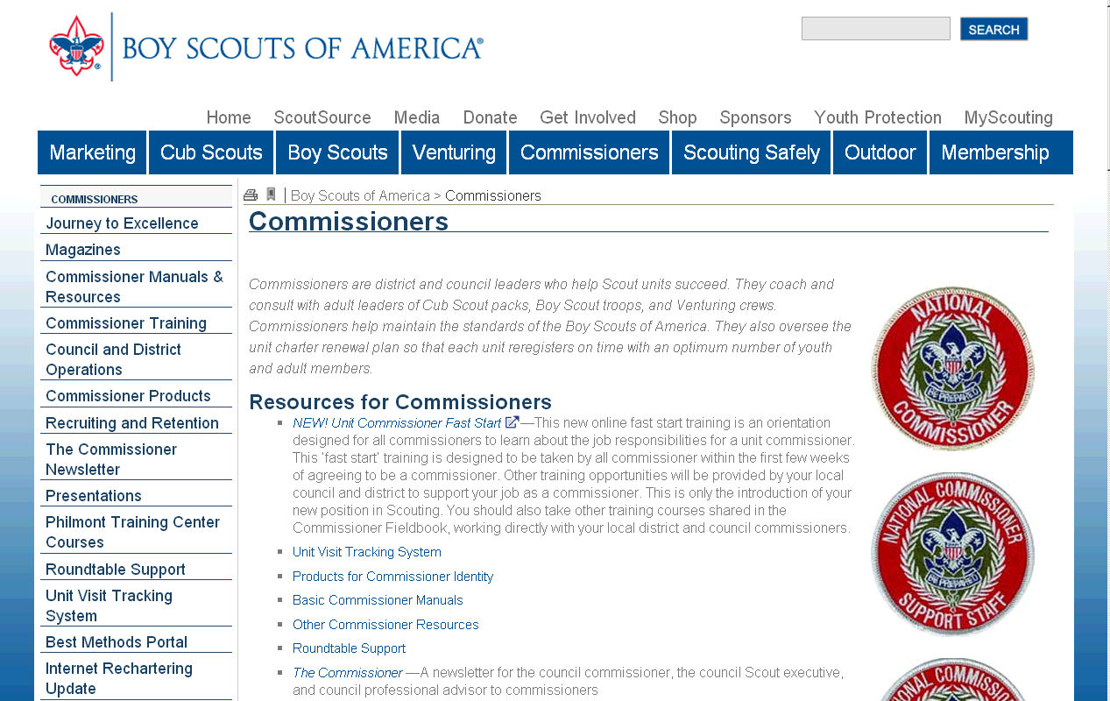

Slide 23
Orienting & Training Commissioners
Commissioner Websites
Laurel Highlands Council: Commissioner-BSA.org Click on Commissioner Cabinet Meeting / Year

Slide 24
