Slide 1
COMMISSIONER
RECHARTER TRAINING

Slide 2
The Commissioner Role
Assures rechartering of assigned units
Trainer
Resource
Supporter
Reminder
Checker
Chaser
Saver

Slide 3
What is a “Charter”
Permission granted by the national council to an organization enabling them to use the Scouting program as part of their youth service program.
Agreement between organization and BSA.
Renewed annually.

Slide 4
Why Re-charter
Renews partnership annually between organization and BSA.
Updates paperwork – who is active/inactive.
No one volunteers for more than one year. Scouting is NOT a lifelong commitment. We renew that commitment annually.
(Qualifies Commissioners for awards)

Slide 5
Why this training?! (again)
Commissioners are responsible for unit charter renewal.
It is essential that we know the steps in the process.

Slide 6
Aligns with 4 Focus Areas
Support unit growth in the JTE criteria
Link District Committee resources to unit
Visit units and log the visits into UVTS
Support On-time re-chartering

Slide 7
Renewal packet contents
Online charter renewal code and instructions (unit specific)
Unit account card (ID’s who can sign for unit account at Flag Plaza)
Charter renewal checklist
JTE requirements (unit type specific)
Free advancement form (in triplicate)
Internet advancement Instructions
Free hat incentive form
Accident insurance worksheet (unit type specific)

Slide 8
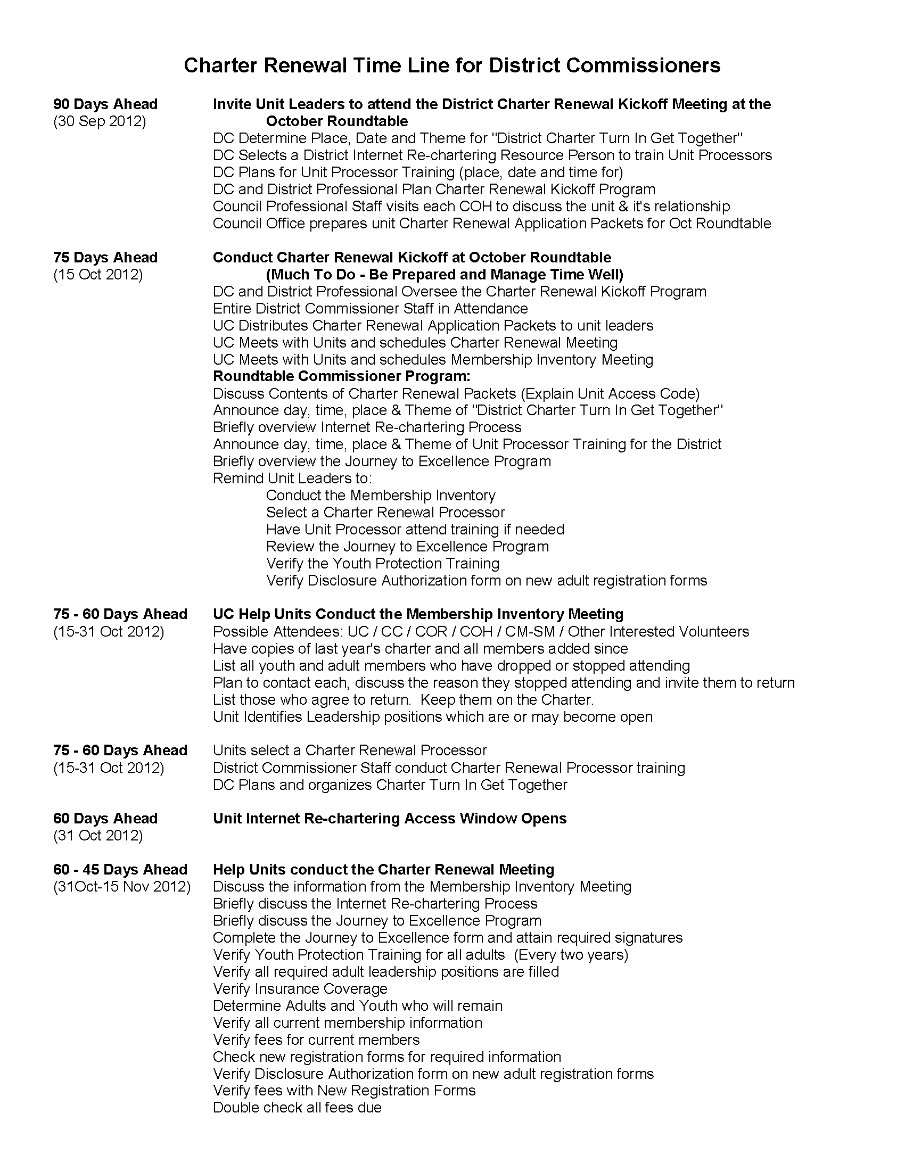
Charter Renewal Time Line
Follow the LHC Timeline.
Process already started.

Slide 9
Process
3-Months (90-days) prior to re-charter date
DE (USE) meets with Charter Organization Executive Officer:
Discuss the successes and challenges of unit.
Review role of the charter organization and local council.
Consider key unit personnel to determine replacements, additions, and recognitions.

Slide 10
Process
2 Months (60-days) prior to re-charter date
Unit Key 3 (Commissioner, unit leader, COR) conduct a membership inventory of youth and adults.
Contacts or visits should be made to inactive youth and adults.
Every effort should be made to recruit additional youth and adults so the unit re-registers with no loss in membership.

Slide 11
Process
1.5 Months (45-days) prior to re-charter date
Commissioner and unit committee conduct the charter renewal meeting
Identifies youth and adults that will re-charter
Complete forms
Collect fees
Charter Organization Executive Officer and Charter Organization Representative approves all volunteers and unit leader certifies the youth to be registered.
Participants include: commissioner, charter representative, executive officer, unit leader and all unit volunteers.

Slide 12
Process
15 days before renewal date – All paperwork and money turned into the council office.
December 15, 2012
30 days after renewal date – formal charter presentation conducted.

Slide 13
Internet Re-chartering
Unit designates an adult member as the “Unit Renewal Processor” – (UP)
UP uses this years access code for re-chartering provided to each unit to log into the system. (Log in as 1st time user)
www.lhc-bsa.org – and click on “Internet Rechartering” at top of page

Slide 14
Internet Re-chartering
UP can:
Load council information from ScoutNet
or
Upload file from Packmaster/Troop Master
Update roster
Update information
Select which current members to renew
Promote members
Add adult members
Add youth members
Update member data
Update member positions

Slide 15
Internet Re-chartering
Update member fees
Assign “Multiple” status
Sign up members and leaders for Boys’ Life
Complete survey of why people are not re-chartering.
After double checking everything, submit to council and print paperwork for signatures.

Slide 16
Internet Re-chartering
Note: NOT done when they hit “submit to council”.
All paperwork must be signed and fees paid before re-chartering is complete.
Paperwork and fees taken to council office (or given to USE) for processing.

Slide 17
Availability
Internet re-chartering 60 days prior to renewal date:
31 October 2012
Recharter due the 15th of the month of expiration.

Slide 18
Common Mistakes Made during recharter
Things you should check, please!

Slide 19
Missing required positions
Cub Scouts
Charter Rep.
Committee Chair
2 Committee
Pack Trainer and Scout Parent Coordinator Counts here
Cubmaster
1 Den Leader (at least)
Boy Scouts and Venturing
Charter Rep.
Committee Chair
2 Committee
Scout Parent Coordinator Counts
Scoutmaster or Crew Advisor

Slide 20
Charter & apps not signed
The Executive Officer must sign the charter approving the adult leadership.
The Unit Leader must sign the charter certifying all members are active.
Parents and Unit Leader must sign all youth applications.
Charter Organization Executive Officer or Charter Rep. and Committee Chairman must sign all adult applications.

Slide 21
No apps for new youth/adults
If new youth or adult added to the re-charter; new application needed.
A list will print at the end as needing apps.
Reminder – new adult applications require the Disclosure Form for Criminal Background Checks and proof of Youth Protection Training.
Notes:
NOTE: Once charter is loaded, it is “FROZEN” any new adult or youth applications received after loading charter must be included with the charter. IF apps are turned into Flag Plaza after loading charter and prior to submission of paperwork, make a copy of apps and still include with reacharter.

Slide 22
Adults not providing SS#
All adult leaders go through criminal background check.
Lexis Nexis uses the SS# to ID the person.
No SS#, they can not be a leader.

Slide 23
Too Many Multiple Positions
The Charter Representative can also be the Committee Chairman or Committee Member.
The Charter Organization Executive Officer can be any position in the unit (but would pay for that position).
All other positions – one person, one job.

Slide 24
People Multiple Out of Program
Happens when they Multiple everywhere.
Each person must have a primary position in which they pay registration fees.
When the “primary registration” becomes due and not renewed, that person drops from being registered in all locations.

Slide 25
Information input
No spaces in last names (DeCarlo not De Carlo)
No apostrophes (OBrian not O’Brian)
No initials for first names
Use an initial for a middle name; don’t use a period
Prefixes are Dr., Rev. etc.
Suffixes are Jr., III, etc.
No need to enter Mr. or Mrs.

Slide 26
Information Input
Change wrong contact information (Address, phone number, etc.)
Change grades if wrong, but don’t “update” to the next years grade. (ScoutNet will do automatically on June 1)

Slide 27
No Follow-up with drops
Every person, youth and adult, should be contacted and asked to renew in Scouting and/or invited to rejoin.
If they chose not to, ask why. This allows us to gain a better understanding of why people are leaving the program.
In some circumstances, where you can offer alternatives (another unit with another meeting night.)

Slide 28
More Information To help you succeed!
And have the knowledge you need!

Slide 29
Communicate
Provide status to ADC/DC and USE frequently.
Use the “Commissioners Unit Charter Renewal Status Report” (available from USE).
Use the data to properly monitor and support the rechartering process.

Slide 30
Stage Status
Load Roster (UMS Reconciliation)
Renew Roster
Check Roster
Summary
Submitted

Slide 31
Use your “tools”
“UCRS Members Not Renewed Roster”
Available from your Unit Service Executive
Recruit members back into Scouting
It’s worth the time and effort!

Slide 32
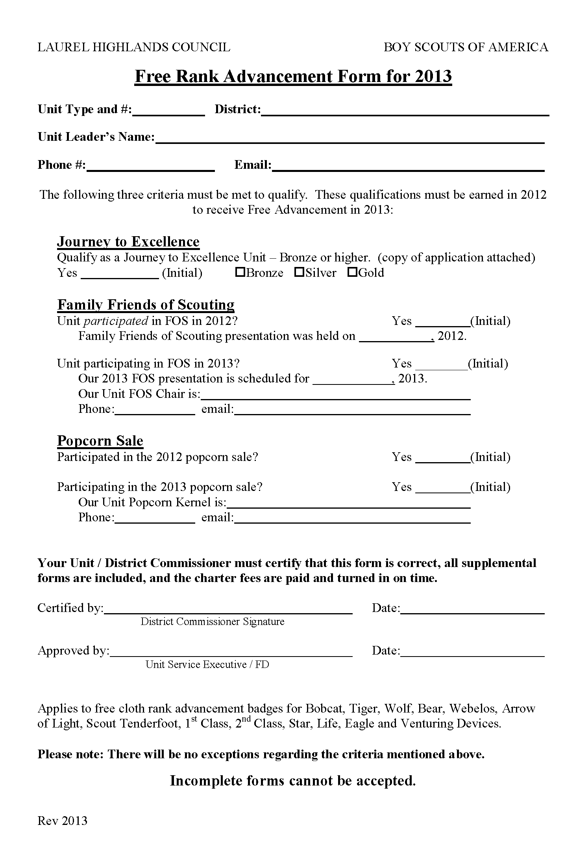
Free advancement
JTE Bronze or higher
Participatee in FOS & Popcorn 2012
Plan to participate in FOS & Popcorn 2013
Complete form
FINE PRINT: Applies to free cloth rank advancement badges for Bobcat, Tiger, Wolf, Bear, Webelos, Arrow of Light, Scout Tenderfoot, 1st Class, 2nd Class, Star, Life, Eagle and Venturing Devices.

Slide 33
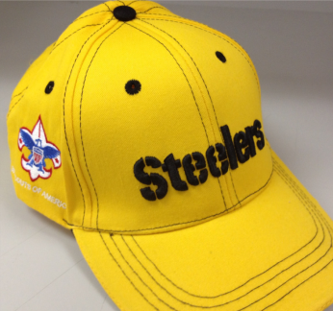
Free Steelers hats!
One hat for each registered leader.
Turn in Charter by December 15.
Use checklist.
Complete and correct.
All fees paid.
Complete form.
Obtain approval of DC or DE (USE).

Slide 34
Fees
$15 for every registered youth and adult.
NOTE: Tiger Cub Adult Partners do NOT pay registration fees.
Accident & Sickness Insurance:
Packs: $1 per youth and adult
NOTE: Tiger Cub Adult Partners DO pay insurance fee
Troops & Crews: $1.50 per youth and adult
$40 charter fee for unit.

Slide 35
Fees
Include separate checks
Recharter fees
Insurance fees
Make checks payable to: “LAUREL HIGHLANDS COUNCIL, B.S.A.”

Slide 36
Journey to Excellence
Help fill out the Journey to Excellence form and determine if unit qualifies for Bronze, Silver, or Gold recognition.
Use LHC JTE Worksheet
Ask if unit logged their service hours in the JTE Service Hours Reporting website (https://servicehours.scouting.org)

Slide 37
Youth Protection Begins with “YOU”
Every registered adult leader is required to go through youth protection training every 2 years.

Slide 38
Update emails in system
Allows for better communication.
Needed for the 18th JTE criteria! (Voice of the Scout).
District & Unit management capabilities are coming!
Notes:
UC’s can provide e=mail lists to USE’s

Slide 39
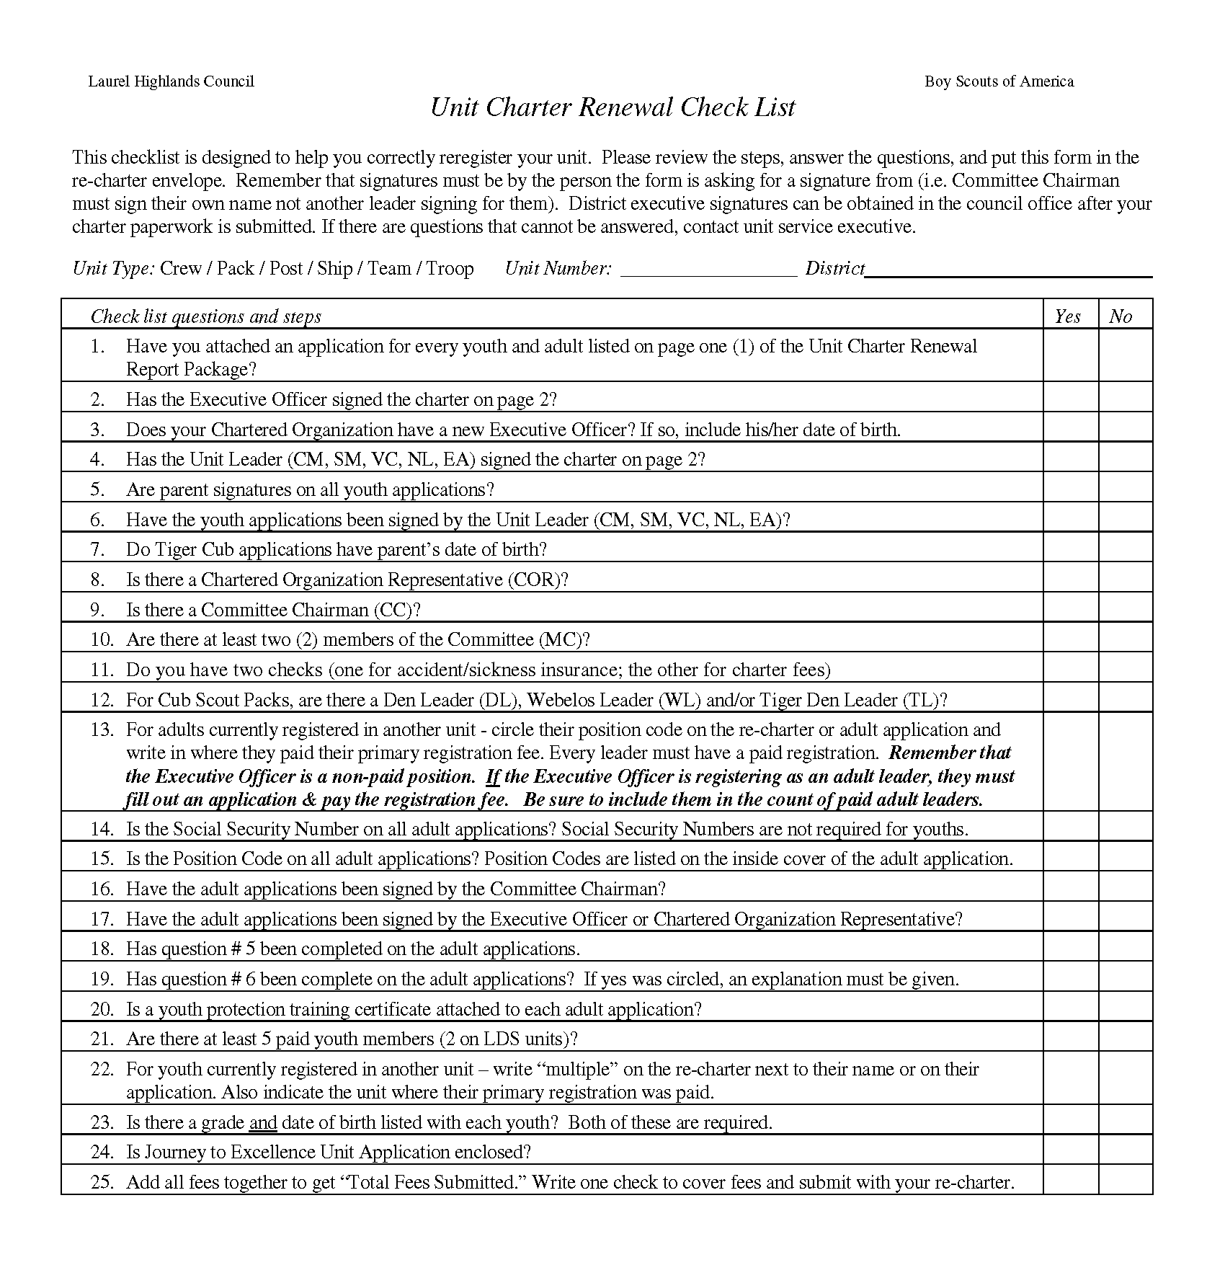
The best “tool”
Unit Charter Renewal Checklist

Slide 40
Consider a turn-in event
Pancake breakfast, coffee & donuts, etc.
Have computer available and internet access.
Combine with training.

Slide 41
2 principles to ensure success
Keep the process simple.
Don’t add anything!
Anticipate anything that could delay on-time renewal
Is the unit leader going to be out of town for a month?
Are there unit problems that might delay the renewal?
Has there been a loss of adults? Youth?

