Slide 1
Quote of the month:
“In our uniforms we are not just individuals, but representatives of the vast movement, a great cause, a vital part of a great nation.”
James E. West
Notes:
First professional Executive Secretary of the BSA – (later renamed Chief Scout Executive).
His starting salary was $4,000 per year and was raised to $6,000 per year (equivalent to about $140,000 in 2009)
BSA’s founders (Boyce, Beard & Seton) had conflicts with West… which ultimately led to the removal or resignation (banishment) of Seton and the erasure of Boyce’s name for BSA records for a few years!

Slide 2
COMMISSIONER Training Updates

Slide 3
Ask the Commish

Slide 4
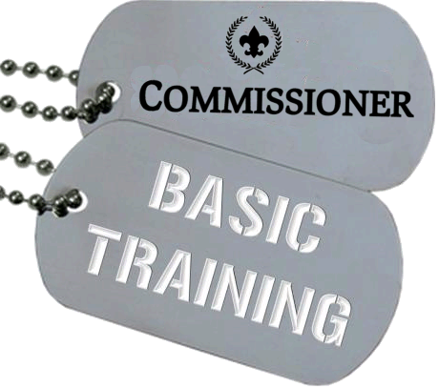
• June 15, 2013 – Area 6 8:30 AM @ Ebensburg Office
• Aug 10 @ Barbecue

Slide 5
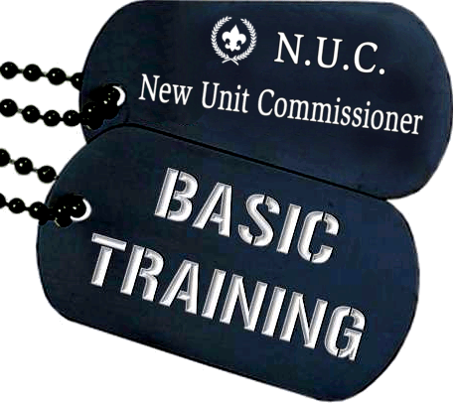
• May 18, 2013 8 AM @ Flag Plaza
New Unit Membership Conference
Includes Membership Committee

Slide 6
We had a BLAST!
It wasn’t cold at all….

Slide 7
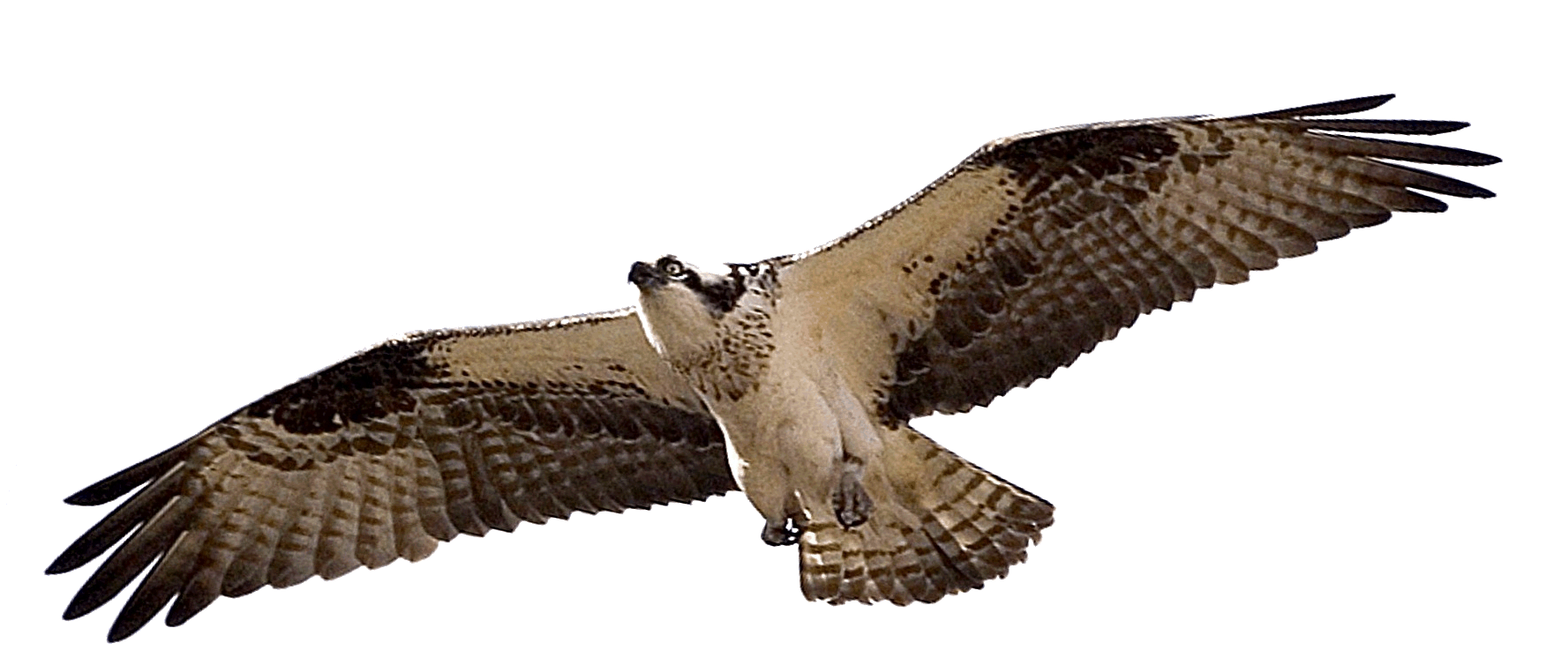
August 10 Camp Seph Mack
Commissioner Barbecue
Notes:
Don’t Miss This!

Slide 8
Having trouble getting volunteers to do their jobs?
Notes:
Content Due – April 1

Slide 10
START THINKING ABOUT…
Program Kick-Offs

Slide 11
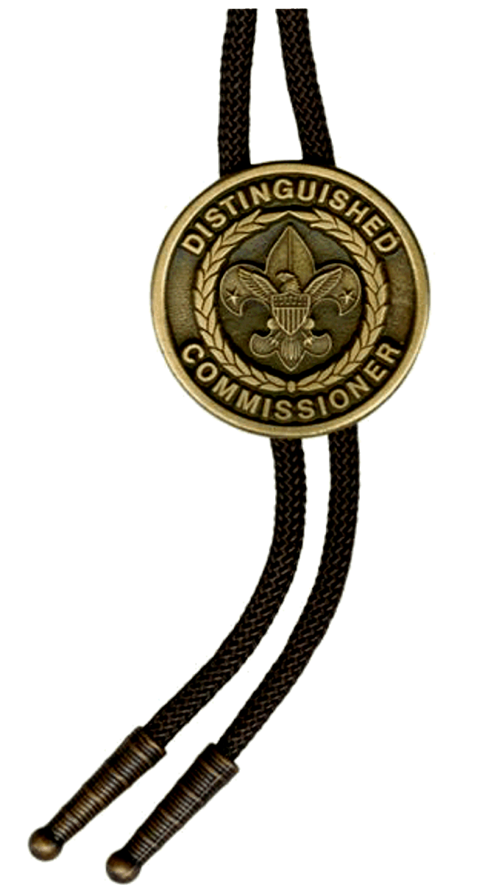
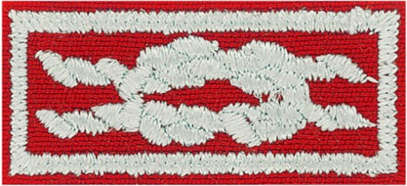
CONTINUE THINKING ABOUT…
D.C.S.A.
Distinguished Commissioner Service Award
http://dcsa.commissioner-bsa.org
Notes:
Commissioner Award of Excellence in Unit Service

Slide 12
COMMISSIONER QUIZ
Uniforming is a “method” of…
Cub Scouts
Boy Scouts
Venturing
All of the above
Notes:
a) & c)
Uniforming is NOT a method of Venturing

Slide 13
COMMISSIONER QUIZ
Uniforming is a “method” of…
Cub Scouts
Boy Scouts
Venturing
All of the above
Notes:
a) & c)
Uniforming is NOT a method of Venturing

Slide 14
COMMISSIONER QUIZ
2) True or False. The following represents the color epaulets in BSA —
Blue – Cub Scouts
Forest Green – Boy Scouts
Orange – Varsity Scouts
Green – Venturing
Silver – Council and District
Gold – National, regional, and area
BONUS QUESTION:
What color do COR’s wear?
Notes:
FALSE – there are NO colored epaulets in BSA. We have colored Shoulder Loops.
The epaulets are the tabs of cloth that hold the shoulder loops.
BONUS QUESTION: what color do chartered organization representatives wear?
SILVER

Slide 15
COMMISSIONER QUIZ
2) True or False. The following represents the color epaulets in BSA —
Blue – Cub Scouts
Forest Green – Boy Scouts
Orange – Varsity Scouts
Green – Venturing
Silver – Council and District
Gold – National, regional, and area
BONUS QUESTION:
What color do COR’s wear? SILVER
Notes:
FALSE – there are NO colored epaulets in BSA. We have colored Shoulder Loops.
The epaulets are the tabs of cloth that hold the shoulder loops.
BONUS QUESTION: what color do chartered organization representatives wear?
SILVER

Slide 16
COMMISSIONER QUIZ
3) The Eagle Scout mentor pin should be worn—
On the left lapel (closest to heart)
One the left pocket flap
Anywhere you want
Nowhere on the uniform
BONUS QUESTION:
Instead of the universal hat pin, what pin can a youth wear on the front of his campaign hat? (or on his uniform)
Notes:
There are very few pins authorized for wear on the BSA uniform. MOST pins are for nonuniform wear.
Adults may wear the adult universal hat pin, No. 50150, on the campaign hat and the expedition hat.
No other pins may be worn on official headgear of the BSA. (Pins may be worn on the jamboree hat but only while at the jamboree)
Name some pins that are OK on the adult uniform:
-Service Star pins
-Emergency Preparedness award
-Miniature devices on square knots
-Lots of different Sea Scout pins ;-)
BONUS QUESTION: The large standard First Class metal pin, No. 17, has been reinstated as an option to the cloth First Class rank
badge. The large pin may also be worn only by boys on the front of the campaign hat.

Slide 17
COMMISSIONER QUIZ
3) The Eagle Scout mentor pin should be worn—
On the left lapel (closest to heart)
One the left pocket flap
Anywhere you want
Nowhere on the uniform
BONUS QUESTION:
Instead of the universal hat pin, what pin can a youth wear on the front of his campaign hat? (or on his uniform)
The large standard First Class metal pin, No. 17
Notes:
There are very few pins authorized for wear on the BSA uniform. MOST pins are for nonuniform wear.
Adults may wear the adult universal hat pin, No. 50150, on the campaign hat and the expedition hat.
No other pins may be worn on official headgear of the BSA. (Pins may be worn on the jamboree hat but only while at the jamboree)
Name some pins that are OK on the adult uniform:
-Service Star pins
-Emergency Preparedness award
-Miniature devices on square knots
-Lots of different Sea Scout pins ;-)
BONUS QUESTION: The large standard First Class metal pin, No. 17, has been reinstated as an option to the cloth First Class rank
badge. The large pin may also be worn only by boys on the front of the campaign hat.

Slide 18
COMMISSIONER QUIZ
4) The Boy Scout neckerchief —
Is required at all uniformed events
Worn over an open collar, over the turned-under collar or under the (unbuttoned) open collar
The troop committee decides if the boys must wear a neckerchief
Eagle Scout s can wear a different color neckerchief than the rest of the troop
All of the above
None of the above
Notes:
f. NONE of the above
Boy Scout neckerchiefs are optional.
The unit has a choice of wearing the neckerchief over the collar (with the collar tucked in) or under the collar. NEVER over an open collar.
The troop decides by vote, and all members abide by the decision.
All members of a troop wear the same color.

Slide 19
COMMISSIONER QUIZ
4) The Boy Scout neckerchief —
Is required at all uniformed events
Worn over an open collar, over the turned-under collar or under the (unbuttoned) open collar
The troop committee decides if the boys must wear a neckerchief
Eagle Scouts can wear a different color neckerchief than the rest of the troop
All of the above
None of the above
Notes:
f. NONE of the above
Boy Scout neckerchiefs are optional.
The unit has a choice of wearing the neckerchief over the collar (with the collar tucked in) or under the collar. NEVER over an open collar.
The troop decides by vote, and all members abide by the decision.
All members of a troop wear the same color.

Slide 20
COMMISSIONER QUIZ
5) Name the only youth awards an adult may wear on their uniform as knots —
BONUS: Which five knots can be worn by EITHER youth or adult?
Notes:
Arrow of Light
Eagle Scout
Venturing Silver
Quartermaster
Religious emblems earned as a youth member
Hornaday
BONUS: Venturing Leadership Award
Lifesaving or Meritorious Action Awards: Medal of Merit / Heroism Award / Honor Medal
James E. West
**Findley Award

Slide 21
COMMISSIONER QUIZ
5) Name the only youth awards an adult may wear on their uniform as knots —
Arrow of Light
Eagle Scout
Venturing Silver
Quartermaster
Religious emblems earned as a youth member
Hornaday
BONUS: Which five knots can be worn by EITHER youth or adult?
Venturing Leadership Award
Medal of Merit / Heroism Award / Honor Medal
James E. West (maybe the Findley Award/CS Knot)
Notes:
Arrow of Light
Eagle Scout
Venturing Silver
Quartermaster
Religious emblems earned as a youth member
Hornaday
BONUS: Venturing Leadership Award
Lifesaving or Meritorious Action Awards: Medal of Merit / Heroism Award / Honor Medal
James E. West
**Findley Award

Slide 22
COMMISSIONER QUIZ
6) Which of the following is true about the “World Crest”—
It is required on all BSA uniforms
The two stars symbolize brotherhood and unity
Is an award for participation in an international program
Can be replaced on the uniform by the World Conservation Award
Lady Baden Powell said the badge “shows the true way to go”
BSA donates a portion of the patch money to the World Scout Foundation
It’s a mini-replica of the flag that flies over the WOSM office in Switzerland
Notes:
There is NO requirement to wear the crest – but it is highly recommended.
The two decorative five-pointed stars stand for truth and knowledge. (The three tips of the center fleur-de-lis represent the three points of the Scout Promise. The white on the patch represents purity; the royal purple denotes leadership and help given to other people..)
From 1956 to 1991 this was true! NOT NOW!
NO! However this is a common uniform mistake.
Lord Baden-Powell said: "Our badge we took from the 'North Point' used on maps for orienteering." Lady Baden-Powell said later, "It shows the true way to go.“
Yes.
Yes.

Slide 23
COMMISSIONER QUIZ
6) Which of the following is true about the “World Crest”—
It is required on all BSA uniforms
The two stars symbolize brotherhood and unity
Is an award for participation in an international program
Can be replaced on the uniform by the World Conservation Award
Lady Baden Powell said the badge “shows the true way to go”
BSA donates a portion of the patch money to the World Scout Foundation
It’s a mini-replica of the flag that flies over the WOSM office in Switzerland
Notes:
There is NO requirement to wear the crest – but it is highly recommended.
The two decorative five-pointed stars stand for truth and knowledge. (The three tips of the center fleur-de-lis represent the three points of the Scout Promise. The white on the patch represents purity; the royal purple denotes leadership and help given to other people..)
From 1956 to 1991 this was true! NOT NOW!
NO! However this is a common uniform mistake.
Lord Baden-Powell said: "Our badge we took from the 'North Point' used on maps for orienteering." Lady Baden-Powell said later, "It shows the true way to go.“
Yes!
Yes!

Slide 24
COMMISSIONER QUIZ
BONUS QUESTION
In 1991, the World Crest was discontinued as an award for participation in an international activity.
It was replaced by the International Activity Patch which was a large 3” temporary patch with an optional 5” patch for jac-shirts.
In 2013 the international activity patch was replaced by what award???
Notes:
BONUS QUESTION!
In 1991, the World Crest was no longer an award for participation in an international activity. It was replaced by the International Activity Patch which was a large 3” temporary patch with an optional 5” patch for jac-shirts.
QUESTION: In 2013 the international activity patch was replaced by what award???
ANSWER: The International Spirit Award

Slide 25
COMMISSIONER QUIZ
6. BONUS QUESTION
In 1991, the World Crest was discontinued as an award for participation in an international activity.
It was replaced by the International Activity Patch which was a large 3” temporary patch with an optional 5” patch for jac-shirts.
In 2013 the international activity patch was replaced by what award???
The International Spirit Award
Notes:
BONUS QUESTION!
In 1991, the World Crest was no longer an award for participation in an international activity. It was replaced by the International Activity Patch which was a large 3” temporary patch with an optional 5” patch for jac-shirts.
QUESTION: In 2013 the international activity patch was replaced by what award???
ANSWER: The International Spirit Award

Slide 26
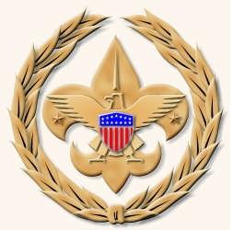
COMMISSIONER CABINET
Monthly Training

Slide 27
JOHN NEUHAUS
District Commissioner
How To Perform A
Uniform Inspection

Slide 28
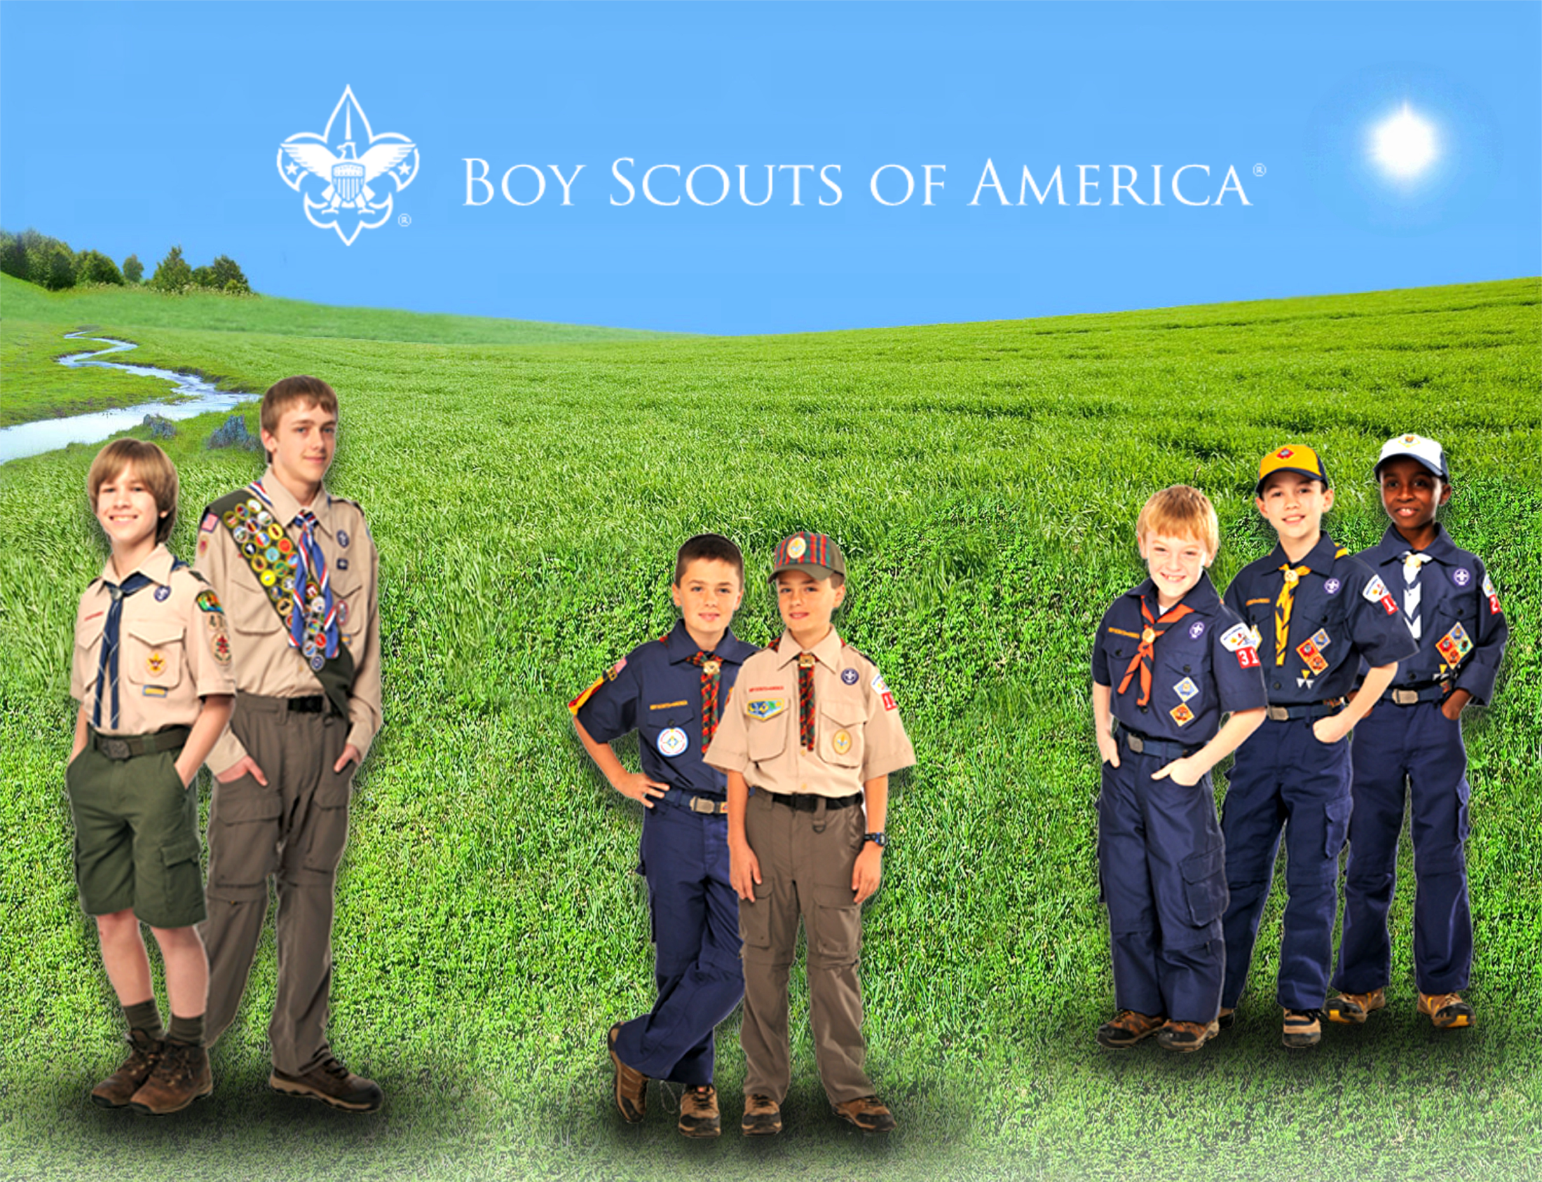
Notes:
The Boy Scouts of America has always been a uniformed body. Its uniforms help to create a sense of belonging. They symbolize character development, citizenship training, and personal fitness. Wearing a uniform gives youth and adult members a sense of identification and commitment.
Personal equality - The uniform represents a democratic idea of equality, bringing people of different backgrounds together in the Scouting tradition.
Identification - The uniform identifies youth and adult members of the Boy Scouts of America, visible as a force for good in the community. When properly and smartly worn, the uniform can build good unit spirit.
Achievement - The uniform shows the wearer's activity, responsibility, and achievement. The accomplishments of every youth and adult member can be recognized by the insignia worn on the uniform.
Personal commitment - The uniform is a constant reminder to all members of their commitment to the ideals and purpose of the Scouting movement. It is a way of making visible members' commitment to a belief in God, loyalty to country, and helping others at all times.

Slide 29
Uniform Inspection
Set the Example!
Perfect uniform score
Modest display of badges
Commissioner’s badges should reflect service at Council or District level
Consider no more than 9 knots (BSA Guide to Awards & Insignia – Page 61)
Notes:
Commissioners set a personal example with correct uniforming and a modest display of badges.
What is a modest display of badges?
It has often been said that unit leaders wear most of their badges on the uniforms of their youth members.
It might also be said that commissioners wear most of their badges on the uniforms of their unit leaders.
Most of a commissioner’s badges should reflect their service at a council or district level.
For example, they proudly wear the JTE District emblem, but good taste might dictate that they refrain from wearing the JTE Unit emblem simply because they serve on the troop committee of their son’s JTE troop.
Insignia Guide – Page 61 “It is recommended that the number of knots be limited to three rows of three (a total of nine knots).”

Slide 30
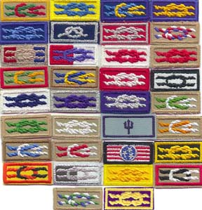
Uniform Inspection

Slide 31
Uniform Inspection
While Scouters may wear the insignia to which they are entitled, a ‘total display’ may not be in the best taste if the uniform looks overcrowded.
The Commissioner who wears only his Commissioner emblem, council shoulder patch and service star on his uniform is never guilty of poor taste.
Notes:
Set the Example!
While Scouters may wear the insignia to which they are entitled, a ‘total display’ may not be in the best taste if the uniform looks overcrowded.
The Commissioner who wears only his Commissioner emblem, council shoulder patch and service star on his uniform is never guilty of poor taste.
SOURCE: Scoutmaster Handbook – replacing Scoutmaster with Commissioner.

Slide 32
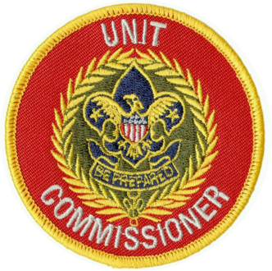
Uniform Inspection
Who:
Unit Commissioner
Integral part of Annual Commissioner Service Plan
Notes:
The commissioner helps pack and troop leaders and lends dignity to a high-morale event.

Slide 33
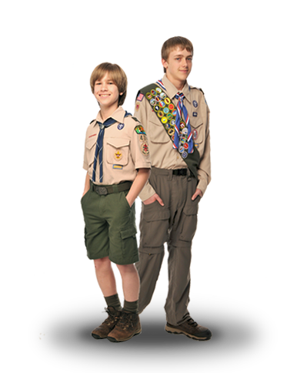
Uniform Inspection
Why:
Encourages complete uniforms
Persuade new members to obtain a uniform
Develops unit pride
Notes:
The Scouting movement is built on positive values, as reflected in a properly worn uniform.
A uniform inspection helps Boy Scouts take pride in themselves and their appearance, and shouldn't be used as a way to degrade a member.
Inspections are also a great opportunity to:
Encourage a complete uniform for all members.
Develop unit pride.

Slide 34
Uniform Inspection
When:
Cub Scout Packs - Fall
Boy Scout Troops – Spring & Fall
Venturing Crews – Never*
At the request of the unit leader
Notes:
When:
Cub Scout Packs - Fall
Boy Scout Troops – Spring & Fall
Venturing Crews – Never (generally)
Uniforms are NOT one of the methods of Venturing – but units who choose to wear uniforms should wear them properly.
Occasionally you will be asked to inspect the unit.

Slide 35
Uniform Inspection
How:
Obtain a supply of inspection sheets
2x each youth/adult
Supply unit leader with a set
Unit Leader distributes sheets 7-14 days before inspection
Members are instructed to take home and check their uniforms
Notes:
How:
Obtain a supply of inspection sheets
2x each youth/adult
Supply unit leader with a set
Unit Leader distributes sheets 7-14 days before inspection
Members are instructed to take home and check their uniforms

Slide 36
Uniform Inspection
How:
Short & Snappy
Friendly but dignified manner
Use common sense
Basic rule is neatness
Positive experience
Notes:
How:
Short & Snappy
They are morale features rather than major parts of unit meetings.
Conduct inspection in a friendly but dignified manner
Use common sense
Basic rule is neatness
Make it a positive experience Never embarrass or ridicule!

Slide 37
Uniform Inspection
How:
Involve Pack or Troop leaders
SPL with you to inspect Troop
PL with you to inspect Patrol
DC with you for their Dens
Notes:
How:
Involve Pack or Troop leaders
SPL with you to inspect Troop
PL with you to inspect Patrol
DC with you for their Dens

Slide 38
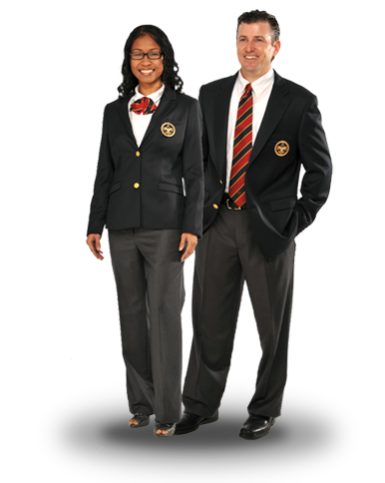
Uniform Inspection
How:
Use unit committee members as inspecting officers
Work in teams.
One check uniforms
One inspect insignia
Notes:
How:
Use unit committee members as inspecting officers
Work in teams.
One check uniforms
One inspect insignia
NOTE: in larger troops, consider inviting other Commissioners to help you!

Slide 39
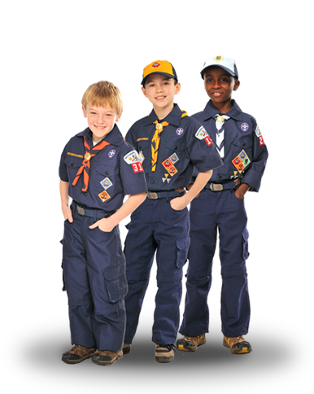
Uniform Inspection
How:
Use inspection sheets
Find things to compliment during inspection
Brief complimentary statement at end
Notes:
How:
Use inspection sheets
Find things to compliment during inspection
Brief complimentary statement at end

Slide 40
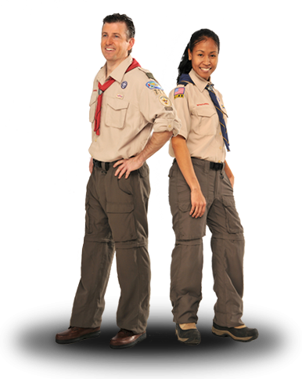
Uniform Inspection
How:
Follow up with unit leaders on any serious uniform issues
Review leader uniforms in private
Notes:
How:
Follow up with unit leaders on any serious uniform issues
Review leader uniforms in private

Slide 41
Uniform Inspection
What about!?
Boys without Uniforms?
Leaders who aren’t properly uniformed
When to wear the uniform
When not to wear uniform
Notes:
Remember: a boy is not required to have a uniform to be a Boy Scout
Uniform Exchange
Leaders – DISCUSS!
Be knowledgeable about WHEN to wear the uniform:
All Scout activities == we used to say “indoor” activities and use a Field Uniform for physically active outdoor events.
The new Centennial Uniform is made for outdoor activity with high-tech features that emphasize flexibility, durability, easy care, and functionality. Field Uniforms can be still used for informal events.
Be knowledgeable about when NOT to wear the uniform:
When selling a commercial product or service (except popcorn)
Situations that might imply endorsement by the BSA
When engaged in an activities that could dishonor or discredit the BSA or the person wearing the uniform.

Slide 42
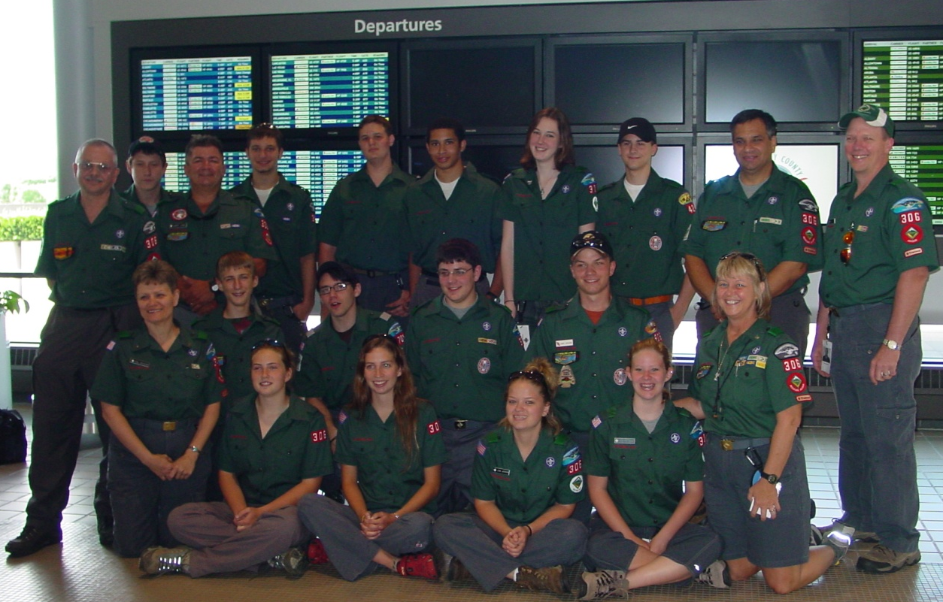
Uniform Inspection
What about!?
Uniforms when travelling
Notes:
Uniforms when travelling –
There is a rule that says you can’t wear the uniform outside the US without a Letter of Introduction or as part of a group travelling on a tour permit.
There are no rules preventing a Scout unit from wearing their uniforms when they travel OR requiring them to wear a uniform. Sometimes the unit leader will place “requirements” on their boys…
While not required, it looks great if they wear the uniform as they travel together as a unit. Of course in that case, they must have a tour permit.

Slide 43
Uniforms
Where does this go?!
Notes:
NEW - Amateur Radio Operator Rating Strip
For registered youth or adult member with a valid amateur radio license, of any class, issued by the Federal Communications Commission (FCC).

Slide 44
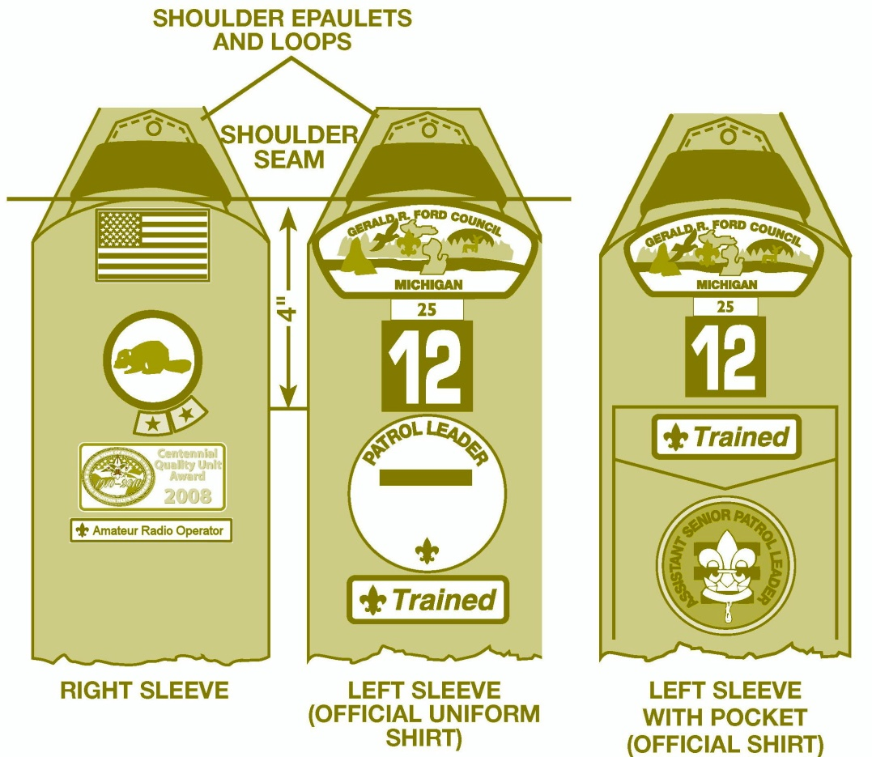
Uniforms
Right sleeve
Notes:
Strip on your right sleeve, below the U.S. flag, patrol/den emblem, and a unit award, if you have one.

Slide 45
Uniforms
Extra points – where does this go?
Notes:
Spells: M O R S E

Slide 46
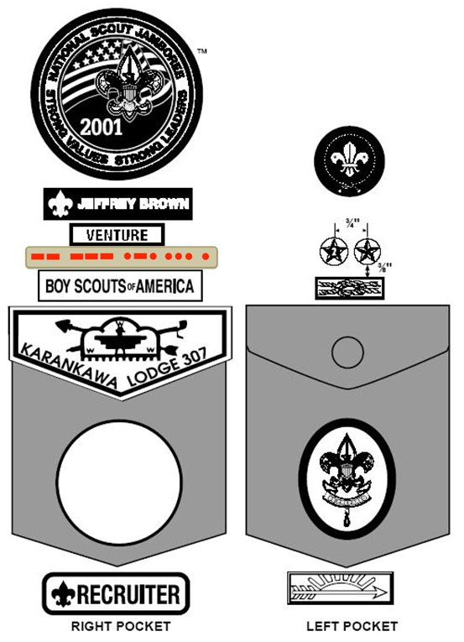
Uniforms
Right pocket
Notes:
WHY? Morse Code is considered an interpreter strip.

Slide 47
Uniforms
Notes:
Anyone want to try Sea Scout Uniforms?!

Slide 48
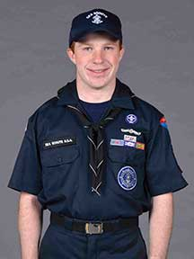
Uniforms
Notes:
Actually…. The Sea Scout Uniforms just became easier!!! This is the newest uniform in the bsa!
Called the New Century Universal Sea Scout Uniform”
It is intended to make it easy for members of newly formed Sea Scout Ships to outfit themselves in a Sea Scout uniform and may be chosen by any unit new or existing.
New Century Universal Sea Scout Uniform Components
Navy Blue ball cap; with SEA SCOUTS and the Sea Scout First Class Anchor embroidered in white. Youth may wear the white Dixie cup (unit option) and adults may wear the white combination cover (unit option)
Dark Navy Blue shirt (similar to Dickies Nos.1574(male) and FS574(female), color DN)
Dark Navy Blue crew-neck t-shirt
Optional neckerchief for youth (unit option) either the New Century Neckerchief (black “tar flap” design), or Sea Scout Neckerchief (triangular black with white embroidered Sea Scout First Class Anchor and edging)
Dark Navy Blue trousers (similar to Dickies Nos. 874(male) and 774 (female); color DN)
Black web belt with silver buckle and tab
Black plain-toe shoes and black sock

Slide 49
Uniform Inspection
Resources
#33066 Guide to Awards & Insignia
Uniform Inspection Sheets
34282 Tiger-Wolf-Bear
34760 Webelos
34283 Boy Scout-Varsity
34048 Leader
Commissioner-BSA.org
Notes:
Commissioner-BSA.org
Right under the April training PowerPoint

Slide 50
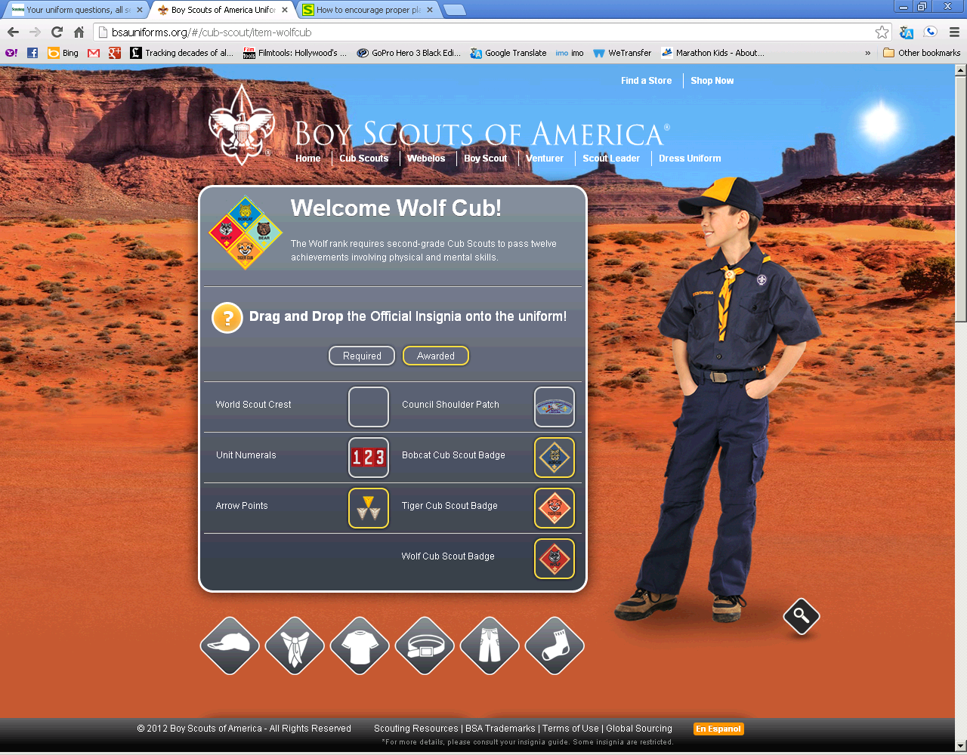
Uniform Inspection
Resources
bsauniforms.org
Notes:
Bsauniforms.org is an AWESOME tool for new Scouts and new Scout parents to figure out their uniforms!

Slide 51
Questions?
Notes:
Questions?

