Slide 1
Cub Scout Retention Toolbox
Notes:
The Cub Scout Retention Toolbox is not a physical toolbox. It is an execution of year-round Cub Scout retention strategies.
Why Cub Scouting?
Over 90 percent of Boy Scouts are former Cub Scouts, and a new Cub Scout may be with us for 10 or more years!
Cub Scouting is a financial driver at the local council level—uniforms, pinewood derby®, handbooks, day camp, Friends of Scouting, popcorn,
and so on.
Today’s primary takeaway is a set of tools, or ideas, that will help you increase retention in Cub Scouting in your service area.
We encourage you to share them throughout your council’s operation. You will also leave here with a short list of action steps that can assist in achieving the vision of sustainable gains in retention and membership.

Slide 2
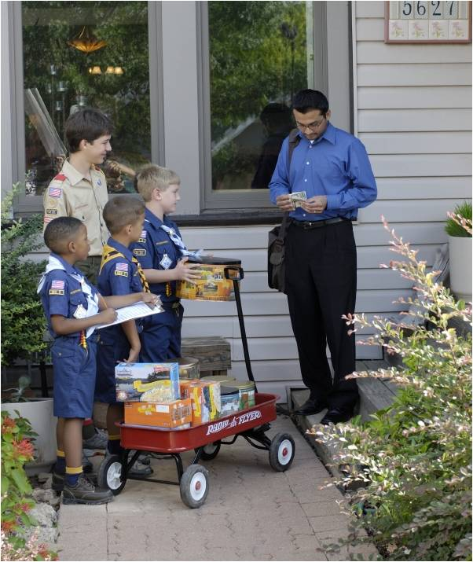
Notes:
We have seen the studies of the impact of Scouting on the life of a youth the longer they are involved, but what is the monetary aspect
of retention?
A recent study indicated that the net contribution by an individual Cub Scout to the National Council and local council is $59 per year.

Slide 3
The lifetime value of 500,000 more Cub Scouts at a 75% retention rate:
$90,214,245
Notes:
In addition to providing a great, enduring Scouting experience, at a 75 percent retention rate, 500,000 more youth registered in Cub Scouting provides a net customer lifetime value to the local council and National Council of $90,214,245.
The net customer lifetime value is based on the net income generated from product sales, supply purchases, camp attendance, and family Friends of Scouting, minus the per-member cost of a unit-serving executive.

Slide 4
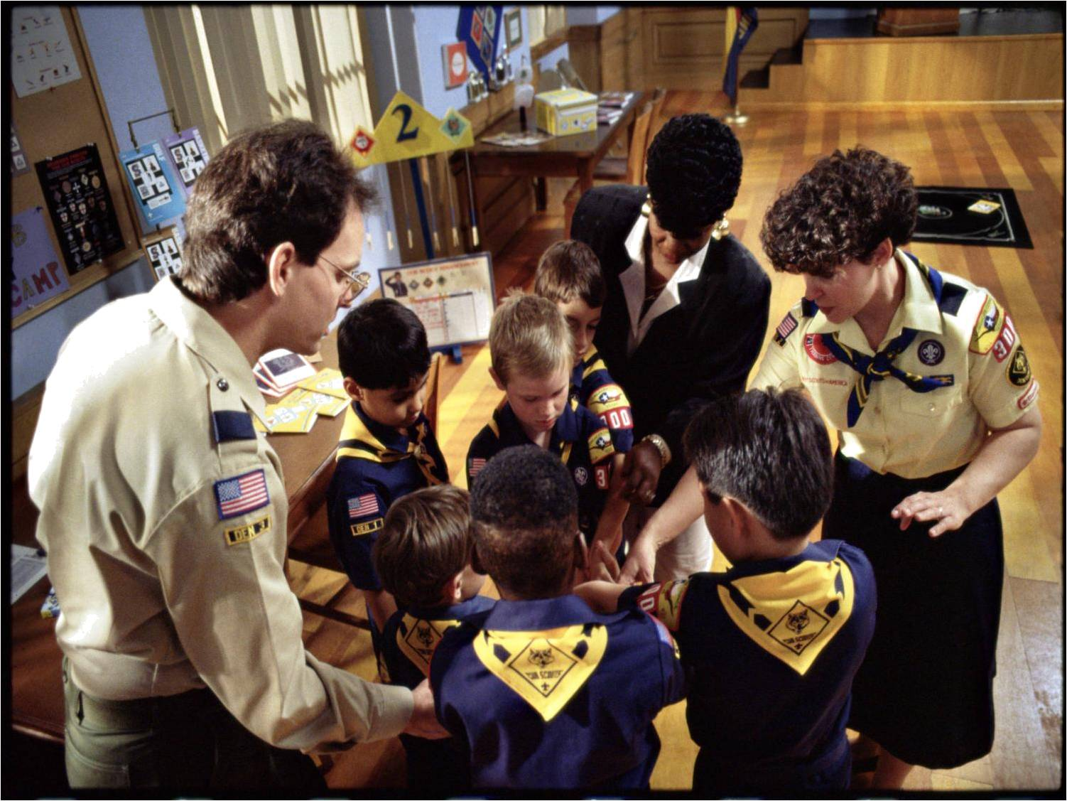
Retention Begins at the Unit Level!
Notes:
Retention begins and ends at the unit level.
The unit is where the most program happens and where the youth are most affected.
Through research and experience, we have identified some key factors in Cub Scout retention.

Slide 5
Notes:
First impressions:
As soon as the boy and his parent walk in a room at a join Scouting night, retention begins.
These first impressions are critical, and the stakes are high. You may have only 60 minutes to influence a boy’s entire Scouting career!
The first meeting needs to be all about these new parents since they are our primary decision makers at this point, and are potential leaders.
Be sure to have a person greet each boy and his parent as they arrive, and welcome them to Cub Scouting. Our research tells us this does not happen in all cases—as it should. It is a great way to immediately make the boy and the parent feel at ease and comfortable.

Slide 6
INFORMATION
Notes:
All too often, this is what that first meeting feels like to new parents.
There is much to tell at that first meeting, but keep it reasonable. There will be time to share more information later.
It is important we give them what they need and not the entire history and structure of the Boy Scouts of America.

Slide 7
Voice of
the Scout
Notes:
The Voice of the Scout is a retention strategy that can tell us what we are doing well—and where we need to improve. It is giving us some good, and some not-so-good, feedback.
Here are some comments from parents from April 2012:
“Our den meetings and activities have been very unorganized. Several have been cancelled at the last minute. The den leader has been late on more than one occasion.”
“Communication has been great from the beginning. This was our first year in Cub Scouts and we felt we knew what was going on from
the start.”
“While we understand the rule that parents must attend with their sons, we found the meetings to be disrespectful of our time.”
“They failed to utilize opportunities to help the boys grow and develop. In addition, pack meetings run too long for boys of this age.”
“At this point, my son doesn't feel like he wants to continue in Cub Scouts. That is a disappointment to us as parents since we both had very meaningful Scouting experiences as children. But, based on what we saw this year, we have to agree with him.”

Slide 8
Onboarding
Notes:
Many councils do not provide an orientation to new customers—parents—at the time they join.
This results in confusion and lack of activation—and eventually leads to attrition and negative word of mouth.
Councils, staff, and volunteers need to understand the secrets of successful onboarding to ensure that new families get the right information when they join.
Successful onboarding builds customer loyalty, lessens parent confusion, reduces the potential of poor participation, leads to retention through education, values parents’ time, and gives them a feeling of support.
The BSA provides a retention tool to help onboarding in the form of an envelope that councils can use to connect a parent and/or potential leader to an onboarding website.
One million postcards were sent out to councils last year, and an envelope like the one shown here will be used in 2012.
The envelopes are bilingual and contain a QR (quick response) code so a parent with a smartphone can connect to information right there at the joining night.

Slide 9
Welcome!
Notes:
The website they are directed to—www.beaScout.org/welcome—will give the new parent immediate general information on Cub Scouting.
This begins the Cub Scout/parent onboarding process. Every new parent and leader should be encouraged to visit the site as soon as they
get home.

Slide 10
Handbooks
Notes:
The next important retention tool is the Scout’s Tiger Cub, Wolf, Bear, or Webelos Scout handbook.
The handbook is the Scout’s guide to adventure and the parents’ guide to their son’s Cub Scouting experience.
Every Scout should have a handbook! It is the vehicle to “take the program home” after the meetings.

Slide 11
Magazines
Notes:
Receiving and reading Boys’ Life magazine helps boys experience Scouting even when not in a meeting. It is award-winning, age-appropriate reading for young boys. Boys who receive Boys’ Life stay in Scouting longer, and it is a bargain at only $12 a year.
Scout leaders receive Scouting magazine, published five times a year, as part of their registration fee. Articles such as “Take a Hike,” “How to Keep Cub Scouts Connected,” and “How to Deal With an Unruly Parent” help leaders have more fun and deliver a better program for Scouts.

Slide 12
Den Meetings
Notes:
Good den meetings are a critical tool for retention. So get them to a good meeting quickly!
Dens should begin meeting within seven days of joining.
Make it a policy to follow the meeting plans laid out in the Cub Scout Den & Pack Meeting Resource Guide.
And make sure every Scout and parent knows the date, time, and place of the first den meeting before they leave the joining meeting. Better yet, give them a printed meeting schedule.

Slide 13
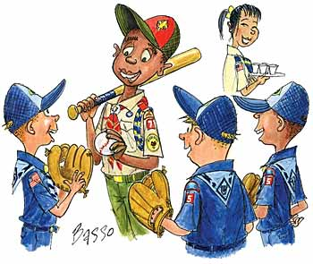
Den Chief
Notes:
A den chief is an older Boy Scout, Varsity Scout, or Venturer who helps lead weekly den meetings and assists the den in its part of the monthly pack meeting. He is selected by the senior patrol leader and either the Scoutmaster, Varsity Scout Coach, or Venturing Advisor at the Cubmaster’s request. He is approved by the Cubmaster and pack committee for recommendation to the den leader and is registered as a youth member of his troop, team, or crew. A good den chief serves as a role model for Cub Scouts. They look up to him and follow his lead on how they should act and behave. As an older, experienced member of the organization, he is like the “big brother” to the den. He sets the bar high through good example, positive attitude, enthusiasm, and proper uniforming. He is a friend to the boys in the den.

Slide 14
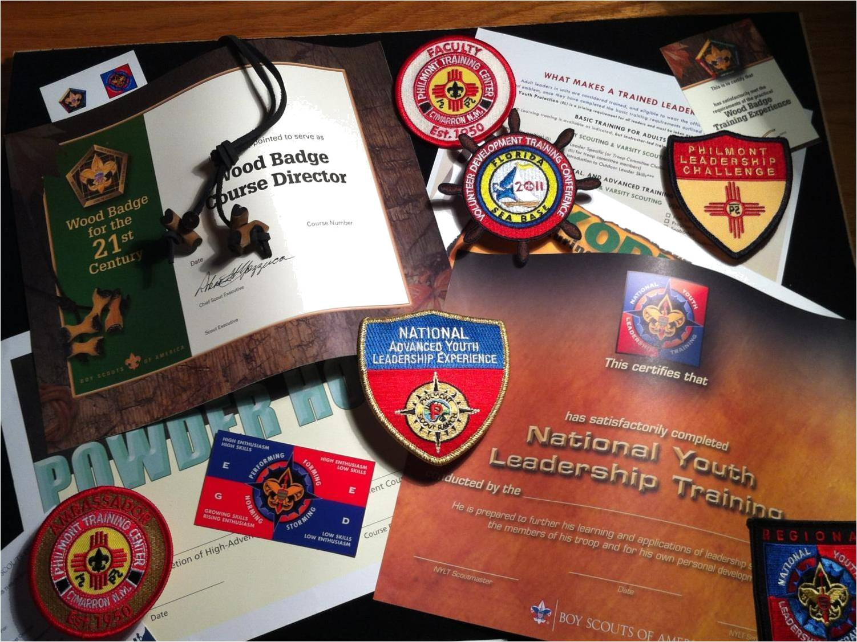
Training
Notes:
Give new leaders a good start!
If den leader–specific training is not available before the first den meeting, a new leader should take Fast Start training. It is available on MyScouting.org, on the same page as Youth Protection.
While den leader–specific training is available online, in-person training creates invaluable mentoring opportunities for the new leader. Districts and packs should make it available any time new leaders join Cub Scouting.
Studies show that a trained leader retains youth longer.
Training gives the leader a good start.
Cub Scout training is fun!

Slide 15
Selection and Succession Plans
Notes:
Most often the pack fails because there is no person prepared and willing to assume a leadership role.
Initial leader selection is critical. Selection of an adult who will be the best leader for the Scouts, and not just the first one to raise a hand, can make a big difference.
But many new and long-tenured packs fail to carry on because of a key adult leader who, for whatever reason, decides to step down. A succession plan is like a good insurance policy. Identify at least two future key leaders for every pack leadership role, and get those leaders trained and prepared to lead when the time comes.

Slide 16
Planning
Notes:
Program planning is one of the most effective tools of retention.
Poor program at the unit level destroys the brand!
During the late spring or early summer, plan the pack’s annual calendar of meetings and events. Start with everything that occurred last year that you want to do again, and add other things your pack wants to do. Be sure to consult school calendars, the chartered organization’s calendar, council events, district events, major sporting events, community events, and the pack’s advancement objectives. Give the annual calendar to the new Scout and his parent when they join so they can include pack events in their family calendar.
Complete an annual budget. Update and circulate the budget every month among parents. Keep them aware of the need for fundraising and how fundraising benefits their Scout.

Slide 17
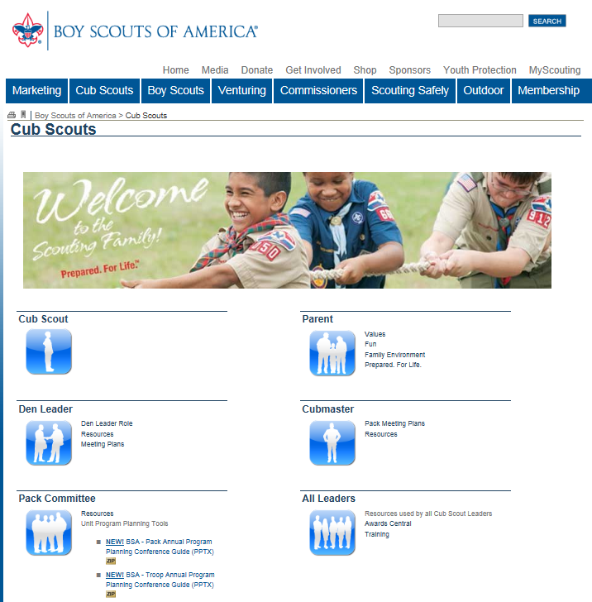
Scouting.org/ cubscouts
Notes:
Use Scouting.org/cubscouts.
This website has resources for:
The Cub Scout
The parent
The den leader, Cubmaster, and assistant Cubmasters
The pack committee
And it includes a new program planning tool!

Slide 18
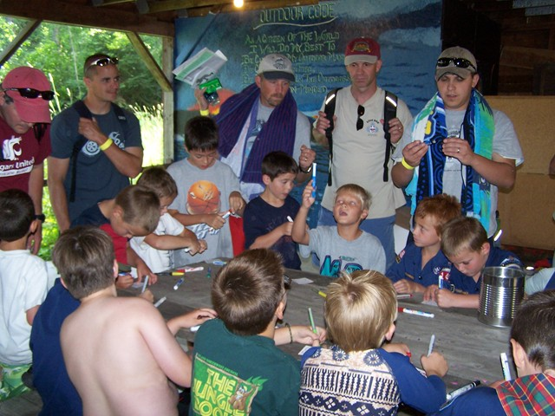
Summertime Pack Program
Notes:
Keeping Cub Scouts active and participating in Scouting over the summer months is an important retention tool.
Scouts and families that enjoy a Scouting summer are more likely to stay involved in the fall, so be sure it is a part of the plan.

Slide 19
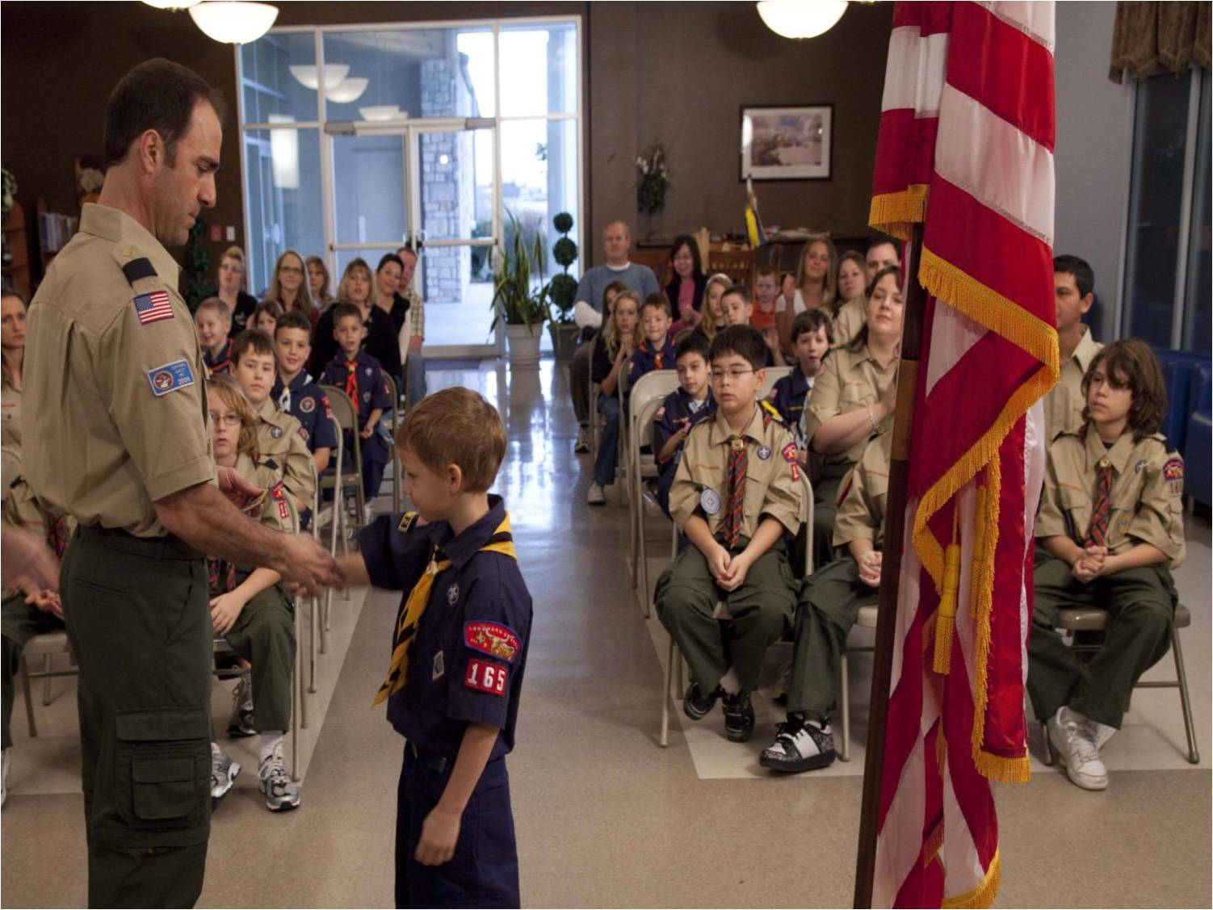
Advancement and Recognition
Notes:
Advancement is another retention tool. Scouts who advance stay in Scouting longer. The den and pack meeting plans found in the Den & Pack Meeting Resource Guide help encourage advancement. Be sure all new Scouts receive their Bobcat at their first pack meeting.
Monthly pack meetings should feature advancement awards, belt loops, pins, achievements, and recognition of birthdays, Good Turns, and good grades. Recognize new leaders, new parents, and their new Scouts. Make a big deal of recognition! It is a big thing, especially to parents who have not been involved in other organizations, and it encourages others to achieve.

Slide 20
Parent Orientation
Notes:
Immediately after a joining night, show the “ScoutParent Orientation” video and/or Scouting Orientation Guide that are available from Scoutparents.org/Resources. Consider this parent orientation their training.
Parents who understand Scouting are more likely to be involved as leaders, or at least more likely to be supportive of leaders. This orientation will help them appreciate the Scouting culture and learn to appreciate the program opportunities for their sons.
Embrace ScoutParents.org as a pack. The mission of ScoutParents is to develop and implement methods that encourage and empower Scouting participants to help maximize the number of dedicated Scouting youth and parents and mentors as dedicated Scouting volunteers who participate with their Scouts.

Slide 21
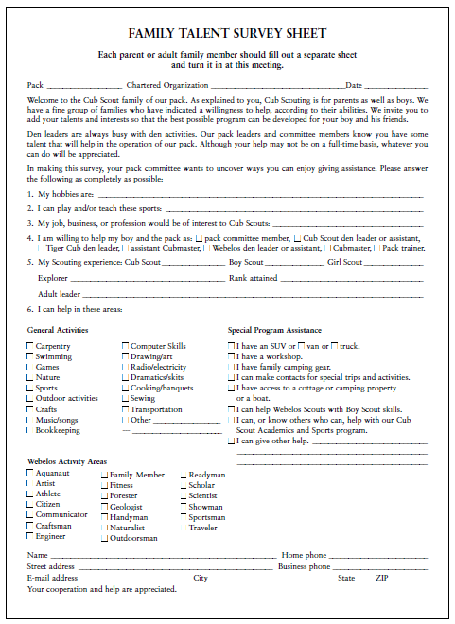
Parent Orientation
Notes:
Have each parent fill out the Family Talent Survey Sheet. Knowing the talents and interests of your parents will only make the unit stronger. And you may uncover some outstanding resources for the pack, the district, and the council.

Slide 22
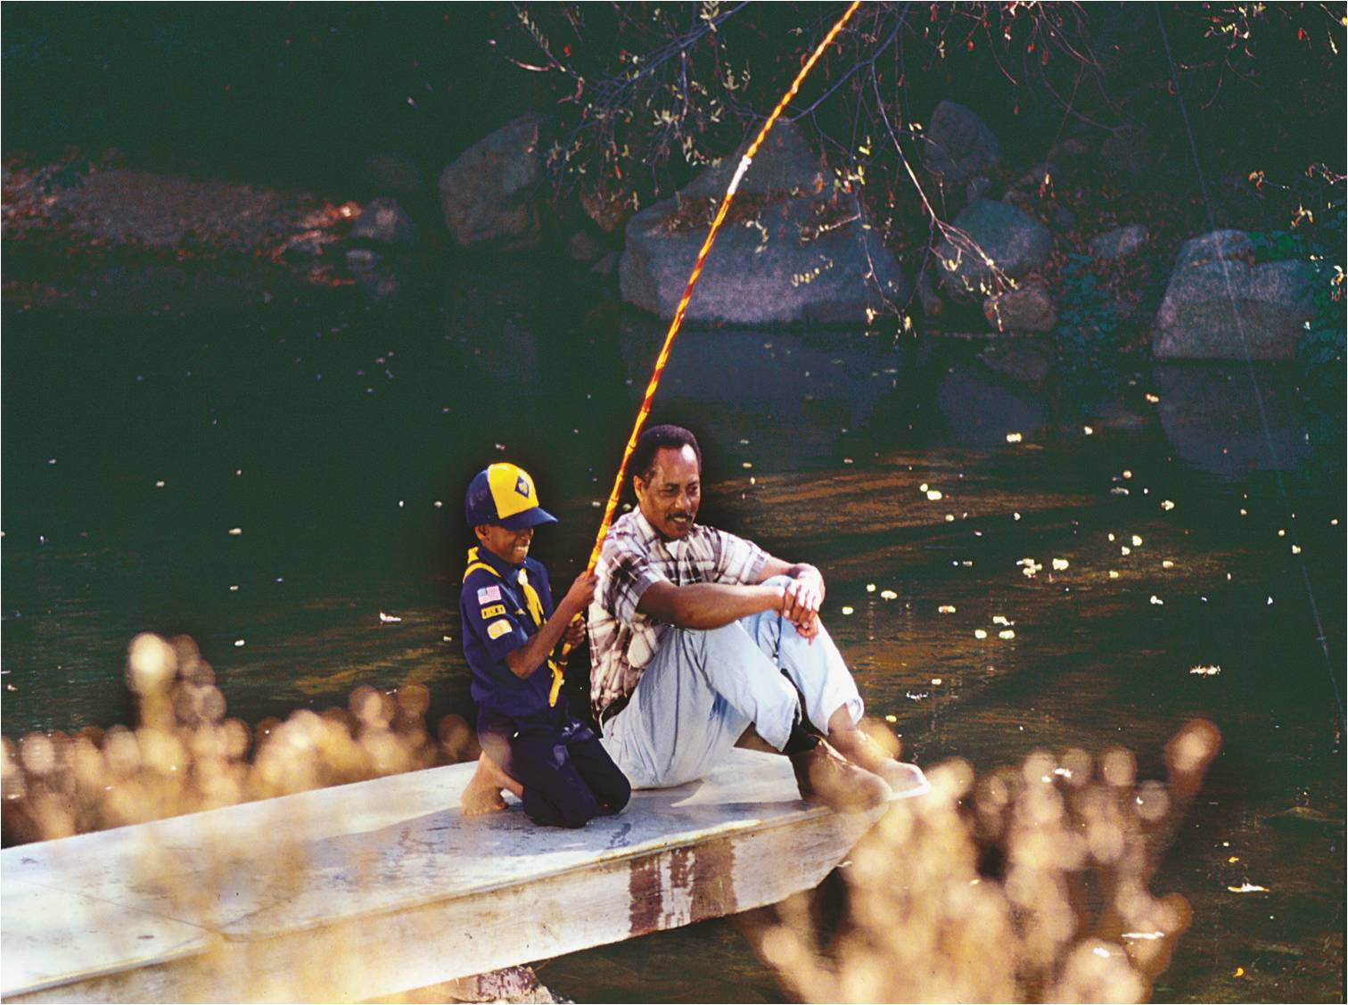
Communicate
Social Events
Bonding
Notes:
A few final retention tools for your toolbox.
Communication is very, very important! Monthly newsletters to parents help keep them informed and involved. Some packs are making good use of social media to push information to parents. Many councils and packs use Constant Contact, an inexpensive email newsletter application.
Make it social! Every parent likes and needs to feel connected with someone to call to discuss an issue, problem, or question. That phone call might be as simple as needing someone to talk with or vent some frustration. Make it easy; circulate a member roster organized by dens. Think about having special gatherings for parents and/or families.
Do not let adult disagreements spill over to the boys.
Create bonding opportunities like family camping and religious awards courses. These bring the families closer together and closer to the pack.

Slide 23
Six Takeaway Actions to Implement Best Practices
Handbooks for All Cub Scouts
Orientation, Selection, and Training
First Den Meeting Within 7 Days
Frequent Communication to Parents
Den Chief for Every Den
Annual Program Plan
Notes:
Use and promote all youth/parents purchasing and using the appropriate Cub Scout handbook—Tiger Cub, Wolf, Bear, Webelos Scout.
Orient new parents and leaders. Select new leaders and replacements. All new leaders complete training.
Have the first den meeting within seven days of joining.
Communicate with parents on a regular basis: monthly newsletter, Facebook, Twitter, etc.
Have a den chief for each den in the pack.
The pack must do program planning in the spring of the year for 12 to 18 months, and it must distribute the plan to parents.

Slide 24
Dedication Now and in the Future
Notes:
Dedication by the council/unit and a commitment to these strategies now and in the future are key.
You can’t just do this or say this one time. You must use this toolbox all the time—today, tomorrow, next year, and beyond.
It is not just a one-time thing. It is an all-the-time thing that takes implementation and discipline.

Slide 25
Cub Scout
Retention Toolbox
Notes:
Trained and dedicated leaders, leading a planned, quality program, retain boys in Scouting longer!
Use the tools you have to make Scouting all that it can be!

