Slide 3
Patron of South Africa Scout Association

Slide 4
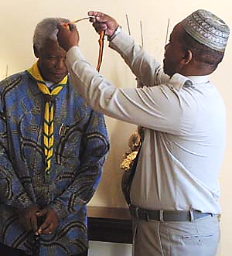
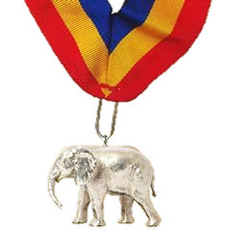
Notes:
Springbok Skin Woggle worn by South African Scouts attending World Jamborees,
Order of the African Elephant

Slide 5
Quote of the month:
"The Scout Movement is a world leader in educating youth. Scouting inspires patriotism, sound moral values, courage, character-building, self-reliance and community awareness. It also motivates our young people to achieve their full potential."
Nelson Rolihlala Mandela
Notes:
Scott Teare, the Secretary General of WOSM said: “He is and will remain a great inspiration for all Scouts around the world. Over 40 million Scouts join the rest of the world in mourning for this great loss and we pray for his soul to rest in peace.”

Slide 7
COMMISSIONER Training Updates

Slide 8
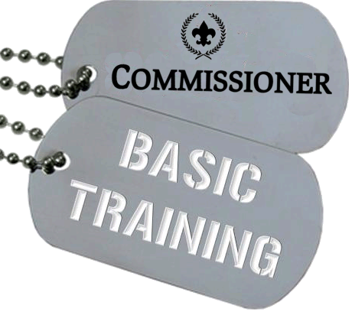
• February 14, 2013 – Sponsored by Area 2 8:30 AM @ Cranberry, PA
April 12 – Sponsored by Area 3 8:30 AM (location TBD)

Slide 9
New “Stuff”
Scouting University
All one Scout Oath
Venturing May 2014
Cub Scouts May 2015
NEW Commissioner Toolkit
Middle School Explorer Clubs
Notes:
Lynda.com
Toolkit – Q1 2014 --
includes better UVTS, unit self assessment, assign commish to unit, etc.

Slide 10
Scouting U
Notes:
Scouting U
eLearning Campus
Every professional course will have an e-learning component
Measure learning… exam… did learning take place
Centralized training…
Year of Conversation…

Slide 11
Scouting U

Slide 12
Looking Ahead
2014 Annual Membership Validation
Planning should have started
Forms due Feb 15 to area director (LHC?)
Commissioners should play a big role!!!
Unit Self-assessment is key

Slide 13
Leadership
School of
Scouting
• March 15, 2014 @ IUP Includes Commissioner College
Bob Reese representing Commissioners
Notes:
SLTC – March 15, 2014

Slide 14
COMMISSIONER General Updates

Slide 15
Council Scorecard
Notes:
The Mission Impact team is working to finalize the expansion of the JTE dashboard, with the goal of pushing the council NPS score and response rate to the JTE dashboard later this month.
This is an ambitious project to take data down to the district level, and the Mission Impact team looks forward to making this valuable data available to you in the near futur

Slide 16
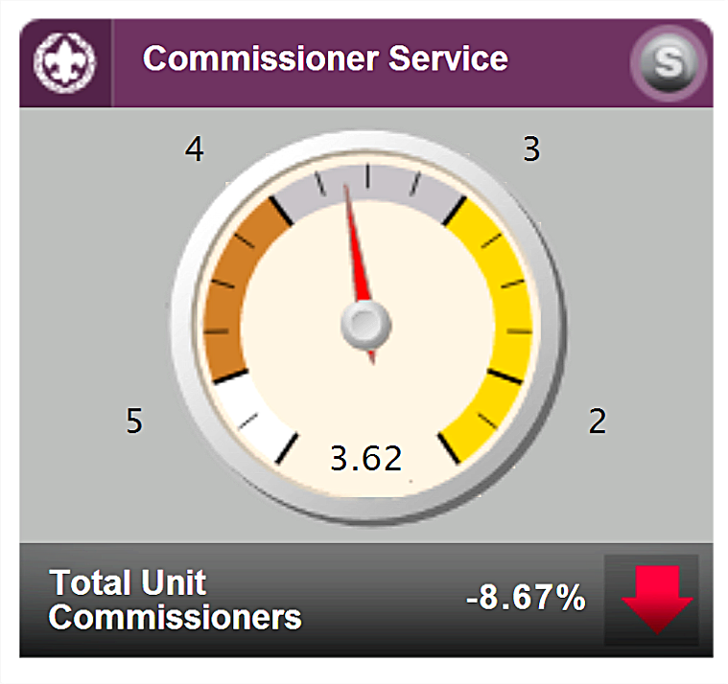
Commissioner Scorecard

Slide 17
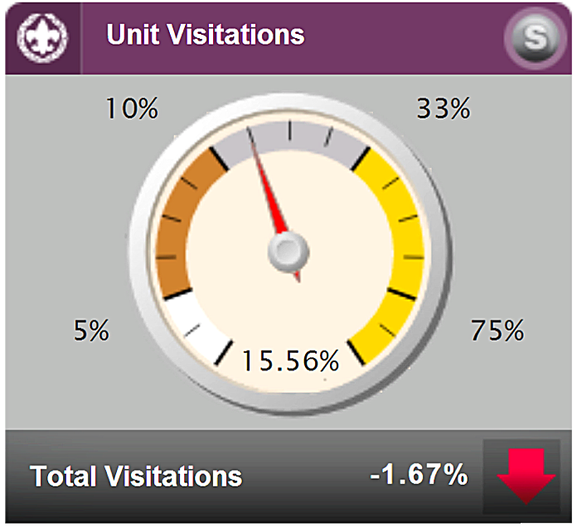
Commissioner Scorecard

Slide 18
UVTS
Monthly unit visits are the single most critical issue to ensure the delivery of a quality program to every unit in our council.

Slide 19
UVTS – November
Beaver Valley Jack Boyde Jr
Beaver Valley Jeffrey Eberle
Beaver Valley Leonard Skultety Jr.
Beaver Valley Thomas Hines
Beaver Valley William Lytle
Chestnut Ridge Joseph Rougeux
Chestnut Ridge Patrick Robinson
Chestnut Ridge Steve Deemer
Chief Logan Donald Grimm
Chief Logan Kirk Leidy
Chief Logan Thomas Gheer

Slide 20
UVTS – November
Conestoga John Neuhaus
Conestoga Kathleen Yates
Conestoga Mercedes Faust
Conestoga Robert Faust
Forbes Trail David Lauer
Forbes Trail Patrick Debroisse
Fort Pitt Beth McKinstry
Fort Pitt Beverly Harding
Fort Pitt Scott Harding
Frontier C Rodi
Greene Carol Salai
Japeechen Evan Erickson

Slide 21
UVTS – November
Keystone Carl Reed
Keystone Leonard Whiteford
Keystone Rodell Snyder
Keystone Vern Walker
Mingo Trails Carl Dokter
Mingo Trails Charles Moyer
Mingo Trails William McLaughlin
Seneca Roger Dickhans
Seneca William Koller
Steel City Anne Davis
Steel City Kimberly Krapp
Tecumsa Gregory Weidman

Slide 22
MEMBERSHIP The Main Thing
National Numbers
November
Total Youth (140,406)
Total Units (3,627)
Total Leaders (38,017)

Slide 23
MEMBERSHIP The Main Thing
LHC Numbers November
Total Youth 17
Total Units (34)
Total Leaders (147)

Slide 24
MEMBERSHIP The Main Thing
LHC Numbers November
Tiger Cubs (365)
Webelos 83
Venturers 211
Unit Adults (84)
Council/District (63)
Notes:
Down Tiger Cubs (300)
Up Webelos (220)
Up Venturers (400)
Down Unit Adults (84)
Down Council/District Adults (63)

Slide 25
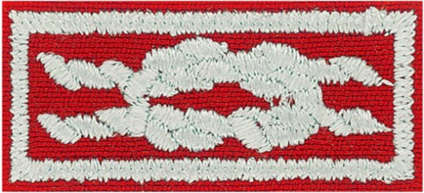
D.C.S.A.
Distinguished Commissioner Service Award

Slide 26
Priorities Unit Commissioners
Support unit growth using JTE
Link district committee resources to units
Visit units and log visits in UVTS
Support on-time charter renewal
Notes:
Supporting unit growth in the Journey to Excellence criteria: JTE measures performance characteristics that unlock the door to a successful unit. We should analyze the unit’s program and identify JTE areas where help is needed to move the unit to a higher level of JTE success.
Linking district committee resources to the unit: We should support the district committee’s delivery of a “catalog of services” to support the specific JTE elements needed for a particular unit’s health and success.
Visiting units and logging the visits into the Unit Visit Tracking System (UVTS): Our core task remains visiting the unit. UVTS input feeds critical information to the district committee to help link resources to the unit.
Supporting on-time charter renewal: The commissioner’s focus is the retention of the unit, though we should be especially mindful of supporting new youth membership efforts as we move more toward a volunteer-led, professionally guided approach to increasing membership.

Slide 27
2014 Priorities District Commissioner
Recruit Unit Commissioners
Recognize effective commissioners
Improve unit visitation
Notes:
The DC’s top priority has always been:
Identify & Recruit Commissioners
Orient & Train Commissioners
Supervise & Motivate Commissioners
To bring that more in focus, we are setting these as our top 3 priorities for 2014:
Recruit Unit Commissioners
Work the recruitment process
Partner with USE for better results
Train & mentor them
Recognize effective commissioners
Hold commissioning ceremonies
Look for reasons recognize publicly & privately
Encourage earning Commissioner Awards (especially Commissioner Award of Excellence in Unit Service)
Improve unit visitation
Motivate ADC’s to work with UC’s to enter visits
Report UVTS status every month
Make personnel changes as necessary

