Slide 1
Quote of the month:
“America needs Scouting, and our policies must be based on what is in the best interest of our kids. We believe good people can disagree and still work together to accomplish great things for youth.
Going forward, we will work to stay focused on that which unites us. Be a part of this discussion by staying engaged and continuing your role in Scouting. The kids in your community need you.”
Wayne Brock
Chief Scout Executive
Notes:
In response to public outcry over the show, National Geographic Channel released the following statement:
“National Geographic Channel is an international media company that is an equal opportunity employer. We do not discriminate in any capacity. As it relates to our upcoming show with the Boy Scouts, we certainly appreciate all points of view on the topic, but when people see our show they will realize it has nothing to do with this debate, and is in fact a competition series between individual scouts and civilians.”

Slide 2
Notes:
First show – March 4
Many people out there have the perception of Scouting that’s about 30 years old. That’s the hardest thing to change. Ninety five percent know who we are but have an old perception of what the brand is. To fix that, we call it “changing the conversation.”
Stephen Endicott, Marketing Group Director
Help the old lady across the street and kick your old man’s butt.
Thomas Beers

Slide 3
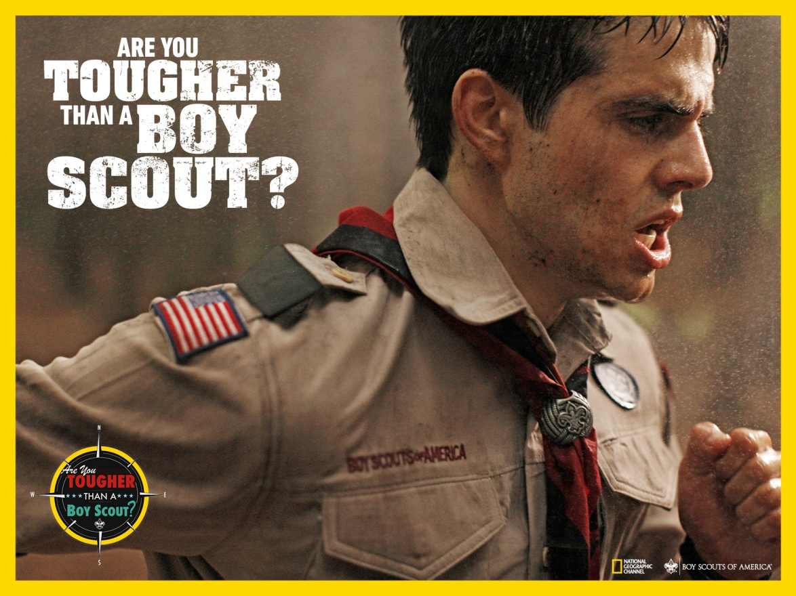
Notes:
Show Video

Slide 4
http://toughscout.com
#TOUGHSCOUT
facebook.com/AreYouTougherThanABoyScout?
Notes:
Spread the word to friends, family, and fellow Scouts that Are You Tougher Than a Boy Scout, a new series from Original Productions (the Emmy award-winning producers of Deadliest Catch and Ice Road Truckers) premieres March 4 on the National Geographic Channel.
In six episodes, adults from all walks of life will compete with the country’s top Boy Scouts in challenges based on the Boy Scout Handbook.
The adult “civilians” are former Scouts, some of whom left Scouting before achieving the Eagle Scout badge. They will compete against Scouts in challenges ranging from archery to rafting and even to setting up a campsite. The adults will try to prove they can keep up with the Scouts, who were selected are among the tops in the nation.

Slide 5
COMMISSIONER Training Updates

Slide 6
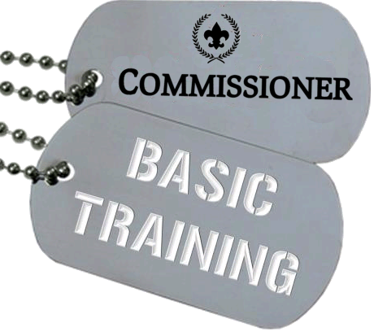
BASIC TRAINING
• February 23, 2013 – Area 1 8:30 AM @ Lebanon Presby Church
• April 20, 2013 – Area 3
Flag Plaza
8:30 AM – CBT
Noon – NUC’s

Slide 7
Wednesday, April 3
tinyurl.com/commishniteatpirates

Slide 8
AskCommish@commissioner-bsa.org Leader Help Hotline! (412) 326-9BSA
Notes:
Content Due – April 1

Slide 9
COMMISSIONER QUIZ
How is the Commissioner Corps Retention Mission Best Achieved?
Recruiting and Training more Commissioners.
Providing an adequate number of trained unit commissioners who provide a link to District Committee resources in support of a quality unit program.
Recruiting new unit commissioners from each unit to be part of the Commissioner Staff.
Fighting with the District Committee because they are bozos.
Scheduling and attending more meetings.
Notes:
How is the Commissioner Corps Retention Mission Best Achieved?
Recruiting and Training more Commissioners.
Providing an adequate number of trained unit commissioners who provide a link to District Committee resources in support of a quality unit program.
Recruiting new unit commissioners from each unit to be part of the Commissioner Staff.
Fighting with the District Committee because they are bozos.
Scheduling and attending more meetings.

Slide 10
COMMISSIONER QUIZ
How is the Commissioner Corps Retention Mission Best Achieved?
Recruiting and Training more Commissioners.
Providing an adequate number of trained unit commissioners who provide a link to District Committee resources in support of a quality unit program.
Recruiting new unit commissioners from each unit to be part of the Commissioner Staff.
Fighting with the District Committee because they are bozos.
Scheduling and attending more meetings.
Notes:
EASY!

Slide 11
COMMISSIONER QUIZ
2) The greatest hazard to the effectiveness of a commissioner?
Taking on non-commissioner-related Scouting responsibilities.
Drinking too much coffee at commissioner meetings.
Giving top priority to a troop that lost its Scoutmaster.
Failing to earn the Arrowhead Award.
Notes:
2. The greatest hazard to the effectiveness of a commissioner is?
Taking on non-commissioner-related Scouting responsibilities.
Drinking too much coffee at commissioner meetings.
Giving top priority to a troop that lost its Scoutmaster.
Failing to earn the Arrowhead Award.

Slide 12
COMMISSIONER QUIZ
2) The greatest hazard to the effectiveness of a commissioner?
Taking on non-commissioner-related Scouting responsibilities.
Drinking too much coffee at commissioner meetings.
Giving top priority to a troop that lost its Scoutmaster.
Failing to earn the Arrowhead Award.
Notes:
Commissioners are usually wonderful Scouters and can be asked to do many things. They must not fall into the trap of doing everything else in Scouting except their appointed job—unit service.

Slide 13
COMMISSIONER QUIZ
3) You have a district with 60 units. What’s the minimum number of commissioners the district needs?
1 in 3
20
Less than 20
More than 20
Notes:
3. You have a district with 60 units. What’s the minimum number of commissioners the district needs?
1 in 3
20
Less than 20
More than 20

Slide 14
COMMISSIONER QUIZ
3) You have a district with 60 units. What’s the minimum number of commissioners the district needs?
1 in 3
20
Less than 20
More than 20
Notes:
d. More than 20.
The district needs 20 unit commissioners just to meet the 1 unit commissioner per 3 unit ratio plus 4 ADCs to meet the
1 ADC per 5 unit commissioner ratio plus 3 roundtable commissioners and a district commissioner, for a total of 26 people.

Slide 15
COMMISSIONER QUIZ
4) A good rule of thumb for the ratio of ADCs to UC’s is?
1 in 3
1 in 4
1 in 5
1 in 6
Notes:
4) A good rule of thumb for the ratio of ADCs to UC’s is?
1 in 3
1 in 4
1 in 5
1 in 6

Slide 16
COMMISSIONER QUIZ
4) A good rule of thumb for the ratio of ADCs to UC’s is?
1 in 3
1 in 4
1 in 5
1 in 6
Notes:
c. 1 ADC for every 5 unit commissioners.

Slide 17
START THINKING ABOUT…
• District Recognition Dinners?
Commissioner Awards!
Training Topic for May

Slide 18
COMMISSIONER CABINET
Monthly Training

Slide 19
KEN VOLLE
District Commissioner
Unit Leadership Inventory

Slide 20
Unit Leadership Inventory
Who:
Unit Commissioner
Integral part of Annual Commissioner Service Plan
Notes:
UNIT LEADERSHIP INVENTORY… is an integral part of the Annual Commissioner Service Plan.

Slide 21
Unit Leadership Inventory
When:
Once per year
Early spring
By April 30
Notes:
Done once per year, early in the spring by April 30.

Slide 22
Unit Leadership Inventory
Why?
Determine – who will continue or drop
Check – two deep leadership?
Check – direct contact leaders trained?
Create – plan of action.
Notes:
Getting an inventory of leaders who plan to participate with the unit in the coming year is an important first step in assessing the number of active adult leaders and the number needed to be recruited.

Slide 23
Unit Leadership Inventory
How:
Obtain printout of charter
Attend meeting of Unit Committee
Take an inventory of adult leaders
Decide who to keep/drop
Plan to visit inactive adults
Create a plan to recruit more!
Notes:
Obtain printout of charter
Attend meeting of Unit Committee
Take an inventory of adult leaders
Decide who to keep/drop
Plan to visit inactive adults
Create a plan to recruit more!

Slide 24
Unit Leadership Inventory
Ways the UC Helps:
Visit inactive adults
Explore reasons for dropping
Give feedback
If appropriate, recruit as a UC!
Notes:
Take time to assess each leader that has dropped from the active Unit inventory.
Visit the inactivated adults.
Explore with the adult their reasons for dropping and give feedback where appropriate.

Slide 25
Unit Leadership Inventory
Ways the UC Helps:
Determine how many leaders are needed
Consider size of unit
Number of patrols or dens
How many activities are planned
How many older Scouts are around
Notes:
Consider the following factors to determine the number of leaders that will need to be added.
The size of the unit and number of patrols or packs will influence adult guidance needed in addition to the activities planned for the year and
the number of experienced Scouts who can help lead their younger counterparts.
The leadership goals of the existing leaders, the committee and the commissioner should also be taken into account.

Slide 26
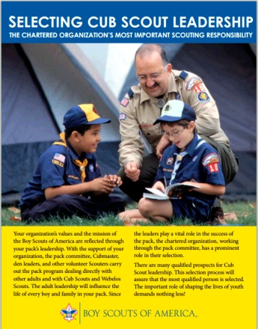
Unit Leadership Inventory
Ways the UC Helps:
Help create plan to recruit more leaders
Use BSA Resources:
Selecting Cub Scout Leadership 13-500
Selecting Quality Leaders 18-981
Provide “job descriptions” for new leaders
Make sure training is part of plan
Notes:
After determining the optimum number of leaders, a plan of action should be developed jointly with the Unit Commissioner and the Unit
Committee to ensure there is and will be adequate leadership for the unit.
New leaders should be selected, recruited, and trained before beginning membership recruiting.
Note - links to BSA resources are on Commissioner-BSA.org website

Slide 27
Unit Leadership Inventory
Ways the UC Helps:
FOLLOW UP!
Notes:
Maintain an “action item” list for each unit.
Be sure to follow up with the Committee Chair on their progress!

