Slide 1
Quote of the month:
“He once told me that a child today spells “love” “t-i-m-e.”
I can think of no greater gift a Scout leader can give to a child than time. It is what sets us apart from so many others in our far too often, fast-paced world. “Time” is a precious gift to give a young person today..”
Scott Teare
Secretary General World Scouting
Notes:
Referring to a quote from Zig Ziglar
World Organization of Scout Movement (WOSM)

Slide 2

COMMISSIONER
Training Updates

Slide 3
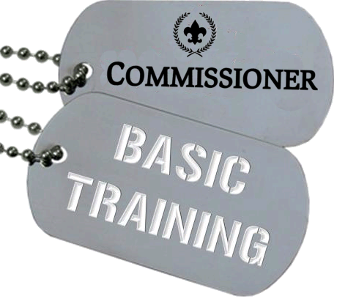
BASIC TRAINING
• February 23, 2013 – Area 1
8:30 AM @ Lebanon Presby Church
• April 20, 2013 – Area 3
• June 15, 2013 – Area 6
Notes:
AWESOME TRAINING ON SATURDAY
Held during the very successful Recharter
OWNED by Frontier, Beaver Valley & Seneca
General Green & Mon Valley have a do-over in February (or schedule their own)
Encouraged by District Committee involvement!!!

Slide 4
2013-2014 TRAINING PLAN
• Assignments
Other Needs?
Notes:
Roundtable/Forum guides being updated
Title change approved by Exec Board (ACC & ADC & staff to be Asst RT)
Program issues that require additional review by Volunteer & Youth Development teams
Committee meets again in February
Rollout – May 2013

Slide 5
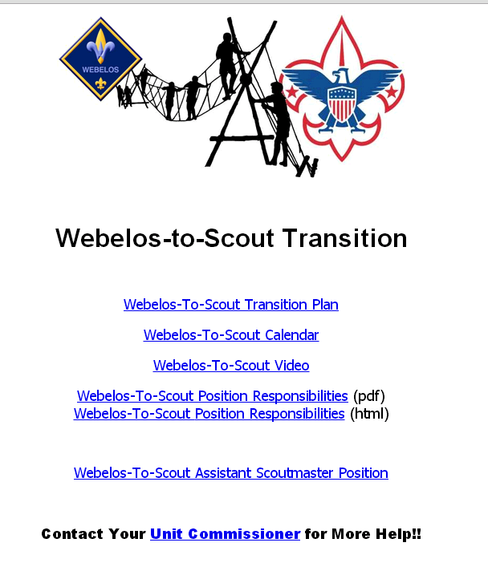
Webelos-To-Scout
WTS.Commissioner-BSA.org
Notes:
Did anyone use the resources?!
Or talk to their Boy Scout Units?
What were the results?

Slide 6
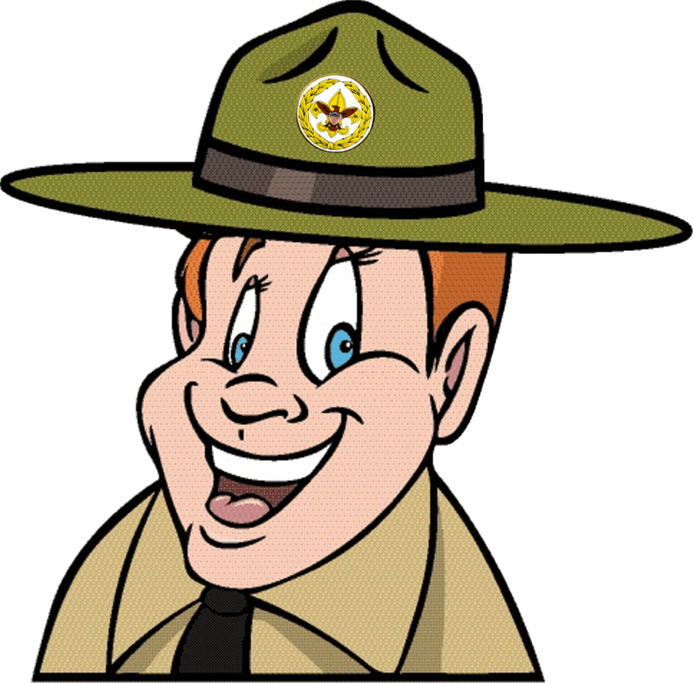
AskCommish@commissioner-bsa.org

Slide 7
COMMISSIONER QUIZ
1) What are the District Commissioners’ top priorities?
Notes:
Identify & Recruit Commissioners
Orient & Train Commissioners
Supervise & Motivate Commissioners
• Identify and recruit enough of the right people as commissioners so that all Scouting units in the district
receive regular, helpful service.
• Provide opportunities for immediate commissioner orientation through online Fast Start, frequent basic training, and monthly learning experiences for all commissioners.
• Supervise and motivate unit commissioners to visit each unit regularly, identify unit needs, and make plans to meet unit needs.

Slide 8
COMMISSIONER QUIZ
2) In order, list the 3 awards that all Commissioners should earn.
Notes:
Arrowhead Honor - within 1 year
Commissioners Award of Excellence – after 2 years
Commissioner’s Key - after 3 years
DCSA – 5 years

Slide 9
COMMISSIONER QUIZ
3) List the four top priorities (primary focus) of Unit Commissioners
Notes:
Supporting unit growth in the Journey to Excellence criteria:
JTE measures performance characteristics that
unlock the door to a successful unit. We should analyze the unit’s program and identify JTE areas where help is needed to move the unit to a higher level of JTE success.
Linking district committee resources to the unit:
We should support the district committee’s delivery of a “catalog of services” to support the specific JTE elements needed for a particular unit’s health and success.
Visiting units and logging the visits into the Unit Visit Tracking System (UVTS):
Our core task remains visiting the unit. UVTS input feeds critical information to the district committee to help link resources to the unit.
Supporting on-time charter renewal:
The commissioner’s focus is the retention of the unit, though we should be especially mindful of supporting new youth membership efforts as we move more toward a volunteer-led, professionally guided approach to increasing membership.

Slide 10
COMMISSIONER QUIZ
What are the District Commissioners’ top priorities?
Identify & Recruit
Orient & Train
Supervise & Motivate
Notes:
Identify & Recruit Commissioners
Orient & Train Commissioners
Supervise & Motivate Commissioners
(in DC & ADC CBT: Recruiting, Training, Guiding, Evaluating)
• Identify and recruit enough of the right people as commissioners so that all Scouting units in the district
receive regular, helpful service.
• Provide opportunities for immediate commissioner orientation through online Fast Start, frequent basic training, and monthly learning experiences for all commissioners.
• Supervise and motivate unit commissioners to visit each unit regularly, identify unit needs, and make plans to meet unit needs.

Slide 11
COMMISSIONER QUIZ
2) In order, list the 3 awards that all Commissioners should earn.
Arrowhead Honor - 1 year
Commissioners Award of Excellence – after 2 years
Commissioner’s Key - after 3 years
Notes:
Arrowhead Honor - within 1 year
Commissioners Award of Excellence – after 2 years
Commissioner’s Key - after 3 years
DCSA – 5 years

Slide 12
COMMISSIONER QUIZ
3) List the four top priorities (primary focus) of Unit Commissioners
Supporting unit growth in the JTE criteria
Linking district committee resources to the unit
Notes:
Helping Units Succeed
Good Commissioner Service - Takes precedence over all other Scouting efforts
Supporting unit growth in the Journey to Excellence criteria:
JTE measures performance characteristics that unlock the door to a successful unit. We should analyze the unit’s program and identify JTE areas where help is needed to move the unit to a higher level of JTE success.
Linking district committee resources to the unit:
We should support the district committee’s delivery of a “catalog of services” to support the specific JTE elements needed for a particular unit’s health and success.
Visiting units and logging the visits into the Unit Visit Tracking System (UVTS):
Our core task remains visiting the unit. UVTS input feeds critical information to the district committee to help link resources to the unit.
Supporting on-time charter renewal:
The commissioner’s focus is the retention of the unit, though we should be especially mindful of supporting new youth membership efforts as we move more toward a volunteer-led, professionally guided approach to increasing membership.

Slide 13
COMMISSIONER QUIZ
3) List the four top priorities (primary focus) of Unit Commissioners
Visiting units and logging the visits
Supporting on-time charter renewal
Notes:
Supporting unit growth in the Journey to Excellence criteria:
JTE measures performance characteristics that unlock the door to a successful unit. We should analyze the unit’s program and identify JTE areas where help is needed to move the unit to a higher level of JTE success.
Linking district committee resources to the unit:
We should support the district committee’s delivery of a “catalog of services” to support the specific JTE elements needed for a particular unit’s health and success.
Visiting units and logging the visits into the Unit Visit Tracking System (UVTS):
Our core task remains visiting the unit. UVTS input feeds critical information to the district committee to help link resources to the unit.
Supporting on-time charter renewal:
The commissioner’s focus is the retention of the unit, though we should be especially mindful of supporting new youth membership efforts as we move more toward a volunteer-led, professionally guided approach to increasing membership.

Slide 14
DON’T FORGET!
• Formal Charter Presentations
The charter belongs in the hands of the organization rather than the unit itself.
Notes:
Ceremony on website --- in books. Fieldbook, Administration of Commissioner Service
Be sure you have the new charter to present.
NOTE: needed for Arrowhead Honor

Slide 15


COMMISSIONER CABINET
Monthly Training

Slide 16
JACK BOYDE
District Commissioner
The Commissioner Role with Youth Protection

Slide 17
Notes:
The personal safety of all youth is of paramount importance to the Boy Scouts of America. Child abuse and neglect,
whether in Scouting or in the community at large, affect everyone.
The BSA focuses on protecting youth through the implementation of comprehensive prevention policies, early detection of child abusers, and meaningful intervention to stop abuse and assist victims.
The BSA reminds us that Youth Protection Begins With You™. As a commissioner, you have a vital responsibility to implement and communicate the BSA’s Youth Protection policies.

Slide 18

Youth Protection and the Commissioner
Ways to Help:
Monitor status of YPT leaders
Annual Youth Protection Visit
Assist with Leader Selection Process
Inform leaders of reporting responsibility
Notes:
OVERVIEW of the Commissioner Role – will go into detail for each point on slides that follow.

Slide 19
Youth Protection and the Commissioner
Ways to Help:
Promote use of YP tools
Encourage participation in YP month
Explain use of YP inserts
Keep current on rules & tools
Notes:
OVERVIEW of the Commissioner Role – will go into detail for each point on slides that follow.

Slide 20
Youth Protection and the Commissioner
Monitor Status of YP-trained leaders
Remind unit leaders/committee chairs of the requirement
Must be renewed every two years
Online tools available to check training status
Notes:
REMEMBER: New leaders have 30 days to complete YPT!

Slide 21

Notes:
OF COURSE – registered leaders are required to get trained…
STRONGLY ENCOURAGE parents, sponsoring organization reps and other to take the training.
(especially parents who actively participate in unit events)

Slide 22
Youth Protection and the Commissioner
Annual Youth Protection Visit
Meeting of adults (unit committee)
Held each fall (usually November)
Review latest training tools
(booklets, videos, etc.)
Encourage unit to show video(s)
Notes:
Part of The Annual Commissioner Service Plan (Chapter 6 – 33621 Fieldbook)

Slide 23
Youth Protection and the Commissioner
Assist With Leader Selection
Explain Charter Organization role
Encourage active reference checks
Provide telephone reference checklists
Notes:
Leadership Requirements
The applicant must possess the moral, educational, and emotional qualities that the Boy Scouts of America deems necessary to afford positive leadership to youth. The applicant must also be the correct age, subscribe to the precepts of the Declaration of Religious Principle, and abide by the Scout Oath or Promise, and the Scout Law.
Following approval by the unit committee chairman, all other adult unit members must be approved by the head of the chartered
organization or the chartered organization representative.

Slide 24
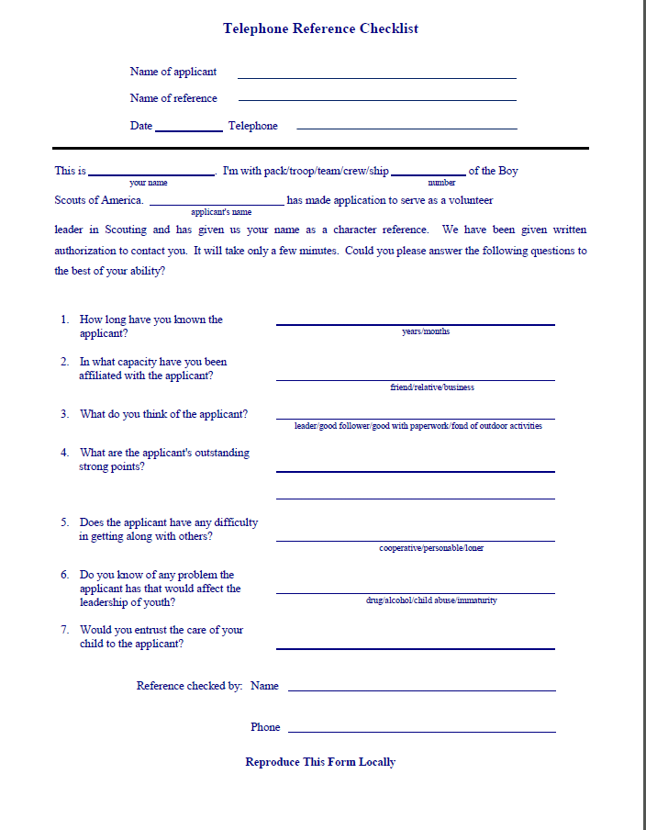
Notes:
Refer to handout.
PDF available on Commissioner-bsa.org for download.

Slide 25
Youth Protection and the Commissioner
Inform/Educate About Reporting Responsibility
IMMEDIATE reporting
Seek guidance as necessary
Be careful!
Notes:
Whether youth come into our programs from abusive households, are bullied in school, are exposed to explicit material in their community or online, or are sexually abused, even in Scouting, we must take immediate action.
You and the person bringing a suspected incident to your attention must immediately report to the authorities any good-faith suspicion or belief that any child is or has been physically or sexually abused, physically or emotionally neglected, exposed to any form of violence or threat, or exposed to any form of sexual exploitation, including the possession, manufacture, or distribution of child pornography; online solicitation; enticement; or showing of obscene material.
You and the person reporting must report the information immediately to the authorities for investigation. The BSA’s mandatory reporting policy on child abuse is clear—No person may abdicate this reporting responsibility to any other person.
Notify your Scout executive of this report, or of any violation may take appropriate action for the safety of our Scouts, make appropriate notifications, and follow-up with investigating agencies.

Slide 26
Youth Protection and the Commissioner
Basic Information Needed
Who is involved?
What happened?
Where did it occur?
Are there witnesses or others with info?
How did you come to know of the violation?
What did you do about it?
Notes:
What basic information needs to be included in the report to the Scout executive and to law enforcement?

Slide 27
Youth Protection and the Commissioner
Promote Use of YP Tools
On line training Sessions
  Two levels.
Videos
  Time to Tell
  It Happened To Me
  Personal Safety Awareness
Notes:
On line training Sessions
Two levels. (Scouts & Venturing)
Videos
Time to Tell
It Happened To Me
Personal Safety Awareness

Slide 28
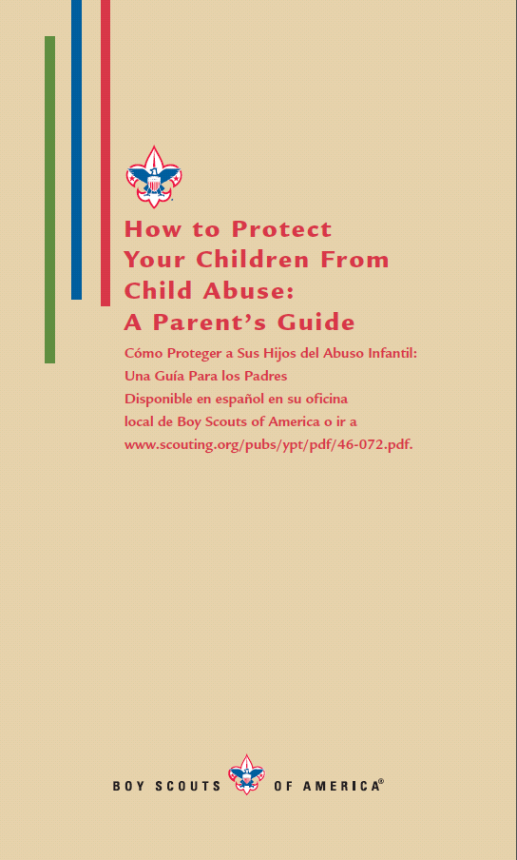
Youth Protection and the Commissioner
Explain use of YP inserts
Teach unit leaders how
boy and parent use inserts
Make sure material is
reviewed during the SM
Conference when boy
joins Troop
Notes:
Explain to unit adult leaders how a boy and his parents use the inserts in the front of the youth handbooks
AND the importance of including a review of this material during the Scoutmaster conference when a boy joins the troop.

Slide 29

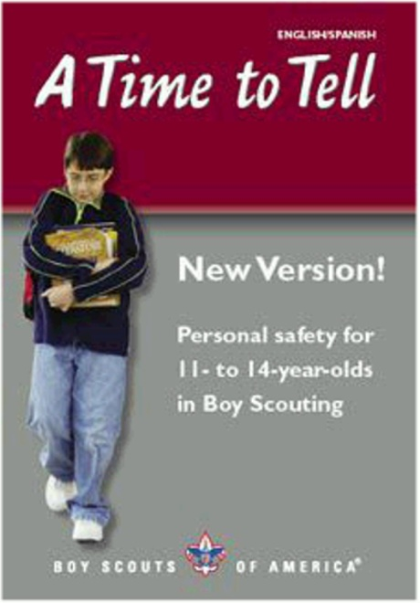

Youth Protection and the Commissioner
Make Sure Units have Latest Version!
Notes:
Videos are constantly being updated.
Make sure your units are using the latest version.

Slide 30
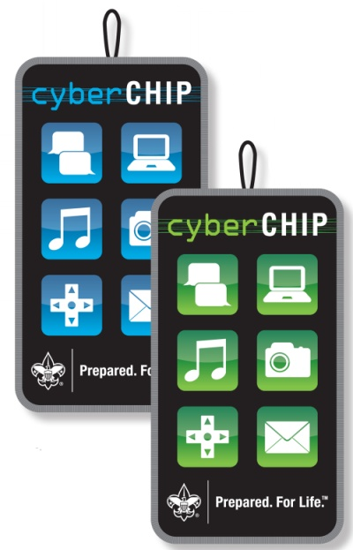
Youth Protection and the Commissioner
Promote Use of YP Tools
Cyber Chip
  Youth should carry like Totin’ Chip, etc.
  www.scouting.org/CyberChip
  Card & Patches available
  June is Internet Safety Month
Notes:
TEACH YOUR UNITS about the Cyber Chip
The Cyber Chip joins the Totin’ Chip and Whittling Chip as important safety tools your Scouts should earn and carry with them
http://www.scouting.org/CyberChip

Slide 31

Youth Protection and the Commissioner
Questions?

Slide 32


