Slide 1
Quote of the month:
“…2013 will involve an intense focus on membership recruitment at all levels of Scouting.
We as volunteers own membership and it is up to us to ensure that we experience membership growth in 2013.
We are all in the membership business!”
Tico Perez
National Commissioner
Notes:
In response to public outcry over the show, National Geographic Channel released the following statement:
“National Geographic Channel is an international media company that is an equal opportunity employer. We do not discriminate in any capacity. As it relates to our upcoming show with the Boy Scouts, we certainly appreciate all points of view on the topic, but when people see our show they will realize it has nothing to do with this debate, and is in fact a competition series between individual scouts and civilians.”

Slide 3
COMMISSIONER Training Updates

Slide 4
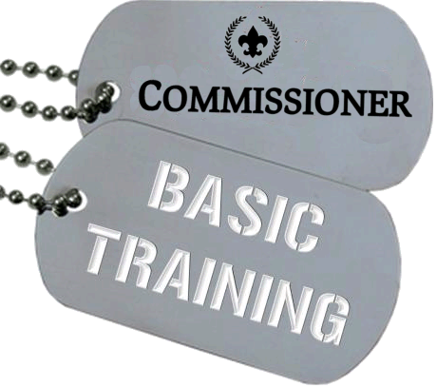
April 20, 2013 – Hosted by Area 3
8:30 AM @ Flag Plaza June 15, 2013 – Area 6

Slide 5
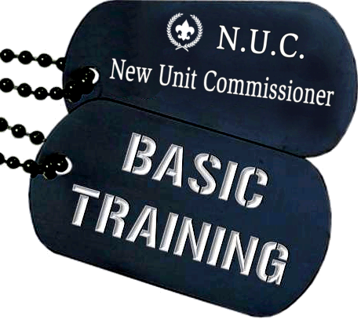
April 20, 2013
Noon@ Flag Plaza

Slide 6
Wednesday, April 3
tinyurl.com/commishniteatpirates

Slide 7
AskCommish@commissioner-bsa.org Leader Help Hotline! (412) 326-9BSA
Notes:
Content Due – April 1

Slide 8
START THINKING ABOUT…
• Inviting future Commissioners to the baseball game (April 3) and Barbecue (August 10)
Who you want to nominate for Distinguished Commissioner Service Award (DCSA).
Grooming your successor.

Slide 9
COMMISSIONER QUIZ
Your district has 7 lapsed units. As District Commissioner, you should:
Be sure the lapsed situation is a top priority for the assigned unit commissioners and their ADCs
Be sure the lapsed situation is a top priority for the district executive
Set up a weekly phone check or other reporting process on each lapse
Do all of the above
Notes:
d. Lapsed units are always a priority, as are any units with life-threatening problems.

Slide 10
COMMISSIONER QUIZ
Your district has 7 lapsed units. As District Commissioner, you should:
Be sure the lapsed situation is a top priority for the assigned unit commissioners and their ADCs
Be sure the lapsed situation is a top priority for the district executive
Set up a weekly phone check or other reporting process on each lapse
Do all of the above
Notes:
d. Lapsed units are always a priority, as are any units with life-threatening problems.

Slide 11
COMMISSIONER QUIZ
2) You have been asked to make a presentation on the two most important ways commissioners can impact youth membership increases. You should include—
Organizing new units and running school nights
Preventing dropped units and ensuring full membership at the time of unit charter renewal
Identifying unregistered boys at the district camporee and organizing new units
Keeping district membership records and recruiting kids at school
Notes:
b. Preventing dropped units and ensuring a full membership at unit charter renewal time.
Other membership tasks are the responsibility of the district membership committee.

Slide 12
COMMISSIONER QUIZ
2) You have been asked to make a presentation on the two most important ways commissioners can impact youth membership increases. You should include—
Organizing new units and running school nights
Preventing dropped units and ensuring full membership at the time of unit charter renewal
Identifying unregistered boys at the district camporee and organizing new units
Keeping district membership records and recruiting kids at school
Notes:
b. Preventing dropped units and ensuring a full membership at unit charter renewal time.
Other membership tasks are the responsibility of the district membership committee.

Slide 13
COMMISSIONER QUIZ
3) When a Scout votes with his feet, walking out of a unit meeting never to return, it’s probably because—
Of the baseball team meeting down the street
Uninspired leadership and program lacking fun and challenge
His parents object to Scouting
Illness or poor school grades
Boring meetings
Notes:
b. The UC’s most important Scouting job is to visit units and to see that the unit has a great unit program!!!

Slide 14
COMMISSIONER QUIZ
3) When a Scout votes with his feet, walking out of a unit meeting never to return, it’s probably because—
Of the baseball team meeting down the street
Uninspired leadership and program lacking fun and challenge
His parents object to Scouting
Illness or poor school grades
Boring meetings
Notes:
b. The UC’s most important Scouting job is to visit units and to see that the unit has a great unit program!!!

Slide 15
COMMISSIONER QUIZ
4) The two most important items on a district commissioner staff agenda are—
Promotion of both district and council activities
Inspirational opening and recognition of commissioner achievement
A brief training topic and a time for ADCs to meet with their unit commissioners to review unit needs
None of the above
Notes:
c. Training is important! (Use the PowerPoint from this meeting)
And… ADC teams must share important observations from recent unit visits, identify key unit needs, and decide who will provide appropriate help.

Slide 16
COMMISSIONER QUIZ
4) The two most important items on a district commissioner staff agenda are—
Promotion of both district and council activities
Inspirational opening and recognition of commissioner achievement
A brief training topic and a time for ADCs to meet with their unit commissioners to review unit needs
None of the above
Notes:
c. Training is important! (Use the PowerPoint from this meeting)
And… ADC teams must share important observations from recent unit visits, identify key unit needs, and decide who will provide appropriate help.

Slide 17
COMMISSIONER QUIZ
5) Kids are most likely to stay in a unit if—
They are advancing in rank
Their unit meets in the summer and youth members take part in a long-term camp or other outdoor event
Unit meetings are fun, challenging, and inspiring
The unit’s commissioner makes sure unit leaders succeed
Notes:
a, b, c, and d. Again a reminder of commissioner priorities.

Slide 18
COMMISSIONER QUIZ
5) Kids are most likely to stay in a unit if—
They are advancing in rank
Their unit meets in the summer and youth members take part in a long-term camp or other outdoor event
Unit meetings are fun, challenging, and inspiring
The unit’s commissioner makes sure unit leaders succeed
Notes:
a, b, c, and d. Again a reminder of commissioner priorities.

Slide 19
COMMISSIONER BONUS!
6) Who “owns” Membership
The area membership executive
The leaders in each unit
The membership committee
The commissioner staff

Slide 20
COMMISSIONER BONUS!
6) Who “owns” Membership
We are all in the membership business!
Notes:
All Volunteers!

Slide 21
COMMISSIONER CABINET
Monthly Training

Slide 22
BRIAN TEDESCHI
Council Membership Committee Chairman
Commissioners Role in The Main Thing*
*Serving more young people with
a quality Scouting experience

Slide 23
Boy Scouts of America Laurel Highlands Council Membership, Marketing and Commissioners – Working Collaboratively to Achieve The Main Thing Commissioner Cabinet meeting March 19, 2013

Slide 24
Commissioners Play Key Role in Membership
Commissioners "own" unit retention
Deliver unit service and work collaboratively to recruit and empower volunteers to lead recruiting
Serve as the key link between the many resources of a functional district/area committee and the unique needs of each unit
In the absence of a strong district/area committee, the unit commissioner fills many unit needs
Support District Key 3 to recruit and deploy the right resource specialists

Slide 25
Are You Linked In?
“Linkage” is critical to mission execution
Retention is best achieved by providing an adequate number of trained Unit commissioners who provide a link to district/area committee resources in support of a quality unit program

Slide 26
Focus on Five
Supporting Unit growth in the Journey to Excellence criteria:
Analyze the Unit's program
Identify JTE areas where help is needed to move the Unit to a higher level
Linking district committee resources to the Unit
Support the district committee's delivery of a "catalog of services" to support specific JTE elements needed for a particular Unit's health and success
Visiting units and logging the visits into the Unit Visit Tracking System
Supporting on-time charter renewal
New youth membership efforts
Volunteer-led professionally guided approach to increasing membership.
Advance new unit commissioner – a one-on-one basis for each new Unit through the first two re-charter cycles

Slide 27
Objectives
Increase share of traditional membership in underutilized market areas
Maintain visibility of Scouting across the region during primary recruiting periods

Slide 28
Membership and Marketing 2013

Slide 29
Objectives
Increase share of traditional membership in underutilized market areas by 3.5%
Increase share of traditional membership in “over”utilized market areas
Maintain visibility of Scouting across the region during primary recruiting periods
Drive combined Membership & Marketing function through organization and down to unit level leadership

Slide 30
Core Strategies
Development of protocol for targeted ZIP markets from the GAP analysis data
Underperforming market densities: can they be moved
Over-performing market densities: can they ride the crest
Timeline for continuation in those markets based on success/failure
Development and deployment of micro-strategies for recruitment

Slide 31
Membership Campaign Components
Deploy New Unit Development letter targeted at “warm” audiences encouraging a one-on-one meeting with Council representatives
Leverage relationship with Catholic Diocese of Pittsburgh via targeted “Together” letter
Mid-summer Council-wide kick-off event
Tap “Are You Tougher Than a Boy Scout?” recruiting tools and tie-in opportunities
Incorporate Membership and Marketing functions
Launch monthly membership newsletter beginning in March 2013
Drive primary Council plan through Areas and field-based professionals

Slide 32
The Trusted Advisor – Commissioners
Counselor – Unit Health & Analysis
Fall Recruitment
Pre-planning sign-up night
Unit planning/calendar
Training monitor and Quality Assurance
Help reconnect the “separated list”
Help ensure successful re-chartering

Slide 33
Schedule of Goods & Services
Commissioner Interface
Quarter 4
Re-chartering
Next Year Planning Goals
JTE Assurance
Quarter 3
Recruiting Planning
Open House/Sign-up
Unit Inventory
Quarter 2
Deployment and planning with District and Unit level Membership & Marketing Chair
Quarter 1
Crossover Management & Oversight
Separated List Follow-up and Analysis

Slide 34
Thank You.
Brian Tedeschi Vice President, Membership
Laurel Highlands Council
Think Communications, Inc.
412-281-9228 – office
412-638-5981 – mobile
brian@thinkceativity.com

