Slide 1
Quote of the month:
“Regardless of the outcome of the current membership standards policy discussion, one thing is clear: It is time for everyone within the Scouting family to work together to stay focused on that which ties us together as a Scouting family.”
Tico Perez
Notes:
Make no mistake—that which unites us is reaching and serving young people to help them grow into good, strong citizens. It is critical that we move forward together.
In many ways, the spirit of the commissioner corps is the glue that ties us together as volunteers. Our commissioner corps can and should lead the way as we move forward together.

Slide 2
COMMISSIONER Training Updates

Slide 3
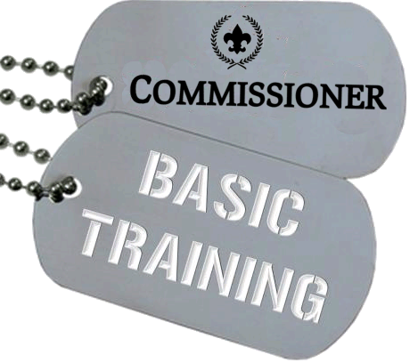
• June 15, 2013 – Area 6 8:30 AM @ Ebensburg Office
• Aug 10 @ Barbecue

Slide 4
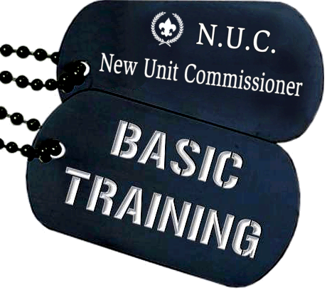
2 out of every 3 new units… FAIL!
NUC’s:
Our best tool for Unit Retention

Slide 5
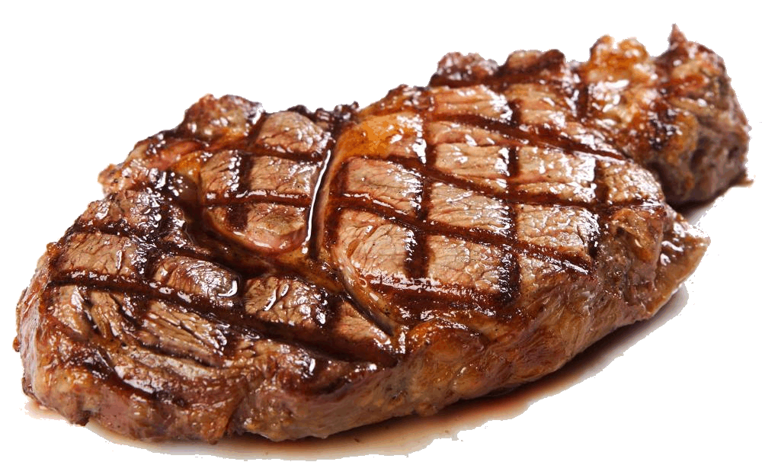
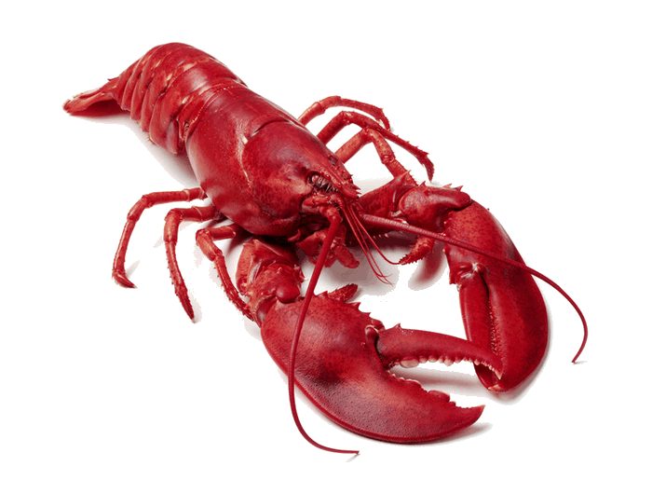
August 10 Camp Seph Mack
Commissioner Barbecue
Notes:
Don’t Miss This!

Slide 7
Please attend… Program Kick-Offs
http://commissioner-bsa.org/program

Slide 8
Program Kick-Off Dates
Area 1 – Held May 9
Area 2 – June 6
Area 3 – June 1
Area 4 – May 23 / General Greene
– June 4 / Mingo Trails
– June 6 / Frontier
Area 6 – June 6 / Chestnut Ridge, Keystone, Fort Bedford
– June 11 / Chief Logan
– June 12 / Forbes Trail

Slide 9
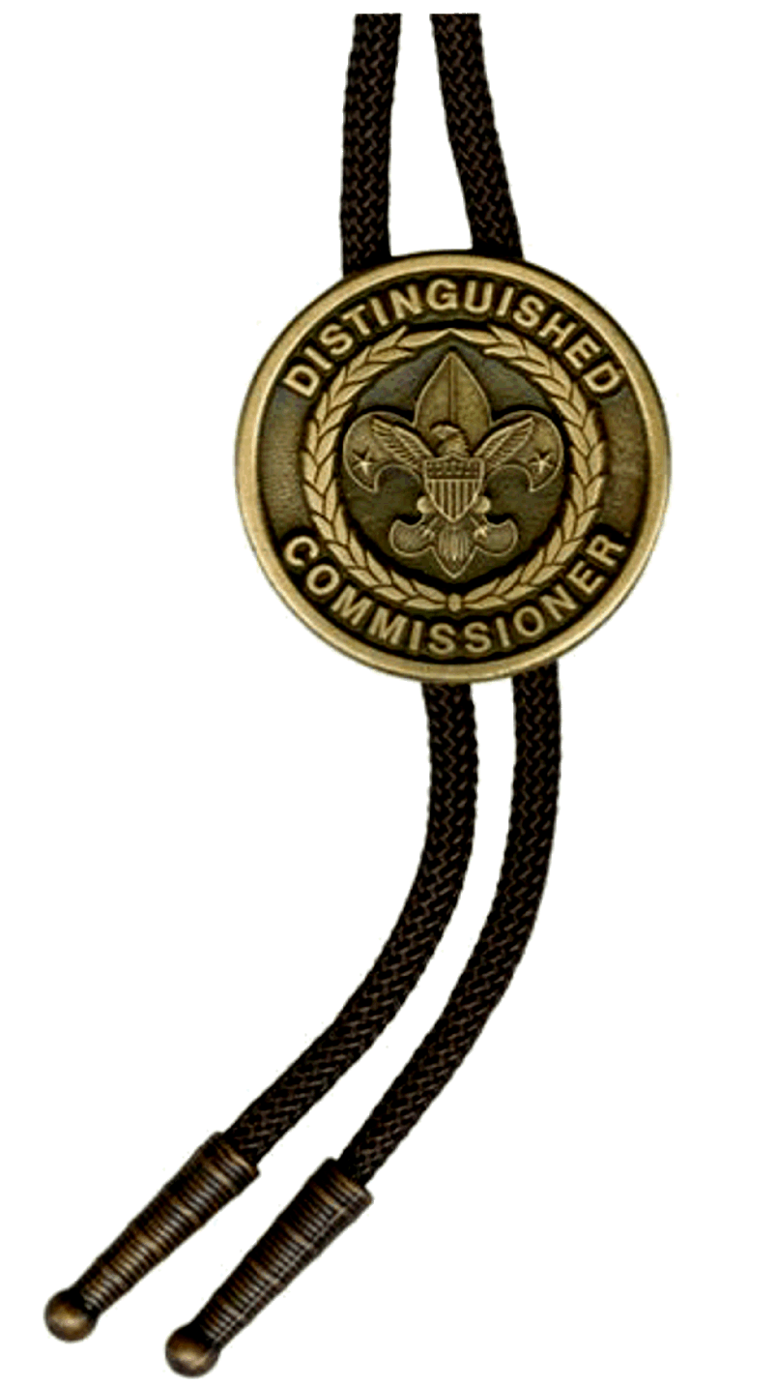
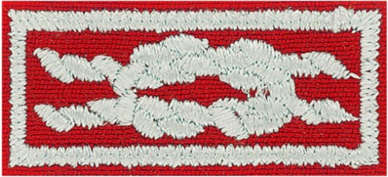
PLAN TO NOMINATE SOMEONE!
D.C.S.A.
Distinguished Commissioner Service Award
http://dcsa.commissioner-bsa.org
Notes:
Commissioner Award of Excellence in Unit Service

Slide 10
COMMISSIONER QUIZ
“Commissioner Lifesaving” is—
A process in which unit commissioners respond quickly when a unit has a life-threatening emergency
Everything a commissioner does to help a unit stay healthy
First aid skills such as CPR learned by commissioners
First aid, swimming, and fire rescue skills that commissioners learned as Boy Scouts or Explorers

Slide 11
COMMISSIONER QUIZ
“Commissioner Lifesaving” is—
A process in which unit commissioners respond quickly when a unit has a life-threatening emergency
Everything a commissioner does to help a unit stay healthy
First aid skills such as CPR learned by commissioners
First aid, swimming, and fire rescue skills that commissioners learned as Boy Scouts or Explorers

Slide 12
COMMISSIONER QUIZ
2) Which of these is NOT a major task for volunteer success—
Define Responsibilities
Select & Recruit
Orient & Train
Coach
Recognize
Evaluate Performance
Pay for Performance

Slide 13
COMMISSIONER QUIZ
2) Which of these is NOT a major task for volunteer success—
Define Responsibilities
Select & Recruit
Orient & Train
Coach
Recognize
Evaluate Performance
Pay for Performance

Slide 14
COMMISSIONER QUIZ
3) Under the category of “Select & Recruit” which of these describe why people volunteer:
They were asked
They like the person asking
They want to give back
They want to learn something new
They have children in Scouting
They were former Scouts
They want recognition
They believe in Scouting principles
They want to fulfill business obligation

Slide 15
COMMISSIONER QUIZ
3) Under the category of “Select & Recruit” which of these describe why people volunteer:
They were asked
They like the person asking
They want to give back
They want to learn something new
They have children in Scouting
They were former Scouts
They want recognition
They believe in Scouting principles
They want to fulfill business obligation

Slide 16
COMMISSIONER QUIZ
3) Under the category of “Select & Recruit” which of these describe why people volunteer:
They were asked
They like the person asking
They want to give back
They want to learn something new
They have children in Scouting
They were former Scouts
They want recognition
They believe in Scouting principles
They want to fulfill business obligation

Slide 17
COMMISSIONER QUIZ
4) What should a district commissioner do who has a staff member who seems totally inadequate to do his or her job?
Fire the sucker today
Refer the problem to the professional
Accept the fact that little can be done
Review with your professional adviser the section in The Commissioner Fieldbook on “How to Remove a Volunteer”

Slide 18
COMMISSIONER QUIZ
4) What should a district commissioner do who has a staff member who seems totally inadequate to do his or her job?
Fire the sucker today
Refer the problem to the professional
Accept the fact that little can be done
Review with your professional adviser the section in The Commissioner Fieldbook on “How to Remove a Volunteer”

Slide 19
COMMISSIONER QUIZ
4) What should a district commissioner do who has a professional staff member who seems totally inadequate to do his or her job?

Slide 20
COMMISSIONER CABINET
Monthly Training

Slide 21
Michael Marks
Assistant Council Commissioner
Self-Assessment
Commissioners
Units

Slide 22
Self-Assessment
In social psychology, self-assessment is the process of looking at oneself in order to assess aspects that are important to one's identity.
It is one of the motives that drive self-evaluation, along with self-verification and self-enhancement.
Notes:
Set the Example!
While Scouters may wear the insignia to which they are entitled, a ‘total display’ may not be in the best taste if the uniform looks overcrowded.
The Commissioner who wears only his Commissioner emblem, council shoulder patch and service star on his uniform is never guilty of poor taste.
SOURCE: Scoutmaster Handbook – replacing Scoutmaster with Commissioner.

Slide 23
Self-Assessment
The Gift of Feedback
The responses generated by the self-assessment motive are behavioural responses
Evident by the fact that people choose to receive feedback on their performance
Notes:
Commissioners set a personal example with correct uniforming and a modest display of badges.
What is a modest display of badges?
It has often been said that unit leaders wear most of their badges on the uniforms of their youth members.
It might also be said that commissioners wear most of their badges on the uniforms of their unit leaders.
Most of a commissioner’s badges should reflect their service at a council or district level.
For example, they proudly wear the JTE District emblem, but good taste might dictate that they refrain from wearing the JTE Unit emblem simply because they serve on the troop committee of their son’s JTE troop.
Insignia Guide – Page 61 “It is recommended that the number of knots be limited to three rows of three (a total of nine knots).”

Slide 24
Commissioner Self-Evaluation
Who:
All Commissioners
Integral part of Annual Commissioner Service Plan
Notes:
All Commissioners
Integral part of Annual Commissioner Service Plan

Slide 25
Commissioner Self-Evaluation
Why:
One of the “Six Major Tasks for Volunteer Success”
Helps commissioners regularly evaluate how they’re doing
Notes:
Why:
One of the “Six Major Tasks for Volunteer Success”
Helps commissioners regularly evaluate how they’re doing

Slide 26
Commissioner Self-Evaluation
When:
Quarterly, semiannually, or annually
As needed
Notes:
When:
Quarterly, semiannually, or annually
As needed.

Slide 27
Commissioner Self-Evaluation
How:
Fill it out yourself
Seek help to improve problem areas
Notes:
How:
Involve Pack or Troop leaders
SPL with you to inspect Troop
PL with you to inspect Patrol
DC with you for their Dens

Slide 28
Commissioner Self-Evaluation
How:
Council Commissioners & District Commissioners can suggest on a regular basis
Should we review with our staffs?
Notes:
How:
Use inspection sheets
Find things to compliment during inspection
Brief complimentary statement at end

Slide 29
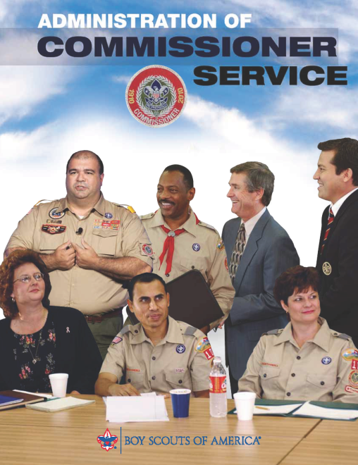
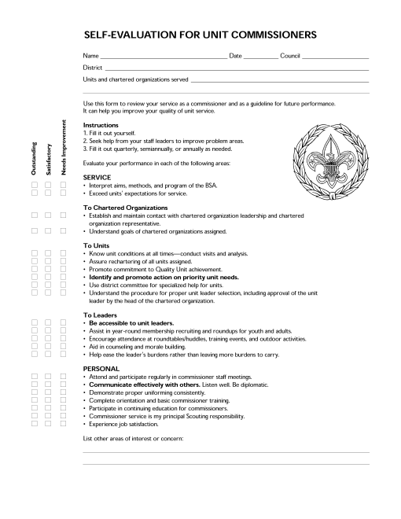
Commissioner Self-Evaluation
Resources
Self-evaluation for Unit Commissioners
Administration of Commissioner Service #34501
Notes:
Commissioner-BSA.org
Right under the April training PowerPoint

Slide 30
Commissioner Self-Evaluation
What about District Commissioners?
See handout

Slide 31
Commissioner Self-Evaluation
What about Council Commissioner?
As council commissioner, what do I do to help my districts meet or surpass the 1-to-3 ratio of commissioners to units or achieve the agreed upon ratio?
The number of units is the key to membership growth and commissioners play a major role in preventing dropped units.
How does my council prepare unit commissioners to help units that have life-threatening problems?
What role do I play when a district commissioner needs to be replaced?

Slide 32
Commissioner Self-Evaluation
What about Council Commissioner? (cont)
Unit commissioners guide units to meet the requirements for the Journey to Excellence Performance Award.
As council commissioner, what do I do to motivate my districts to help units become Journey to Excellence Performance Award units?
New commissioners should view the online Fast Start within 48 hours of being recruited and complete basic training within two months. How does my council ensure that new commissioners receive Fast Start, orientation and basic training within this timeframe?

Slide 33
Commissioner Self-Evaluation
What about Council Commissioner? (cont)
“Continuing education for commissioners” is a concept that says a person must be involved in training as long as they are registered as a commissioner. What do I do to be sure that continuing education is happening for commissioners in my council?
As council commissioner, how do I personally guide and motivate my district commissioners?
What are the most important things that district executives do to ensure success of the commissioners in my districts?

Slide 34
Commissioner Self-Evaluation
What about Council Commissioner? (cont)
What are the most important things that my Scout executive, director of field service, and/or field directors do to ensure success of commissioners in my districts?

Slide 35
Questions?
Notes:
Questions?

Slide 36
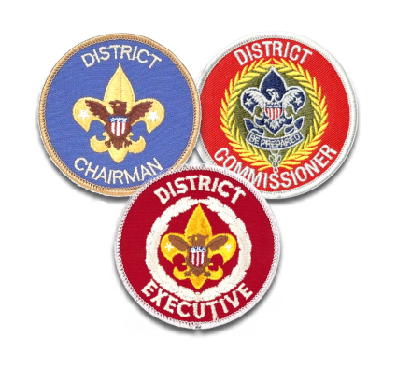
District Self-Evaluation
Who:
District Key 3
Others as determined by SE, CP, CC, DFS, etc.
Notes:
Who:
District Key 3
Others as determined by SE, CP, CC, DFS, etc.

Slide 37
District Self-Evaluation
Why:
Let’s you know you’ve done a good job!
District Scouters want their time and talent to have a maximum benefit to youth
One of the “Six Major Tasks for Volunteer Success”
Notes:
Why:
Let’s you know when you’ve done a good job!
District Scouters want their time and talent to have a maximum benefit to youth
One of the “Six Major Tasks for Volunteer Success”

Slide 38
District Self-Evaluation
Why:
You are successful when the district meets its goals because of your efforts and those of others on the operating committees.
Notes:
Why:
You are successful when the district meets its goals because of your efforts and those of others on the operating committees.

Slide 39
District Self-Evaluation
When:
Annually
Used in conjunction with JTE
Suggested times
Prior to District Annual Meeting
End of the year
During annual planning conference
Other?
Notes:
When:
Annually
Used in conjunction with JTE
Suggested times
Prior to District Annual Meeting
End of the year
During annual planning conference
Other?

Slide 40
District Self-Evaluation
How:
Self Evaluation Guide for Successful District Operations #34207
Notes:
Key Resource:
34739 Handbook for District Operations

Slide 41
District Self-Evaluation
How:
Evaluators assigned sections of guide
Set deadline
Return parts to USE
Review master
Agree on improvements needed
Prioritize
Notes:
How:
Evaluators assigned sections of guide
Set deadline
Return parts to USE
Review master
Agree on improvements needed
Prioritize

Slide 42
District Self-Evaluation
How:
Meeting
District Key 3 invites CP, CC, CE, DFS +
Agree on needs of district
Determine reasonable timeline
Launch program of action
Repeat…
Notes:
How:
Involve Pack or Troop leaders
SPL with you to inspect Troop
PL with you to inspect Patrol
DC with you for their Dens

Slide 43
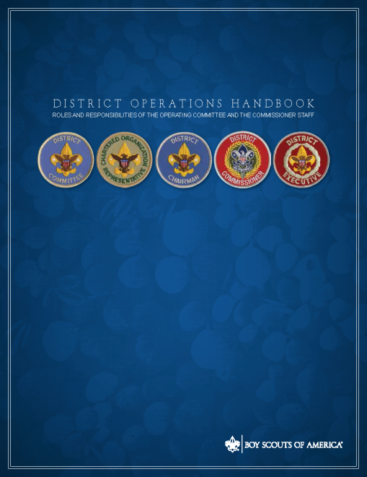
District Self-Evaluation
Key Resource:
34739 Handbook for District Operations
Notes:
Key Resource:
34739 Handbook for District Operations

Slide 44
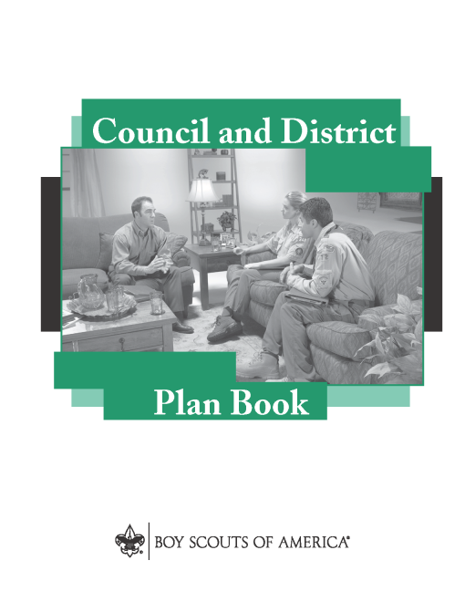
District Self-Evaluation
Other Resources
#513-002 Council & District Plan Book
#34512 Selecting District People
Notes:
Other Resources
#513-002 Council & District Plan Book
#34512 Selecting District People

Slide 45
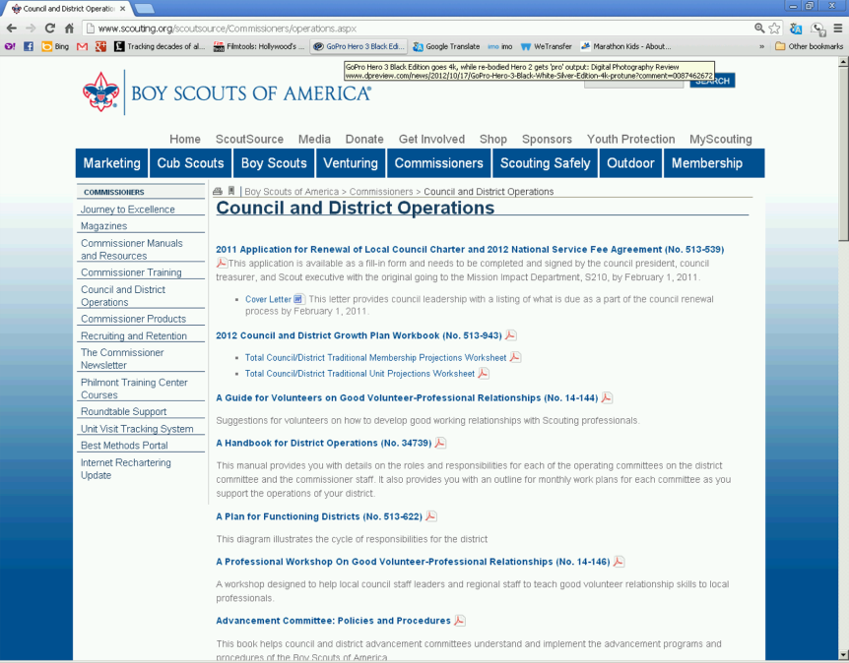
District Self-Evaluation
Internet Resources
scouting.org/Commissioners/operations.aspx
Notes:
Internet Resources
scouting.org/Commissioners/operations.aspx

Slide 46
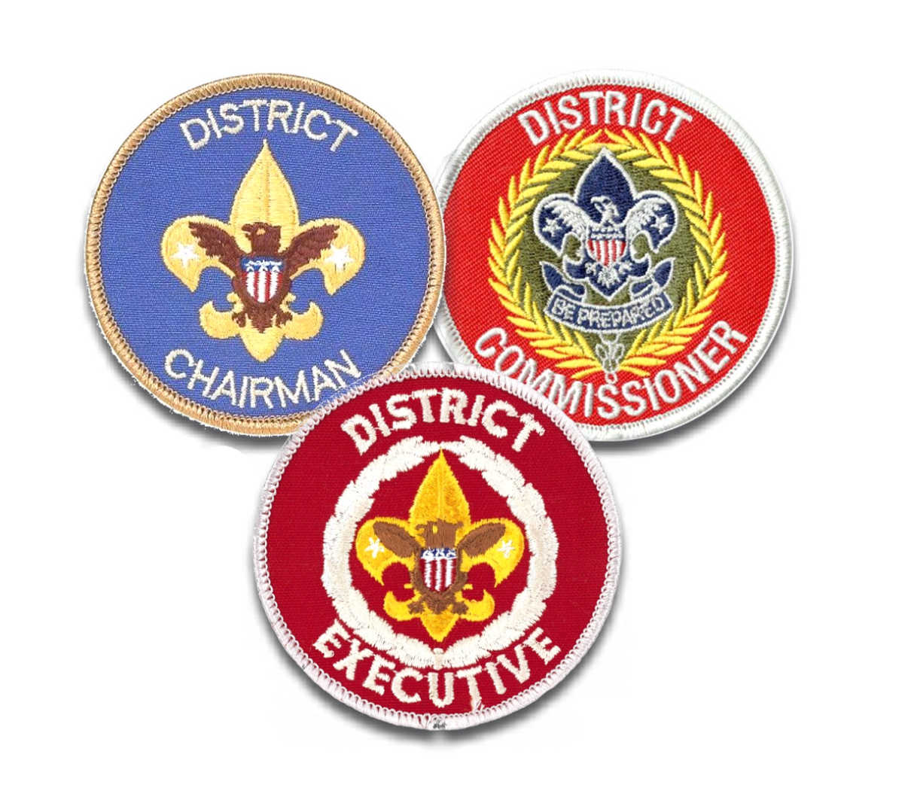
District Self-Evaluation
QUESTIONS?

