Slide 1
Quote of the month:
“To deliver on the promises of our mission, learning must be ingrained in our culture as a shared responsibility and supported at every level.”
Wayne Brock, CSE
Notes:
Never stop learning. It’s vital for the success of Scouting.
To deliver on the promises of our mission, learning must be ingrained in our culture as a shared responsibility and supported at every level.

Slide 4
COMMISSIONER Training Updates

Slide 5
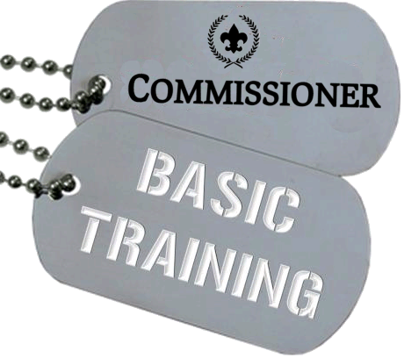
• December 14, 2013 – Sponsored by A4 8:30 AM @ Pittsburgh Office
February 15 – Sponsored by Area 2 8:30 AM in Cranberry, PA (location TBD)

Slide 6
Survey Monkey
7 out of 25 responded (28%)
Newsletter
Print & distribute 1
Forward via e-mail 5
Content isn’t useful 1
Don’t have time to read 1

Slide 7
Survey Monkey
7 out of 25 responded (28%)
Commissioner-BSA.org
Check the website every month 5
Refer others to website 5

Slide 8
Survey Monkey
7 out of 25 responded (28%)
Monthly Cabinet Training
Training is useful & relevant 7
Use the materials with my staff 7

Slide 9
New “Stuff”
Scouting University
All one Scout Oath
Venturing May 2014
Cub Scouts May 2015
NEW Commissioner Toolkit
Middle School Explorer Clubs
Notes:
Lynda.com
Toolkit – Q1 2014 --
includes better UVTS, unit self assessment, assign commish to unit, etc.

Slide 10
NEWS You Can USE
3 Key Components to Membership Growth
Strong, vibrant program
Engaged volunteers
Committee member responsible for membership
scouting.org/Membership/Youth_Recruitment/Membership_Chairman.aspx
tinyurl.com/bsa-member-chair
Notes:
Units that have membership growth and retention have three key components: a strong, vibrant Scouting program; engaged volunteers; and someone on the unit committee who is responsible for membership.

Slide 11
Don’t Miss The Boat!
2014 Volunteer Training Conference
January 12th-17th
Venturing, The NEW Vision
BSA’s Formula for Growth
Overview of Commissioner Service
Advancement Conference (CEAA)
January 20th-25th
Bringing Youth to Christ Through a Baptist Scouting Ministry
Conducting Advanced Leadership Training
STEM Conference
Delivering Training to Unit Leaders
Notes:
Units that have membership growth and retention have three key components: a strong, vibrant Scouting program; engaged volunteers; and someone on the unit committee who is responsible for membership.

Slide 12
• March 15, 2014 @ IUP Includes DLC/Commissioner College
Bob Reese representing Commissioners
Notes:
SLTC – March 15, 2014

